Slide 1
MSCHE Update
Dr. Valerie Luzadis

Slide 2
US Department of Education
Higher Education Accreditation
Congress requires institutions of higher education to meet acceptable levels of quality
    Required for eligibility for Title IV funding (financial aid)
    Some Federal grant programs require accreditation
Middle States Commission on Higher Education (MSCHE)
  Global institutional accreditor recognized by the US Secretary of Education since 1952
  ESF has been continually accredited since 1952

Slide 3
Accreditation Process
Membership in MSCHE
  Agreement to meet best practices
    Articulated as seven standards
Eight-year reaccreditation cycle (next 2029-2030)
  Self-study begins two years ahead (2027-28)
Current status
  Accredited
  Non-compliance Warning related to Standards V and VI

Slide 4
MSCHE Standards
Standard I: Mission, Goals, Strategic Planning & Website
Standard II: Ethics & Integrity
Standard III: Design & Delivery of the Student Learning Experience
Standard IV: Support of the Student Experience
Standard V: Educational Effectiveness Assessment
Standard VI: Planning, Resources, & Institutional Improvement
Standard VII: Governance, Leadership, & Administration

Slide 5
Report to MSCHE Due January 16, 2024
Excerpt of MSCHE Letter, June 22, 2023
To request a monitoring report due January 16, 2024, demonstrating evidence that the institution has achieved and can sustain ongoing compliance with Standards V and VI, including but not limited to
student learning programs that are characterized by coherence and appropriate assessment of student achievement throughout the institution's educational offerings, at both institutional and program levels, with evidence that faculty and appropriate institutional stakeholders have considered and used assessment results to improve teaching and learning (Standard V);
the development and implementation of organized and systematic assessments that evaluate the extent of student achievement in general education (Standard V); and
clearly stated, aligned, and coherent institutional and unit objectives, with evidence of the implementation of a systematic, organized, and sustained assessment process demonstrating that institutional and unit stakeholders have considered and used assessment results in planning, budgeting, and the improvement of institutional and unit effectiveness (Standard VI).

Slide 6
Institutional Response To Date:
Kudos to Faculty and Staff!
April–May began refreshing academic program assessment plans
  Worked with Department Chairs and Undergraduate Coordinators to update academic program assessment plans
May-June began designing and implementing institutional improvement and assessment process
  Admin units developed unit goals and metrics (KPIs) in alignment with institutional priorities and strategic goals and budget needs
Excel spreadsheets developed and shared through MS Teams
  Designed by Jeremy Hall to show data by strategic planning pillars, themes, goals
Report writing team established
  Tyler Dorholt and Kurt Stavenhagen

Slide 7
Status of Standard 5 (Items 1 & 2)
Academic Program Assessment
93% of units have program assessment plans
Program Learning Outcomes (PLOs), measures, targets
Dates for assessment using multi-year data
68% have at least some assessment data uploaded
General Education Assessment
Gen Ed Assessment plan is nearly complete
Data available for multiple years for some Collegewide Learning Outcomes (CWLOs)
Assessment of 2 of the 6 CWLOs will take place each year beginning in Spring 2024
Three-year rotation

Slide 8
Status of Standard 6 (Item 3)
Clearly stated, aligned, and coherent institutional and unit objectives
  100% of admin units have unit goals aligned with strategic plan
Evidence of the implementation of a systematic, organized, and sustained assessment process
  Schematic overview and timeline of process for AY 24-25
  FY 25-26 planning and budgeting timeline and overview in preparation
Demonstrating that institutional and unit stakeholders have considered and used assessment results in planning, budgeting, and the improvement of institutional and unit effectiveness
  Institutional planning meetings in November
  Follow-up planning meetings relating priorities to budget needs

Slide 9
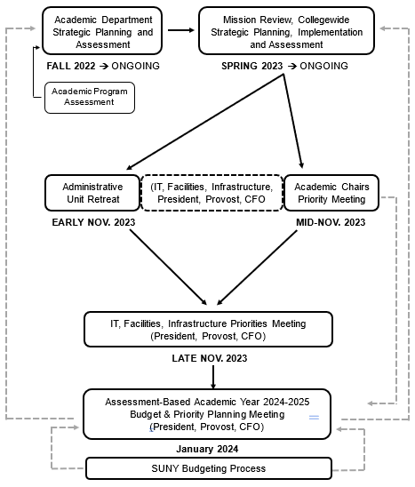
Planning process schematic for
AY 24-25
Notes:
Full year process schematic and timeline for both unit level assessment and budgeting currently being developed

Slide 10
Next Steps Before
External Team Visit, Feb. 28-29
Executive Cabinet
Supervisors Review Unit Plans and Priorities
AY 24-25
Follow-up meetings on budgetary needs
January 10, 2024
Due January 16, 2024
Engagement and Prep Meetings
Report to MSCHE
Full Faculty Planning and Assessment Engagement
AY 24-25
Strategic Plan Institutional Priorities
Executive Summary
Chairs Council
Advisory Committees
Students
1
2
3
4
5
Notes:
Unit plans in pdf – will be available soon
Jeremy’s magic linking the Excel spreadsheets to Word docs that change as the fields change so updated Word or pdf documents can be produced at any given time in the process
All in MS Teams as set up now, so available at all times
Additional data visualizations will be added eventually (most likely after the Feb visit)

Slide 11

Ongoing Efforts
Updated full year planning and budgeting processes and timeline rolling out now
  Assessing current process to inform next round
Academic periodic external program assessment continues
Academic program assessment continues with improvements
  Informed by faculty input as full process is implemented
Institutional effectiveness rubric
  Assessment of assessment

Slide 12
Questions?

