Slide 1
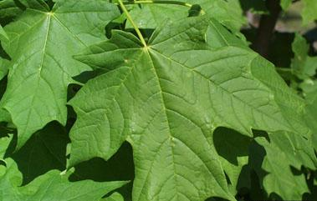

Sugar Maple Condition Following Defoliation:
Investigating Soil Chemistry
Nicholas E. Pitel
Department of Forest Resources Management, SUNY-ESF
1 Forestry Drive, Syracuse, NY 13210
*M.S. Candidate, SUNY-ESF, 2010
May 14, 2010

Slide 2
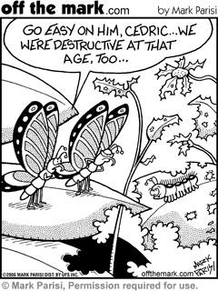

Slide 3
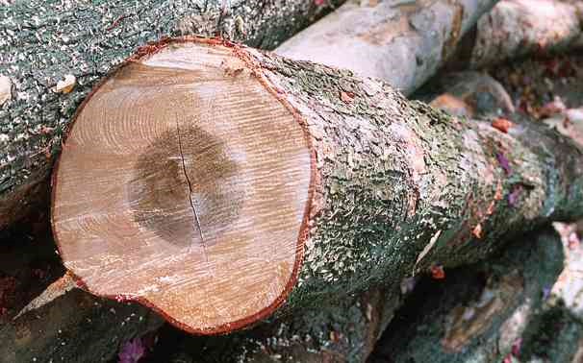
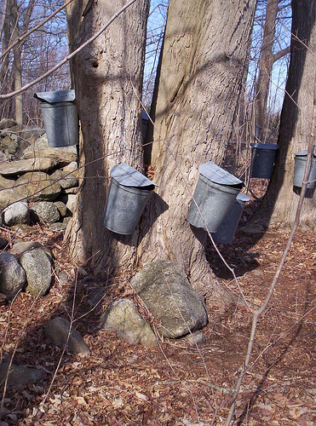
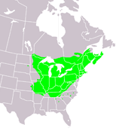
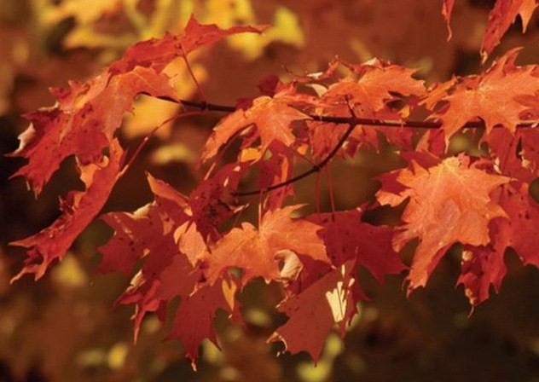
Sugar Maple
Acer saccharum Marsh.
http://farm4.static.flickr.com/3276/2379747203_564b134589.jpg
http://www.statesymbolsusa.org/IMAGES/Vermont/sugar-maple-tree-range.gif
http://www.woodworkerssource.com/blog/?p=980
Introduction
http://www.greenngreen.com/images/products2008/canadian_sugar_maple_sm.jpg

Slide 4
Sugar Maple – Soil Site Conditions
Deep, cool, moist loamy soils
Slightly acidic to neutral pH
Soils high in Ca and Mg
Introduction

Slide 5
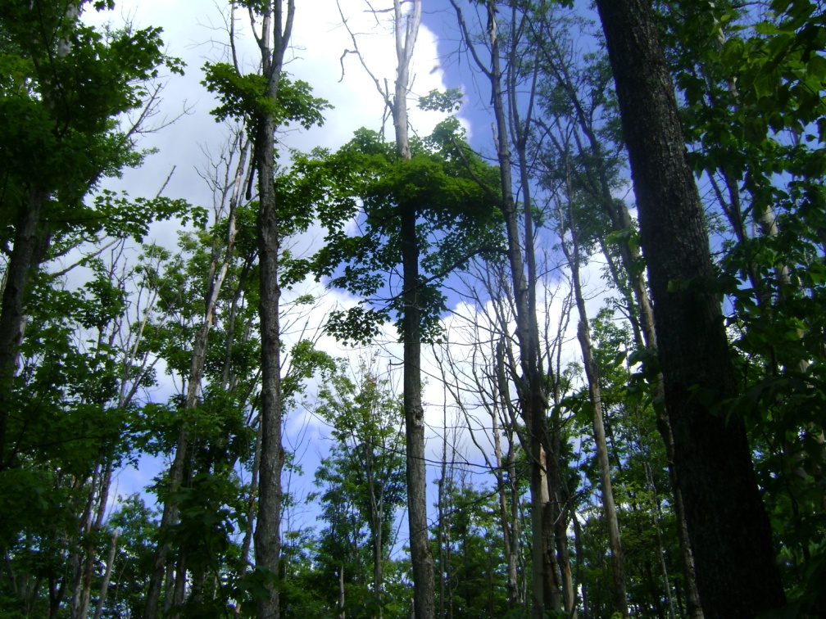
Sugar Maple Decline
Maple
Blight
Introduction
(Houston, 1999)

Slide 6
Sugar Maple Decline-Disease
(Manion, 1991)
Predisposing Factors
Inciting Factors
Contributing Factors
Introduction

Slide 7
Predisposing Conditions
Unglaciated soils
Deficiency in Ca and Mg
Upper slope positions
Low foliar K
Introduction

Slide 8
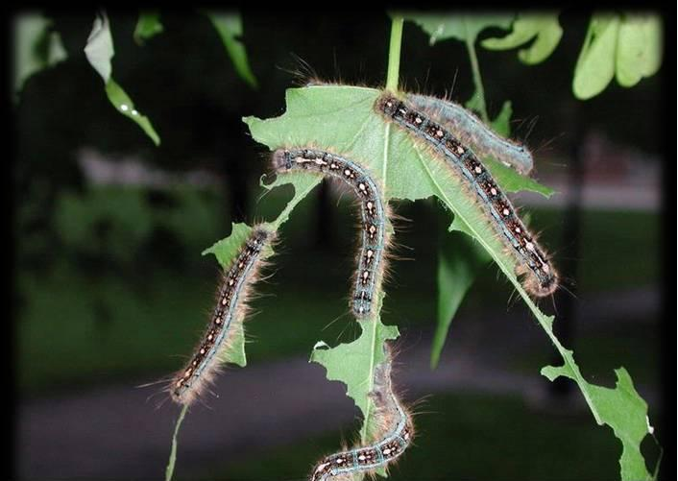
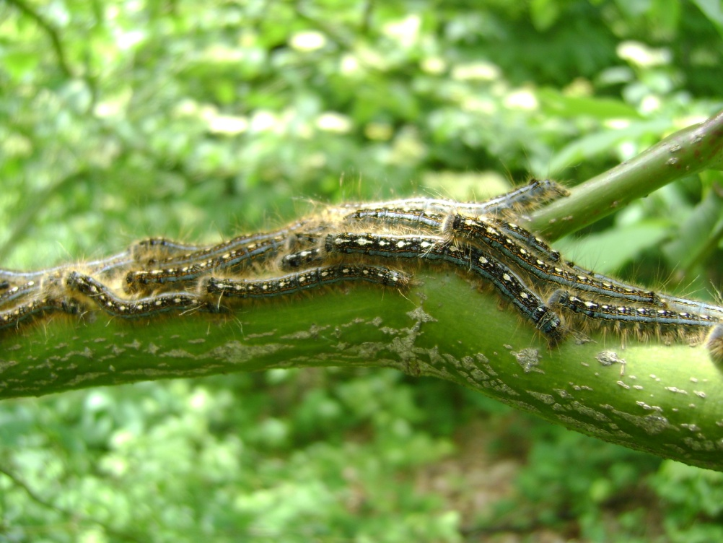
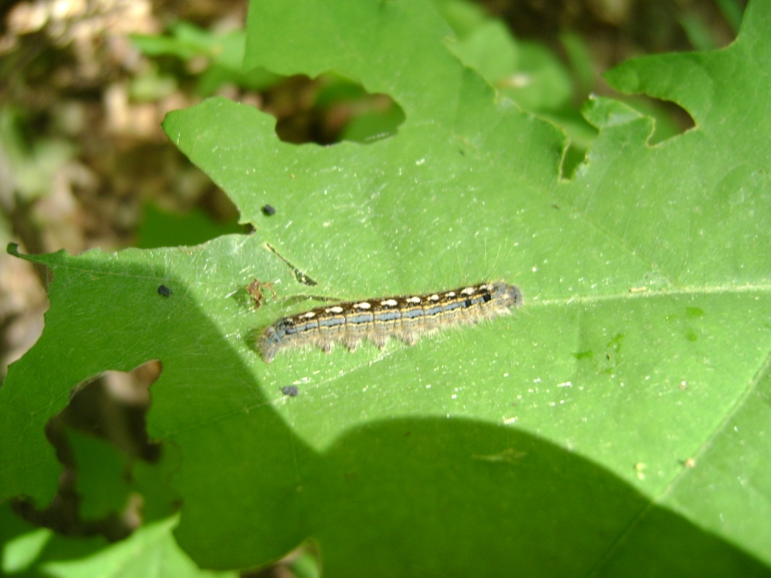
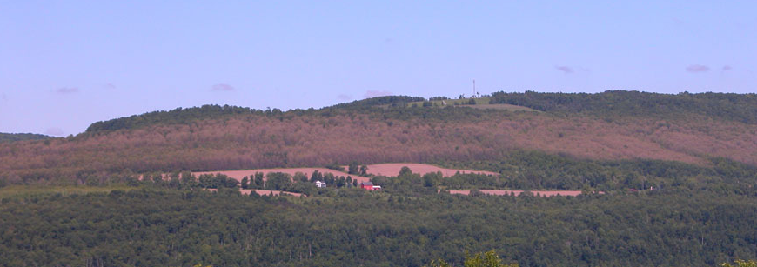
Forest Tent Caterpillar (FTC)
Malacosoma disstria Hübner
Ronald S. Kelley, Vermont Department of Forests, Parks and Recreation, Bugwood.org
D. Parry, SUNY-ESF
Introduction

Slide 9
Recent FTC Outbreak
Northeastern U.S.
2002-2007
Peaked in 2006
  1.2 million acres in New York and 343,000 acres in Vermont were defoliated.
Many stands were defoliated two or three consecutive years.
Introduction

Slide 10
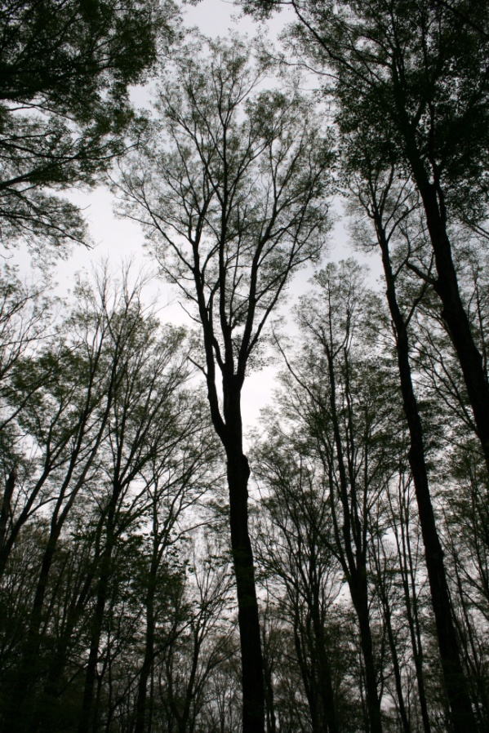
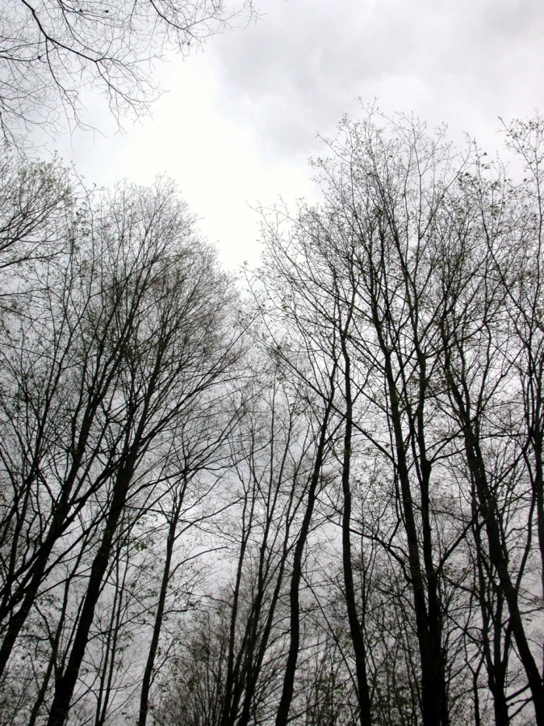
Effects of Defoliation on Tree Health
D. Parry, SUNY-ESF
D. Parry, SUNY-ESF
Decreases starch reserves in roots
Reduces sap flow and sugar content
Increases crown dieback and reduces tree growth
Trees with dieback >50% have high probability of dying within 10 years
Introduction

Slide 11
Phase I: Sugar Maple Decline After Defoliation by FTC
(Wood , Yanai, Allen, & Wilmot, 2009)
CONVEX
PLANAR
CONCAVE
PLANAR
Predisposed to decline by low soil base cations?
Introduction

Slide 12
Phase II: Research Objectives
To Determine:
If sugar maple crown dieback improved within the year
If sugar maple mortality could be predicted from crown dieback the previous year
Unhealthy stands occur on sites with lower concentrations of soil Ca, Mg, K
Which factors best predict sugar maple crown dieback and mortality
Introduction

Slide 13
Study Site Locations
Methods

Slide 14
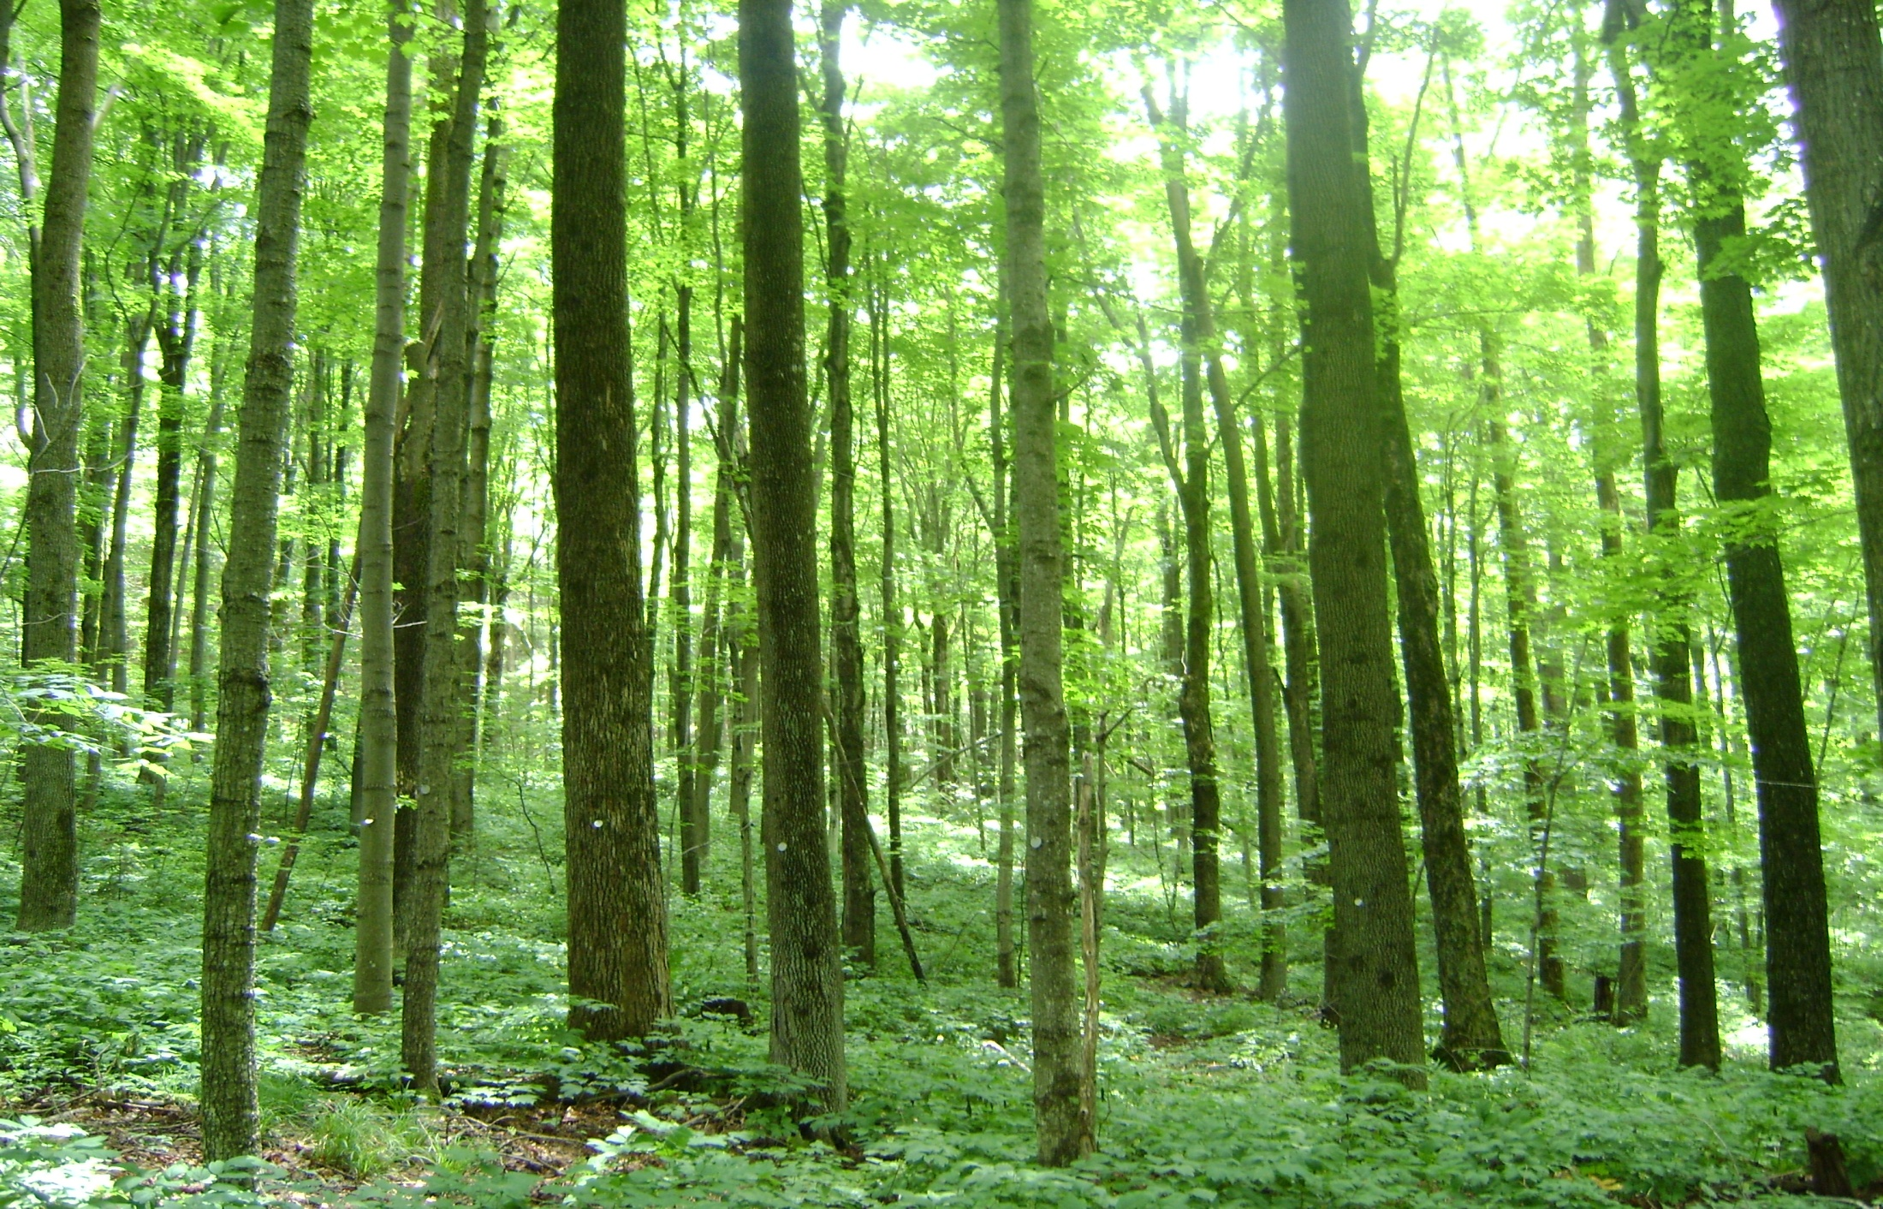
Study Design
47 North American Maple Project (NAMP) stands
  37 original NAMP
  10 established in 2007 where FTC defoliation occurred
Stand basal area > 50% sugar maple
Five 1/10 acre subplots
  Average of 54 sugar maples with DBH of > 10 cm per stand
  No management in the last 15 years
Methods

Slide 15
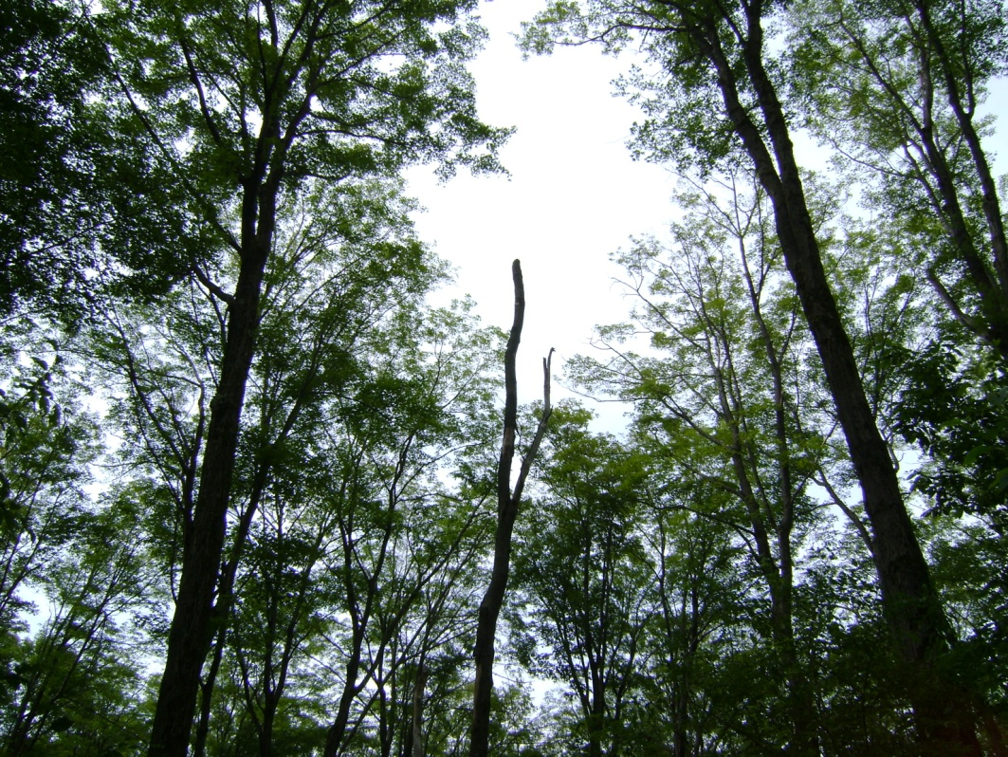
Tree Condition
Massachusetts assessed 2006, 2007
Vermont and New York assessed 2007, 2008
  Tree vigor (1-5)
  Crown dieback (%)
  Recent tree mortality
Methods

Slide 16
Soil Sampling
Methods

Slide 17
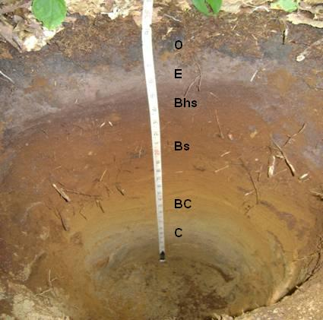
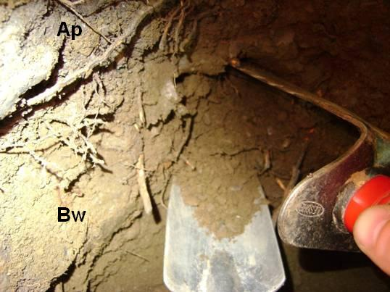
Soil Collection
5 pits per stand
Sampled from:
  A horizon (when present)
  Upper B horizon
Methods

Slide 18
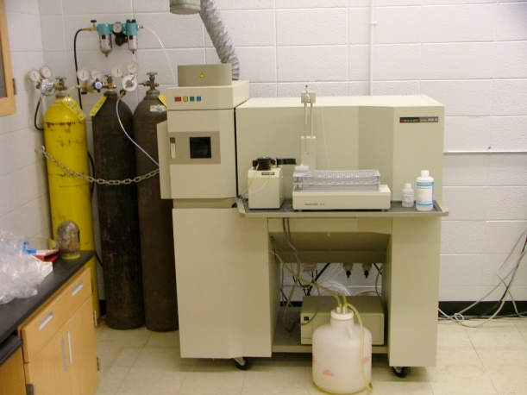
Soil Laboratory Analysis
After air-drying
Soils ground and sieved (2 mm)
Composited by horizon for a stand average
Average soil moisture content calculated
  Concentrations reported on oven-dry basis
Cations extracted from 5 g soil with 100 ml 1 M NH₄Cl
Inductively-Coupled Plasma Spectrometry (ICP)
  Exchangeable Ca, Mg, Al, K, Na
www.uwsp.edu/chemistry/images/ICP.jpg
Methods

Slide 19
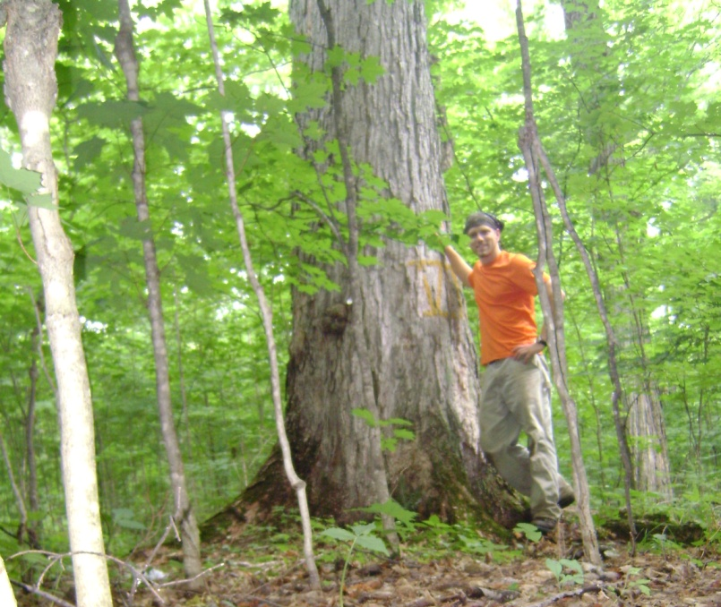
Multiple Regression Model Variables
Dependent Variables
Predictor Variables
Crown Dieback
Mortality
Stand
  Crown structure
  BA (m²/ha)
Site
  Terrain
  Landform
  Microrelief
  Exchangeable soil cations
Climate
  Low temperatures
  Palmer’s Z-index
Defoliation
Methods

Slide 20
Multiple Regression Models
Predictor variables chosen based on R
(α = 0.10)
Best predictive models chosen using AIC_{C}
Models differ if AIC_{C} difference >2
Multicollinearity
VIF > 5
  Ca & Mg
  Annual Mean Temperature & Annual Minimum Temperature
Methods

Slide 21
Comparison of Average Crown Dieback Between Consecutive Years
R² = 0.83
P <0.001
Results &
Discussion
Average crown dieback decreased by 2% across all stands (P <0.01)
Trees considered declining when crown dieback >20% (Allen, 1987)

Slide 22
The Effect of Previous Year’s Crown Dieback on Sugar Maple Mortality
R² = 0.62
P <0.001
Results &
Discussion
Normal annual sugar maple mortality <2% (Allen et al., 1999)
Average mortality across all stands was 2%

Slide 23
Comparison of Preceding Year’s Dieback Between Living and Dead Trees
Results &
Discussion
Most trees died within 2 years when crown dieback >40% (Gross, 1991)

Slide 24
The Effect of Exchangeable Soil Cations in Upper B Horizon on Sugar Maple Mortality
Cation r P-value
Ca -0.31 0.09
Mg -0.33 0.07
K -0.39 0.03
Soil thresholds for stress tolerance (Bailey et al. 2004):
  Ca > 0.20 cmolc/kg
  Mg > 0.05 cmolc/kg
Results &
Discussion

Slide 25
Common Predictor Variables in Multiple Regression Models
Concave Microrelief
Dry Growing Season During Outbreak
Low Temperatures
Low Exchangeable Soil Cations
FTC Defoliation
Results &
Discussion

Slide 26
Crown Dieback Model Selection Using AIC_{C}
Two models within 1 AIC_{C}
Both models included:
  Dry growing season (Palmer’s Z-index)
  Low Mg in A horizon
  Concave microrelief
  2006 Defoliation
Model 1
Low annual mean temperature
R² = 0.76
AIC_{C} = 82.14
w_{i} = 0.55
Chi-square P-value = 0.52
Model 2
Low outbreak mean temperature
Low stand basal area
R² = 0.78
AIC_{C} = 83.14
w_{i} = 0.33
Chi-square P-value = 0.85
Results &
Discussion

Slide 27
Mortality Model Selection Using AIC_{C}
Best model
  Concave microrelief
  Low annual min. temperature
  Dry growing season
  2005 Defoliation
  Low K in upper B
R² = 0.60
AIC_{C} = 63.17
w_{i} = 0.55
Chi-square P-value = 0.52
Results &
Discussion

Slide 28
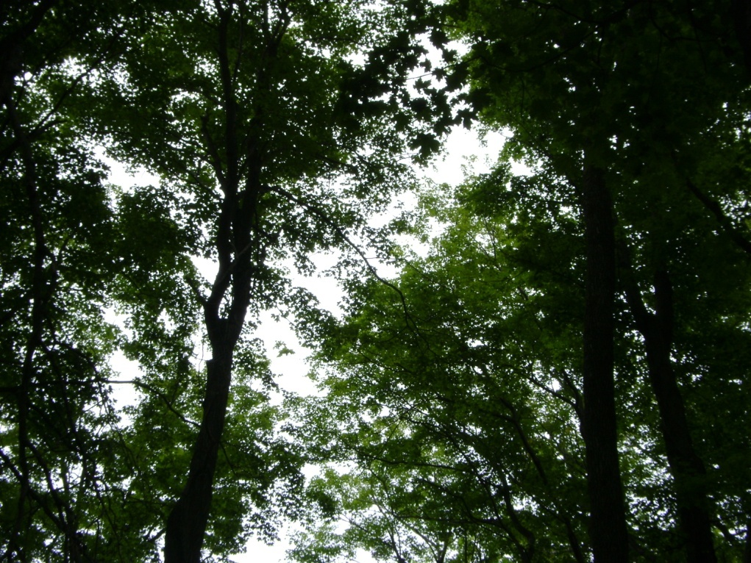
Potassium
N, P, K
Enzyme activator
Synthesis of root starches
Regulates water uptake and loss in trees
  Recovery from frosts
  Recovery from defoliation
  Recovery from drought
Discussion

Slide 29
Summary of Results
Sugar maple stands decreased in crown dieback by an average of 2%
Stands with higher crown dieback had highest mortality the next year
Stands with high sugar maple mortality occurred on soils with low Ca, Mg, and K

Slide 30
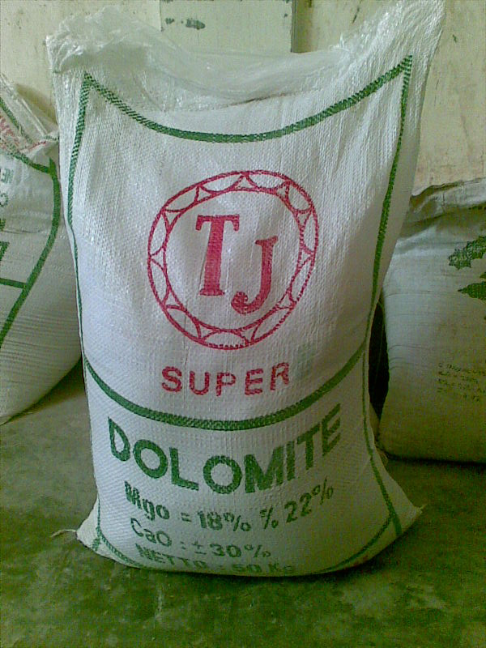
Fertilizer Application
wb9.itrademarket.com/.../64/514564_foto008.jpg
Calcium carbonate (CaCO₃)
Dolomitic lime
(CaMg(CO₃)₂)
Potash
  K₂SO₄
  KNO₃
Implications for Management

Slide 31
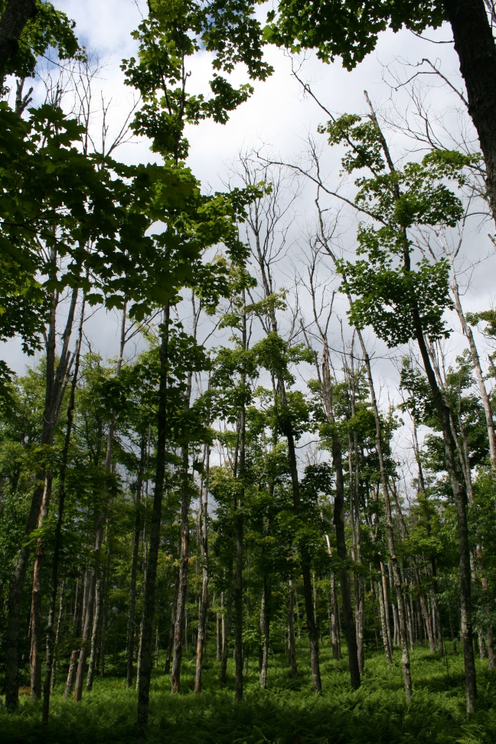
Salvage Cutting
Remove trees with crown dieback >70%
Pay attention to trees with dieback > 50%
Implications for Management
D. Parry, SUNY-ESF

Slide 32
Conclusions
Sugar maple may be susceptible to decline on a wider range of soils than previously defined
More attention should be paid to concentrations of K in soils when investigating sugar maple condition

Slide 33
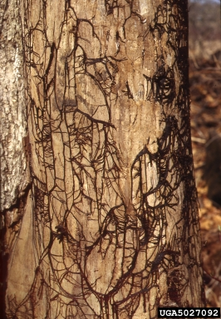
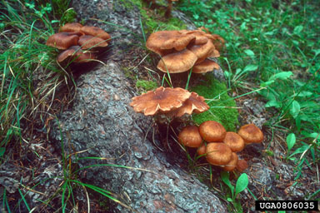
Future Investigation
Long-term data prior to FTC outbreak
Mortality in 10 years
Presence of Armillaria root-rot fungus
Joseph O'Brien, USDA Forest Service, Bugwood.org
Dave Powell, USDA Forest Service, Bugwood.org

Slide 34

Acknowledgements
Dr. Ruth Yanai, SUNY-ESF
Dr. Russ Briggs, SUNY-ESF
Dr. Doug Allen, SUNY-ESF
Dustin Wood, SUNY-ESF, M.S. 2008
Sandra Wilmot & Forest Health Field Crews, VT DFPR
Charlie Burnham & Melanie Joy, MA DCR
NYS DEC
Vermont and New York Landowners
William O’Neill
Alec Pitel
Chuck Schirmer, SUNY-ESF
Deb Driscoll, SUNY-ESF
Dr. Steve Stehman, SUNY-ESF

Slide 35
References
Akaike, H. 1974. A new look at the statistical model identification. IEEE Trans. Automat. Contr. 19, 716-723.
Allen, D.C. 1987. Insects, declines, and general health of northern hardwoods: Issues relevant to good forest management. P. 252-285 in Proc. Of Silvi. Symp. On Managing northern hardwoods, SUNY Coll. Environ. Sci. and For., Syracuse, NY, June 23-25, 1986, SUNY-ESF Fac., Nyland, R.D. (ed.) For. Misc. Publ. 13 (ESF 87-002).
Allen, D.C., Molloy, A.W., Cooke, R.R., Lachance, D., Barnett, C. 1995. North American Maple Project, seven year report. U.S. For. Serv., Northeast State and Private Forest Station, 57.
Allen, D.C., Molloy, A.W., Cooke, R.R., Pendrel, B.A. 1999. A ten-year regional assessment of sugar maple mortality. In: Horsley, S.B., Long, R.P. (Eds.), Sugar Maple Ecology and Health: Proceedings of an International Symposium. 1998 June 2-4; Warren, PA. Gen. Tech. Rep. NE-261. U.S. Department of Agriculture, Forest Service. Northeastern Station, Radnor, PA, 27-43.
Bailey, S.W., Horsley, S.B., Long, R.P., Hallett, R.A. 2004. Influence of edaphic factors on sugar maple nutrition and health on the Allegheny Plateau. Soil Sci. Soc. Am. J. 68, 243-252.
Fitzgerald, T.D. 1995. The tent caterpillars. Ithaca, NY: Cornell Univ. Press.
Kosola, K.R., Dickmann, D.I., Paul, E.A., & D. Parry. 2001. Repeated insect defoliation effects on growth, nitrogen acquisition, carbohydrates, and root demography of poplars. Oecologia, 129(1), 65-74. Retrieved Sep, from Article database.
Hartmann, H. & C. Messier. 2008. The role of forest tent caterpillar defoliations and partial harvest in the decline and death of sugar maple. Annals of Botany: 1-11.
Horsley, S.B., Long, R.P., Bailey, S.W., Hallett, R.A., & T.J. Hall. 2000. Factors associated with the decline disease of sugar maple on the Allegheny Plateau. Can. J. For. Res. 30: 1365-1378.
Horsley, S.B., Long, R.P., Bailey, S.W., Hallett, R.A., & P.M. Wargo. 2002. Health of eastern North American sugar maple forests and factors affecting decline. Nor. J. Appl. For. 19(2): 34-44.
Houston, D.R. 1999. History of sugar maple decline. In: Horsley, S.B., Long, R.P. (Eds.), Sugar Maple Ecology and Health: Proceedings of an International Symposium. 1998 June 2-4; Warren PA. Gen. Tech. Rep. NE-S61. U.S. Department of Agriculture, Forest Service. Northeastern Station, Radnor, PA, 27-43.
Manion, P.D. 1991. Tree disease concepts. Prentice-Hall, Englewood Cliffs, NJ.
Parry, D., Goyer, R.A., 2004. Variation in the suitability of host tree species for geographically discrete populations of forest tent caterpillar. Environ. Entom. 33, 1477-1487.
Roy, G., Larocque, G.R., & C. Ansseau. 2006. Prediction of mortality in Appalachian sugar maple stands affected by dieback in southeastern Quebec, Canada. For. Ecol. Mgmt. 228: 115-123.
Schaetzel, R.J., Krist, F.J., Stanley, K., Hupy, C.M. 2009. The natural soil drainage index: An ordinal estimate of long-term soil wetness. Phys. Geo. 30, 383-409.
Wood, D., Yanai, R., Allen, D. & S. Wilmot. 2009. Sugar maple decline after defoliation by forest tent caterpillar. Jour. For., Jan/Feb: 29-37.

Slide 36
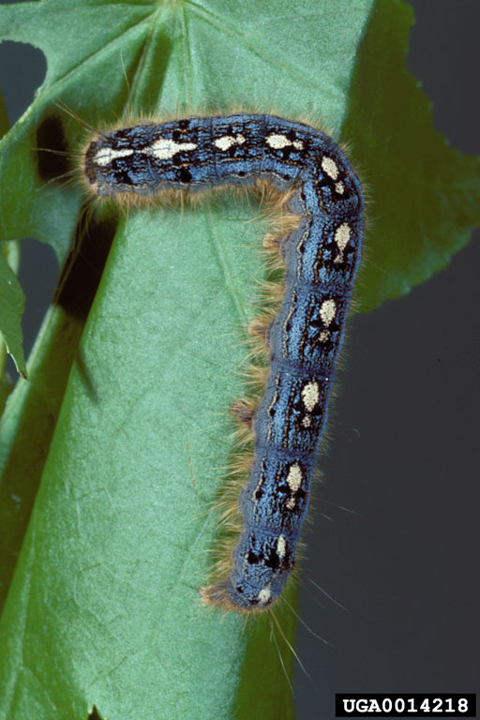
Questions?
Gerald J. Lenhard, Louiana State Univ, Bugwood.org
*Picture on title page provided by Paul Wray, Iowa State University, Bugwood.org

Slide 37
Aluminum

Slide 38
Ca:Al

Slide 39
Aerial Sketch-Mapping

Slide 40
Soil Drainage Index
(Schaetzl et al., 2009)
Soil moisture regime
Soil drainage class
Soil volume for rooting
Slope

