Slide 1
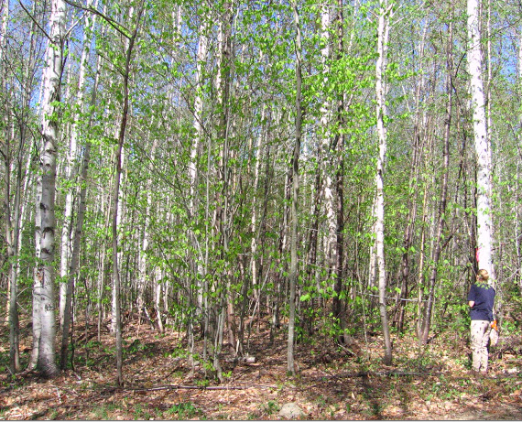

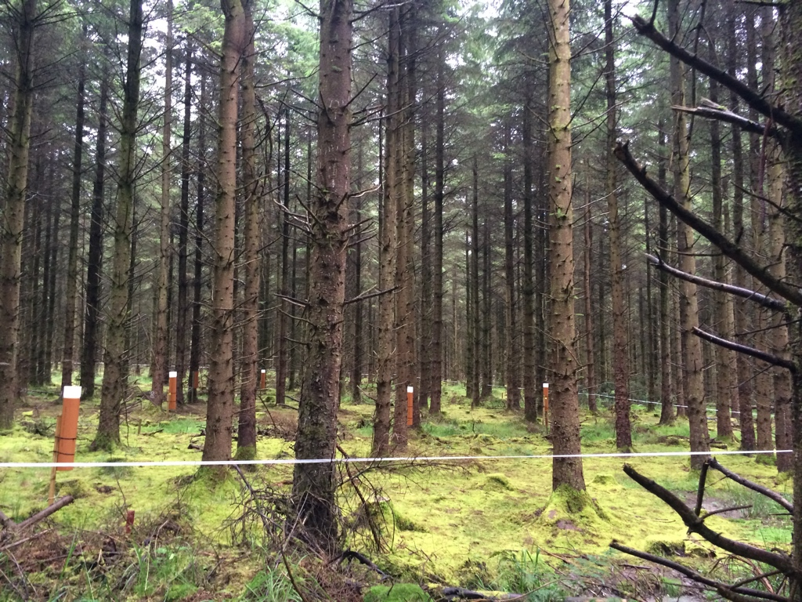
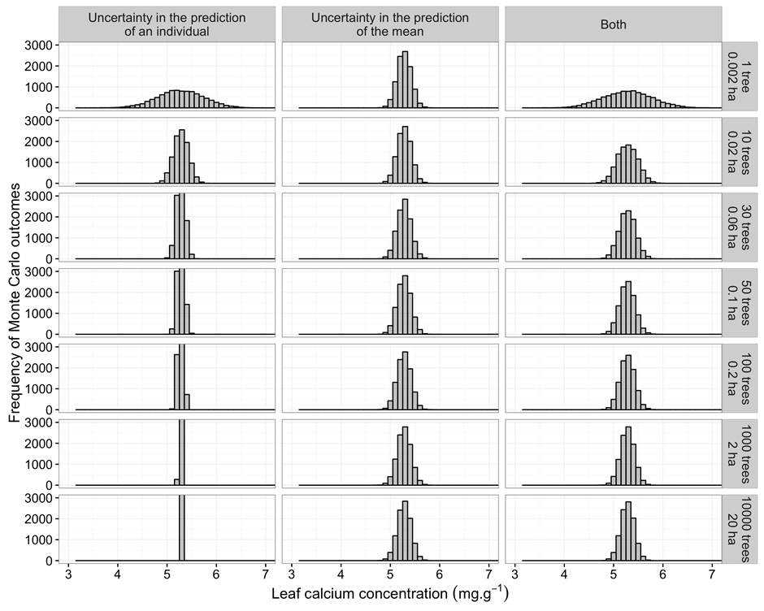
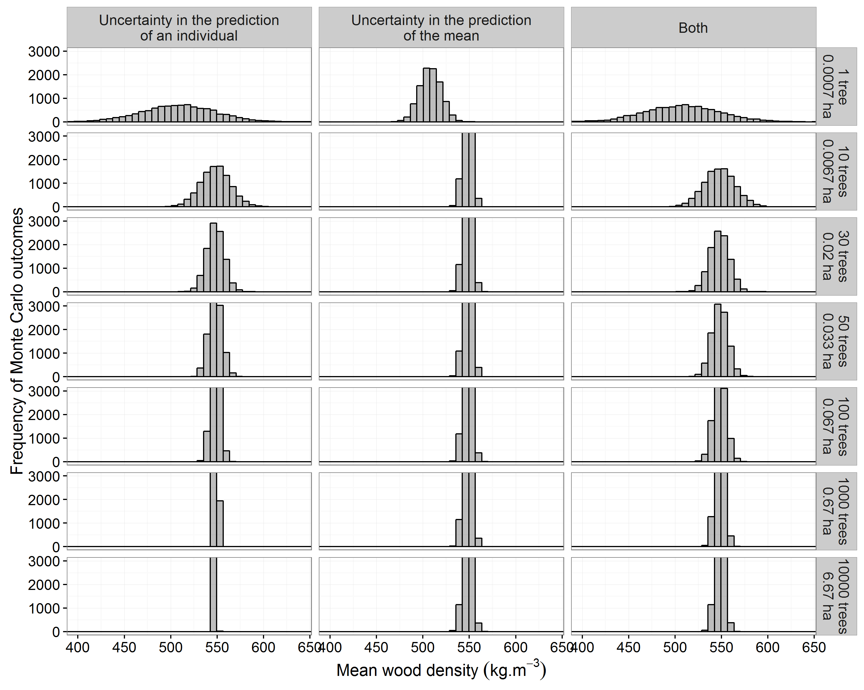
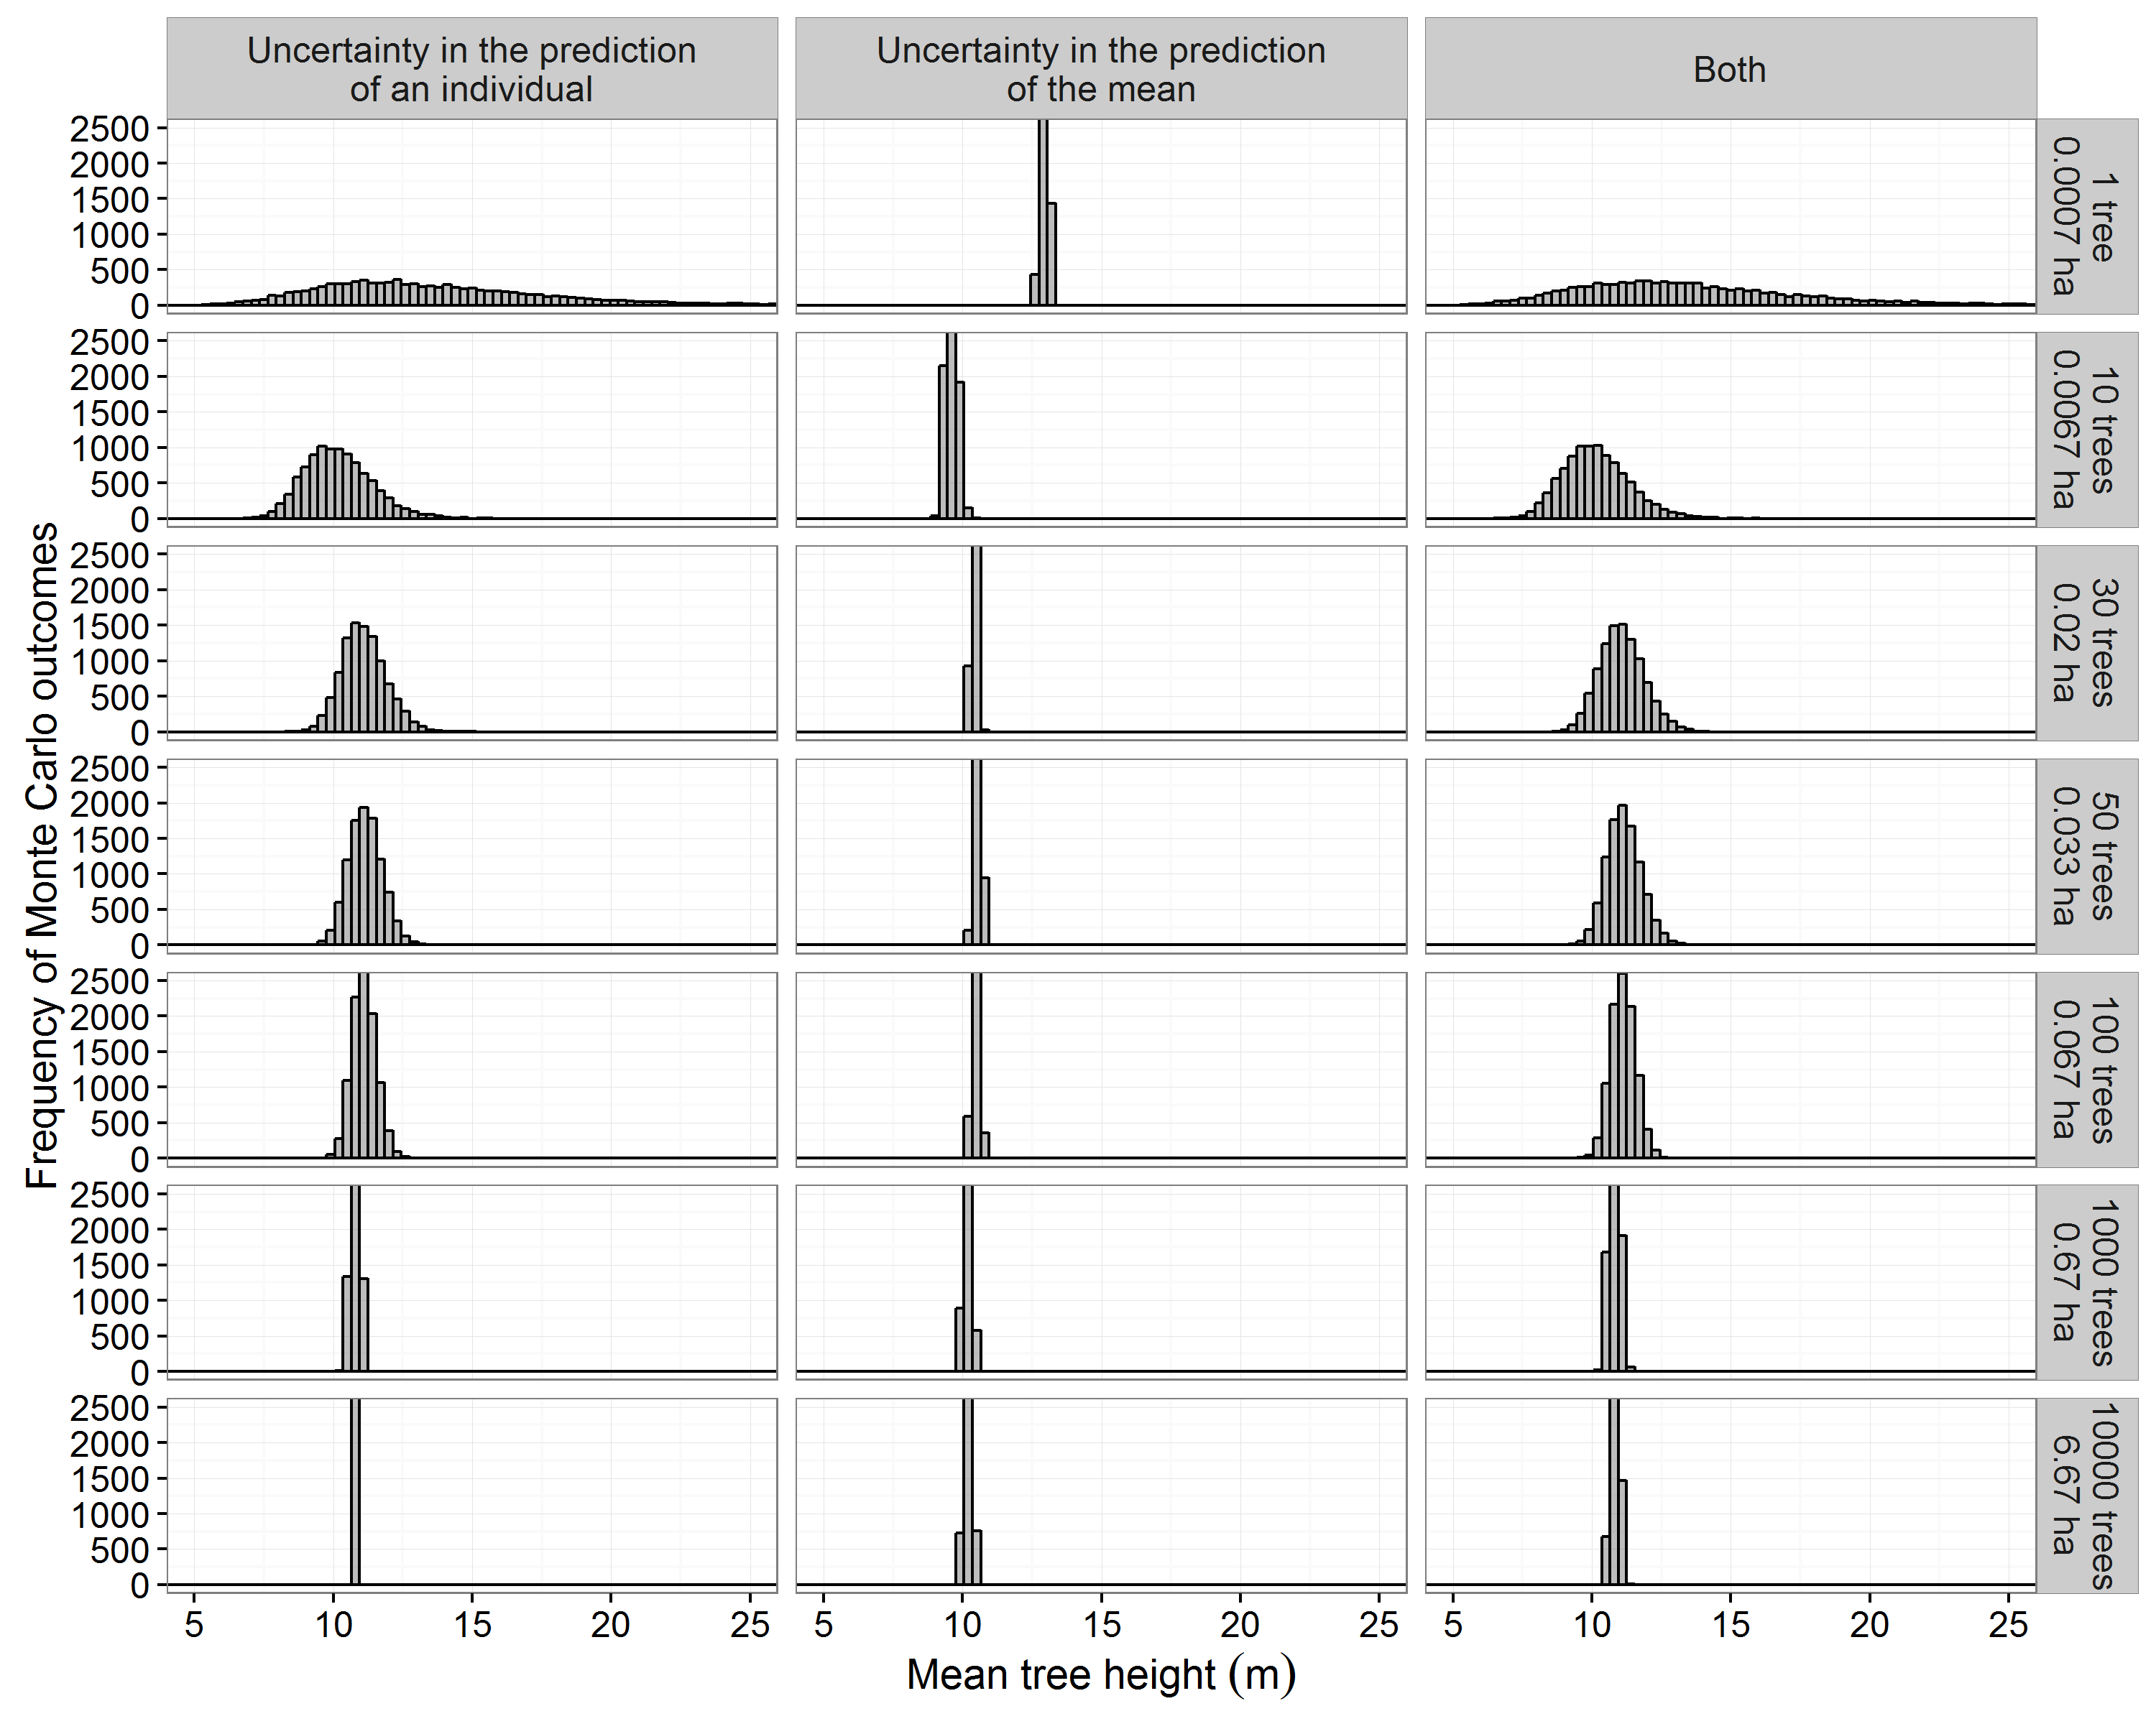
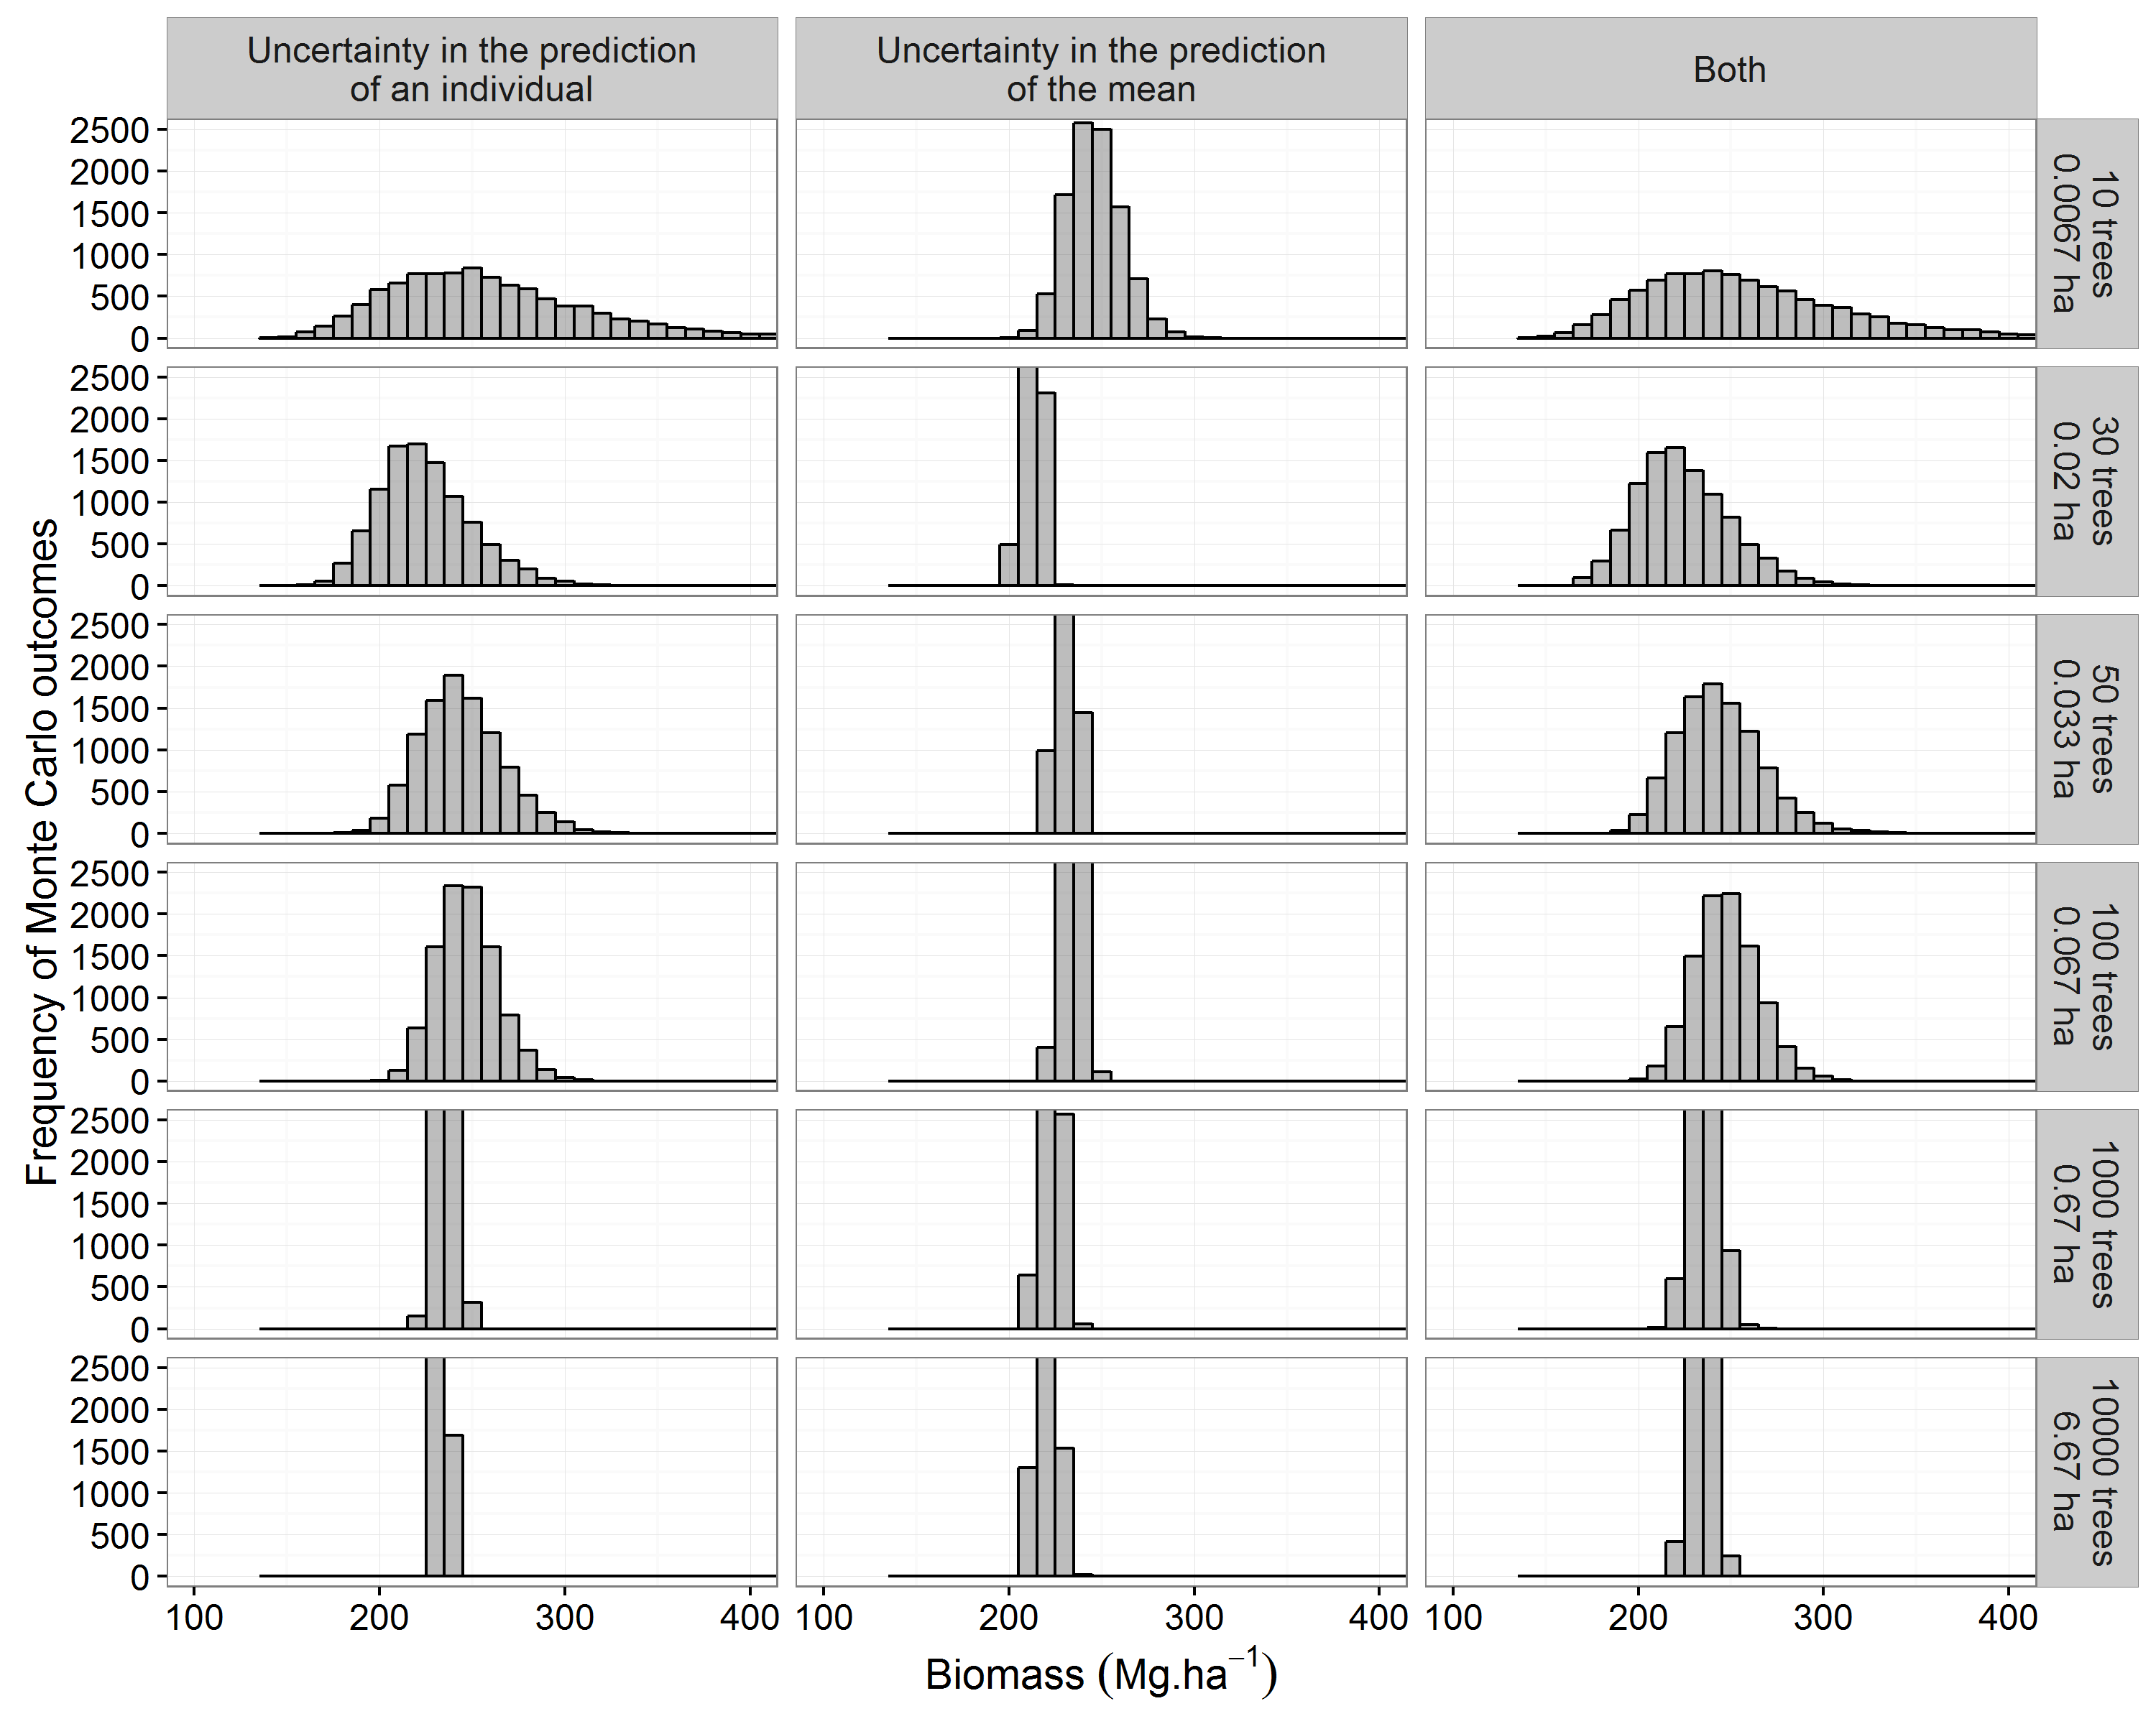
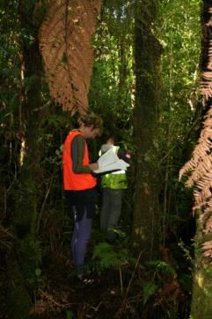
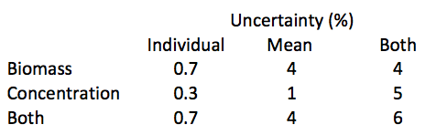
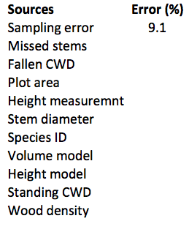
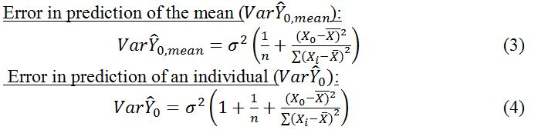
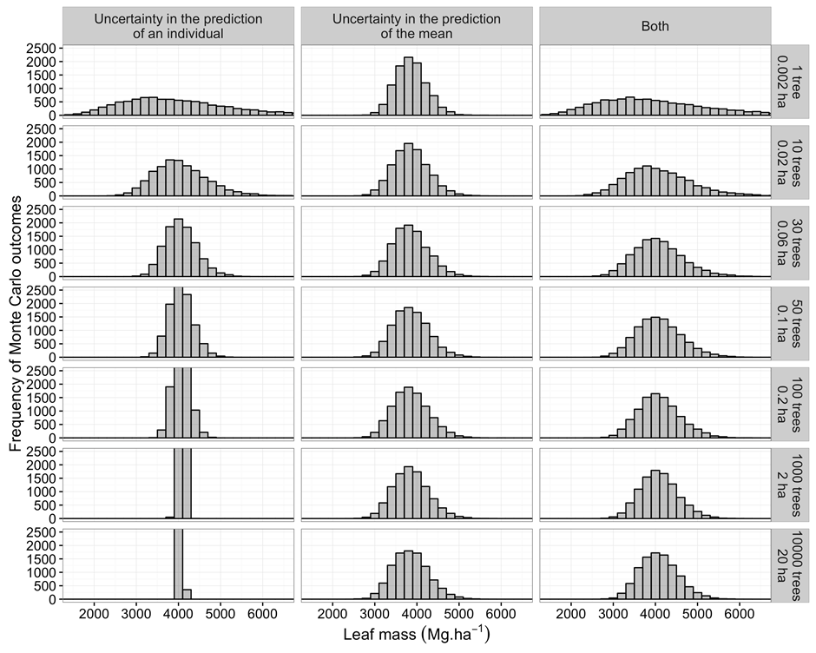
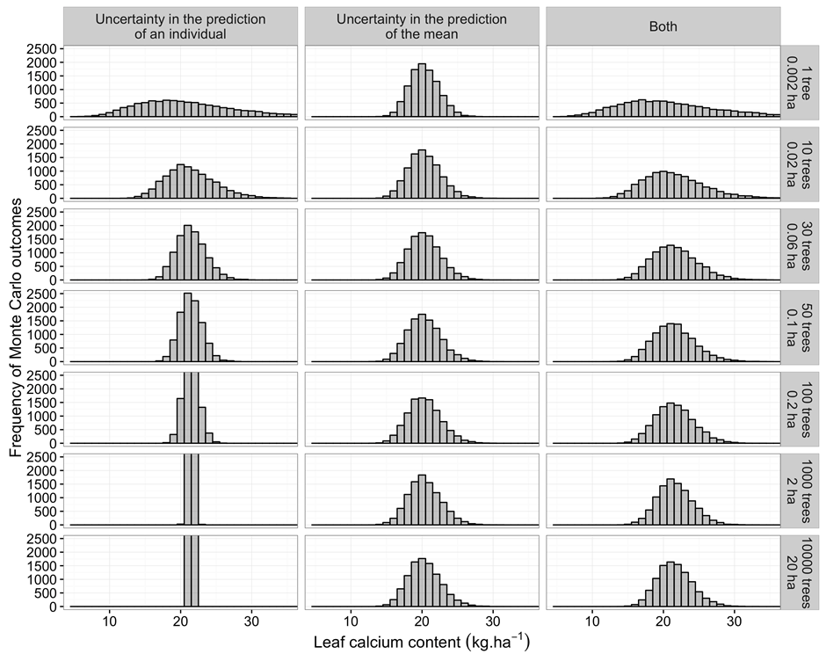
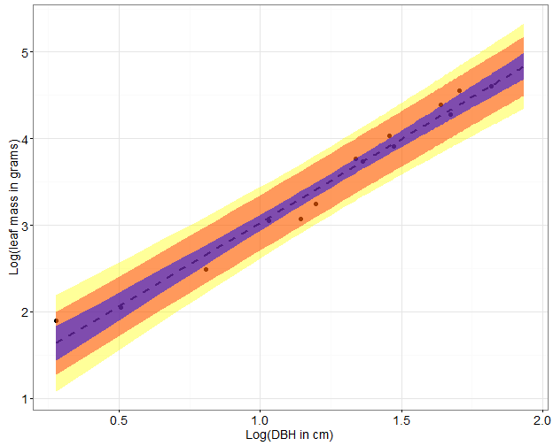
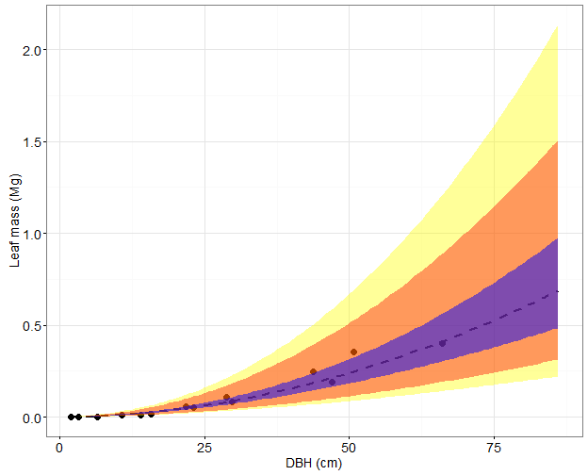
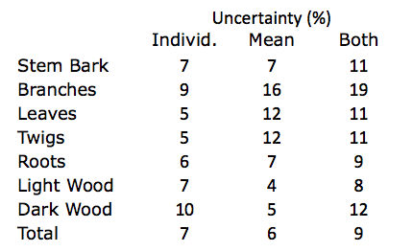
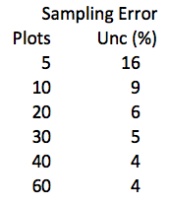
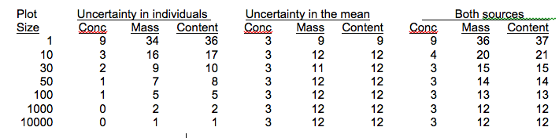
Avoiding Errors in Error Analyses:
How to Propagate Uncertainty in Regression Models
Ruth D. Yanai¹, Hannah L. Buckley², Bradley S. Case², Richard C. Woollons³, Robert J. Holdaway⁴, James Johnson⁵, and Paul J. Lilly¹
¹SUNY College of Environmental Science and Forestry, Syracuse, USA; ²Lincoln University, Lincoln, NZ; ³University of Canterbury, Christchurch, NZ; ⁴Landcare Research, Lincoln, NZ;
⁵University College Dublin, Dublin, Ireland
Introduction
Uncertainty in Forest Biomass
Calculations of forest biomass and elemental content require many measurements and models, each contributing uncertainty to the final estimates. Calculations of forest biomass and elemental content require many measurements and models, each contributing uncertainty to the final estimates. While sampling error is commonly reported, based on replicate plots, error due to uncertainty in the regression used to estimate biomass from tree diameter is usually not quantified. Some published estimates of uncertainty due to the regression models have propagated the uncertainty in the prediction of individuals, ignoring uncertainty in the mean, while others have propagated uncertainty in the mean while ignoring individual variation.
Uncertainty in prediction of individuals vs. the mean
Illustrated with foliar Ca concentration
We sampled from a distribution defined by a sample of 12 trees that had a mean foliar Ca concentration of 5.28, a SD of 0.48, and a SE of 0.14 mg/g. For the uncertainty in predicting an individual, we assigned each tree a concentration randomly selected from a distribution defined by the mean and the SD. For the uncertainty in predicting the mean, at each iteration we assigned all the trees in the plot the same Ca concentration randomly selected from a distribution defined by the mean and the SE. For the full uncertainty analysis, we simulated both sources of error: we randomly selected a mean for all the trees in the plot at each interation, and we also randomly selected from the SD to predict the Ca concentration of each tree.
Figure 2. Uncertainty in the calcium concentration of the leaves of sugar maple trees.
…and foliar mass and Ca content
For all the Monte Carlo simulations, we sampled from the uncertainty in a regression of leaf mass as a function of stem diameter. For the uncertainty in predicting an individual, each tree was assigned a random prediction error (Eq. 4). For the uncertainty in predicting the mean, all the trees in the plot were assigned the same random sample of the error in the regression (Eq. 3) for each iteration of the Monte Carlo. For the full uncertainty analysis, we simulated both sources of error: we randomly selected the error in the regression for all the trees in the plot at each iteration, and we also randomly selected a residual error to determine the foliar mass of each tree. Both the prediction error and the error of the regression depended on the departure of each tree from the mean diameter of the trees used to fit the regression (Figure 1).
The calcium content of leaves on the plot is the sum of the calcium content of all the trees, which is obtained by multiplying the foliar mass (Figure 3) times the calcium concentration (Figure 2).
Reanalysis of published uncertainty estimates,
evaluating uncertainty in prediction of individuals vs. means
New Zealand
Aboveground carbon stocks in natural temperate rainforest across New Zealand were estimated using 227 national inventory plots (Holdaway et al. 2014). One representative 0.04-ha plot was selected for this comparison of uncertainty sources. Species include 10 common NZ forest species. Wood density is a point-level estimate, like the calcium concentration example, except that each species has a different value (Figure 5). Tree height is estimated from species and diameter using regression (Figure 6). Biomass is estimated from tree height, diameter and wood density data using regression (Figure 7). Thus biomass uncertainty includes uncertainty in wood density and in the tree height biomass models.
Ireland
Nutrient budgets were constructed for maritime plantation forests in Ireland using 40 sites selected on a grid across the country (Johnson et al. 2015). One site was selected for this comparison of uncertainty sources, in Sitka spruce at Ballinastoe.
The biomass of the canopy was calculated from regression equations for the biomass of branches and needles, with uncertainty in the regression. The nitrogen concentrations of branches and needles were sampled from the SD for the prediction of individuals and the SE for the prediction of the mean. Uncertainty in the N content of the canopy involves both mass and concentration uncertainty. This is a single 0.25 ha plot:
For comparison, the sampling error across the 27 Sitka spruce plots in Ireland was 16 %.
A
C
A
B
B
Approach
The construction of allometric equations is fundamental to most studies of biomass and nutrient content. Simple linear regression models are commonly constructed, of form:
Models such as Eq. 1 are usually constructed from data obtained from a sample of the population of interest. Therefore, the model does not perfectly describe the population of interest; it is subject to error. For example, if several random samples are drawn from the population, the parameter estimates will vary (a little) from sample to sample. Several statistics have been developed to quantify the model error. The simplest, which assumes a constant variance, is the mean-square-error (MSE), given by:
The MSE can be used to quantify the precision of Eq. 1, which can be used to predict either an average value or a specific single value, both of which depend on the value of the independent variable X (with mean X̅), which we call X₀. The estimated value of Y is the same whether predicting a mean or an individual, but the error is much larger when predicting an individual. Two variances quantify these errors (Draper and Smith 1998):
Note that the error is smallest when X₀ equals the mean of the sample (X̅), and increases as X₀ deviates in either direction from X̅.
In the illustration in the next panel, we use the mass of sugar maple leaves measured in a sample of 14 trees from Hubbard Brook, NH, USA (Whittaker et al. 1974) (Figure 1).
Figure 1. The diameter of a tree is a good predictor of the mass of its leaves. (a) The log of leaf mass is a linear function of the log of tree diameter at breast height (DBH). The purple envelope shows the confidence in the regression (Eq. 3), the orange shows the uncertainty in the prediction of an individual (Eq. 4), and the yellow shows the combined result of the former two uncertainties. (b) Graphed in the original units, the relationship of leaf mass to tree diameter is a power function.
Figure 5. Uncertainty in wood density
Figure 7. Uncertainty in tree height
A
Figure 7. Uncertainty in forest biomass
Across 227 plots, sampling error was the greatest source of uncertainty in forest C, with all sources of measurement and model uncertainty contributing <1%.
Conclusions
Individual uncertainty is important for a single plot with a small number of individuals. For large plots with many trees or for many plots of any size, the contribution of individual uncertainty to the total uncertainty is negligible. When assessing uncertainty in country-level carbon accounting, based on large numbers of plots and thousands or millions of trees, the uncertainty in the mean is more important, but may be smaller than sampling error. Omitting the effect of uncertainty in the mean could lead to exaggerated confidence in estimates of forest biomass and nutrient contents.
New Hampshire
Biomass of a temperate hardwood forest was estimated using 0.05 ha plots across the Hubbard Brook valley in the White Mountains of New Hampshire (Yanai et al. 2010). For one 0.05 ha plot:
Sampling error (variability across plots) was greater than uncertainty in biomass due to the height and biomass regressions if the number of plots was 10 or fewer.
Figure 3. Uncertainty in the mass of sugar maple leaves
Figure 4. Uncertainty in the Ca content of sugar maple leaves
Acknowledgements
The QUEST RCN is funded by the National Science Foundation, DEB 1257906, following preliminary funding under DEB 0949324. Two Synthesis Working Groups were also funded by the NSF Long Term Ecological Research Network Office.
Be a part of QUEST!
● Find more information at: www.quantifyinguncertainty.org
● Read papers, share sample code, stay updated with QUEST News
● Email us at quantifyinguncertainty@gmail.com
● Follow us on LinkedIn and Twitter: @QUEST_RCN

