Slide 1
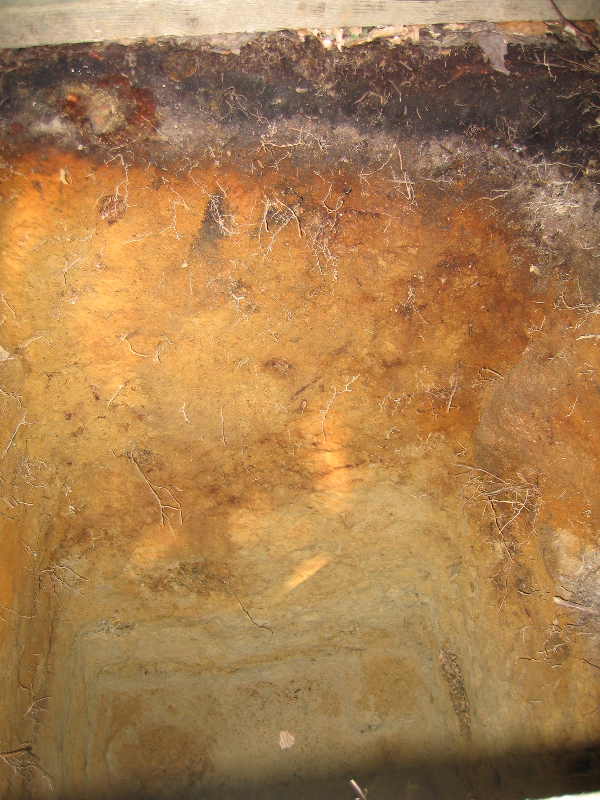


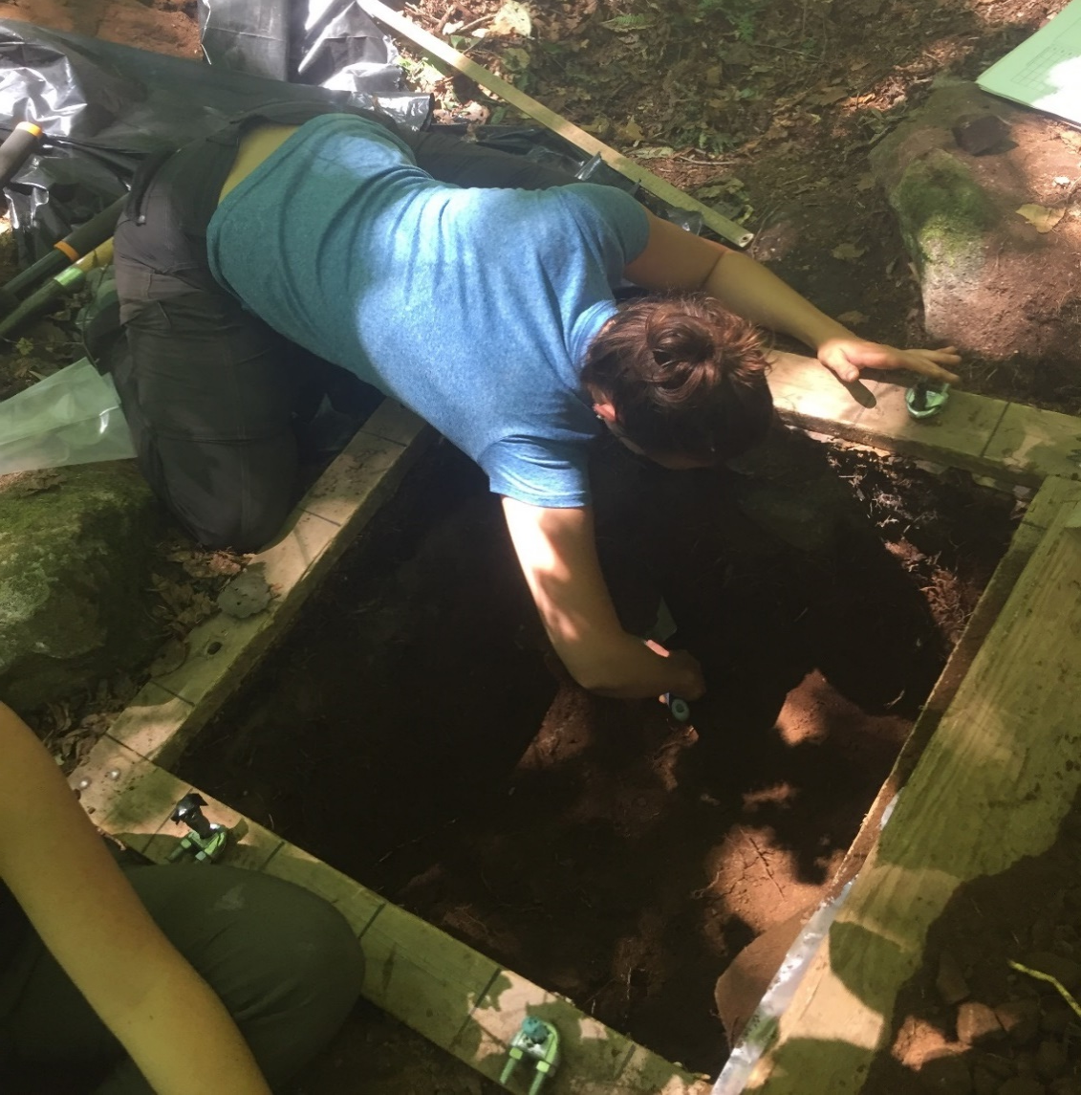
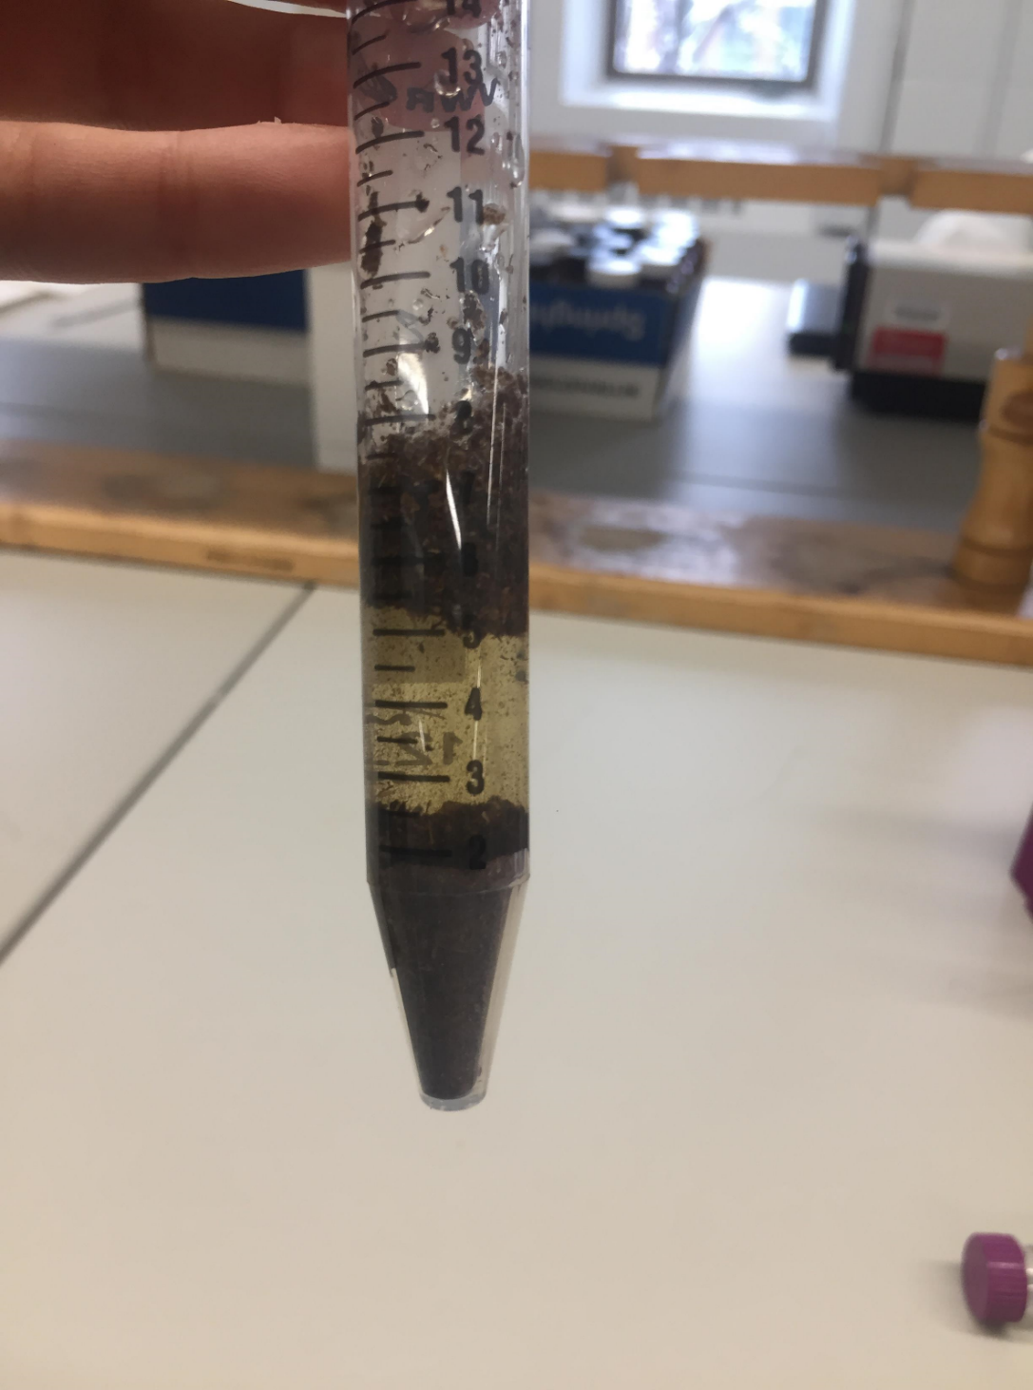
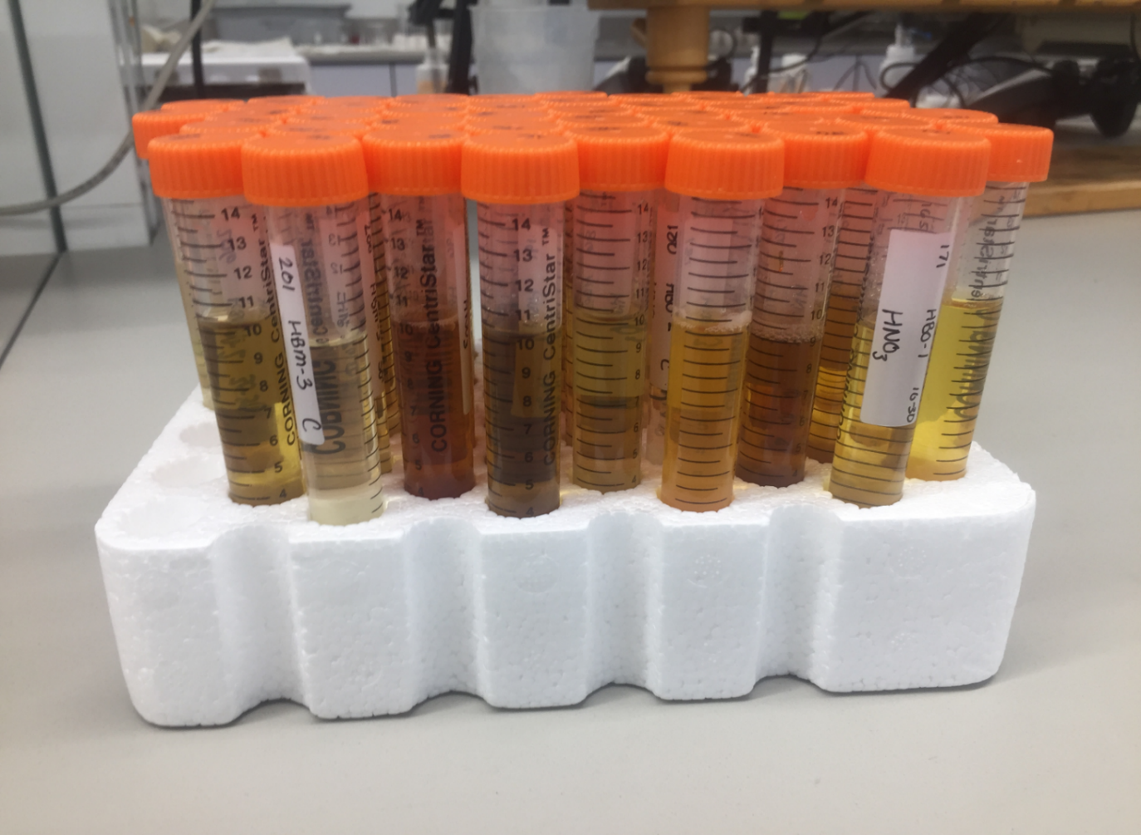

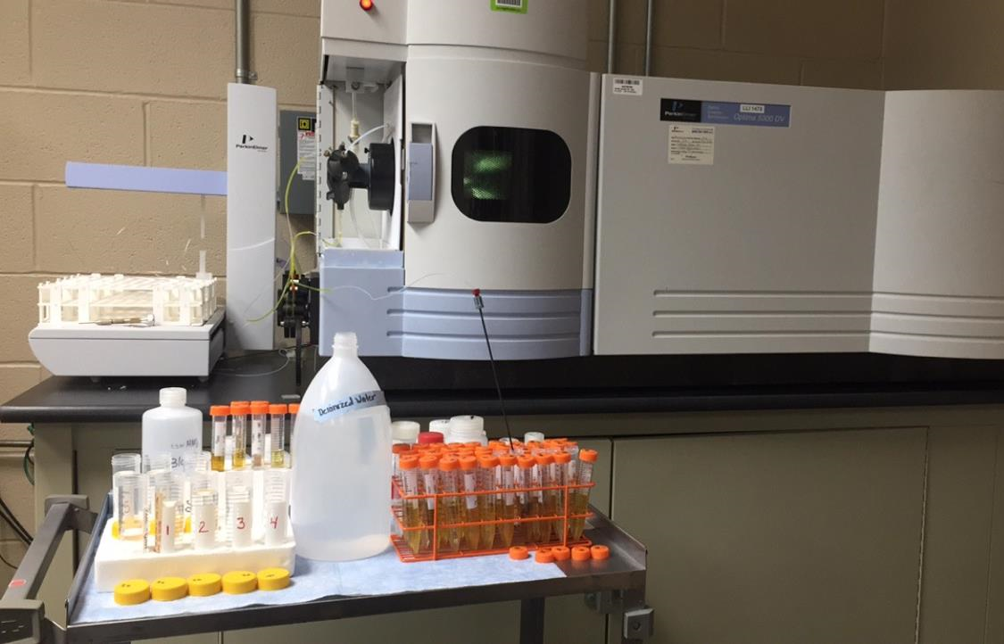
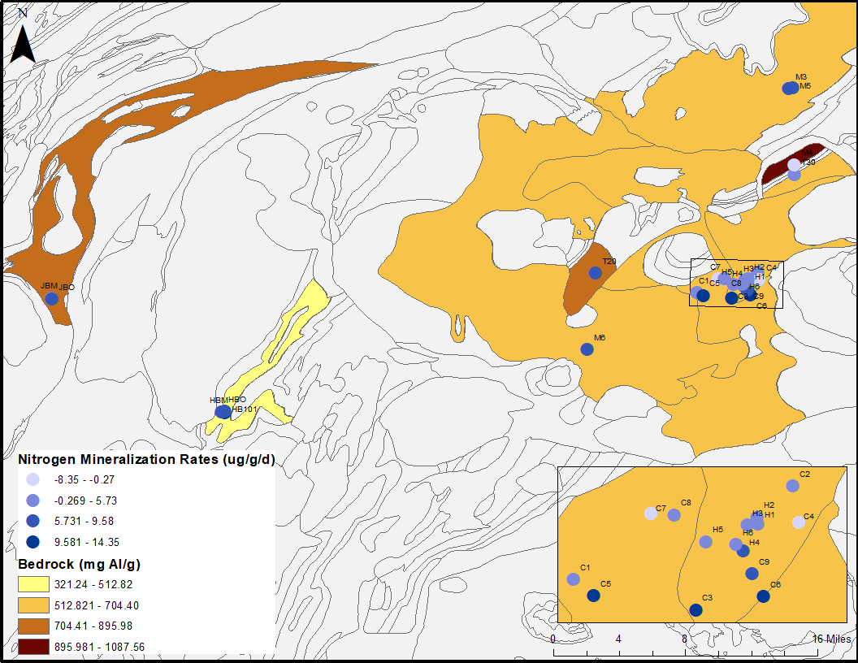
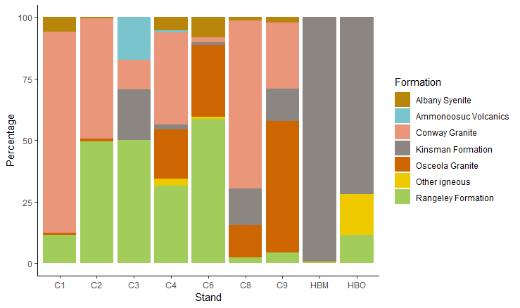
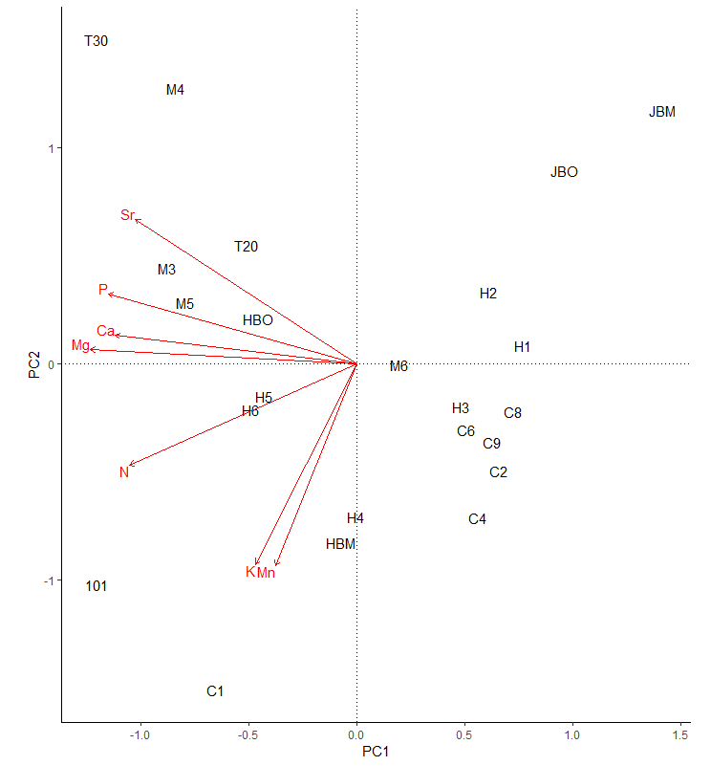
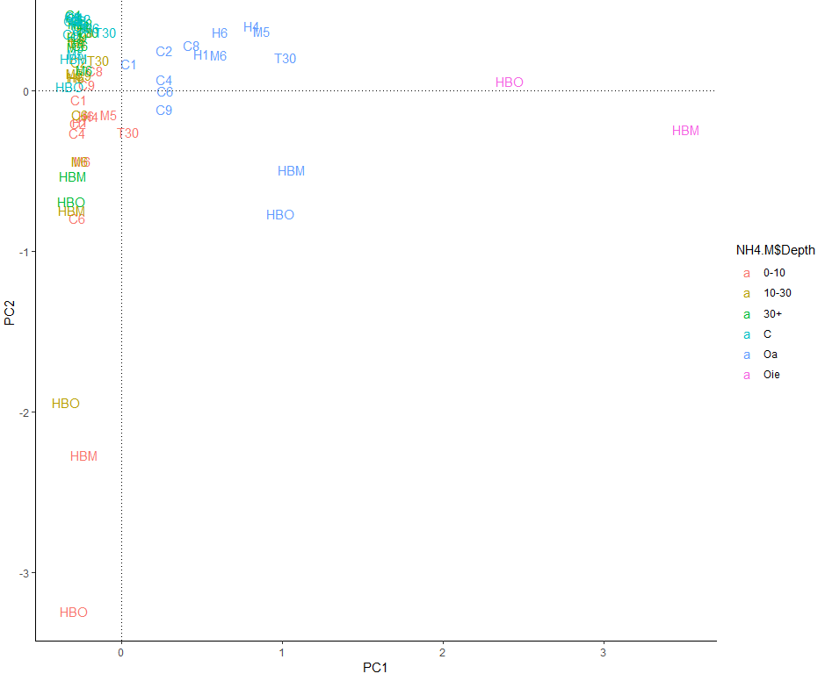
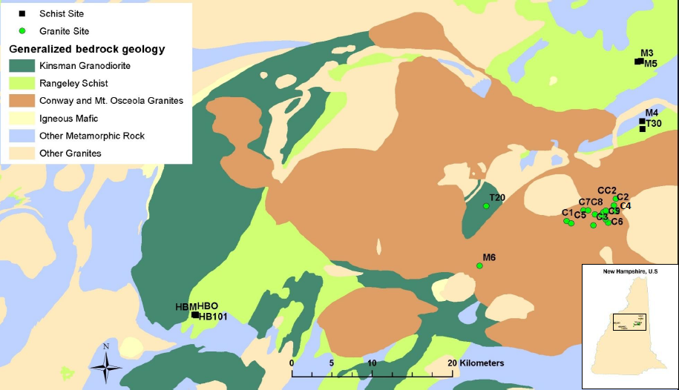
Relating Soil Nutrients to Ecosystem Fluxes
Alexandrea M. Rice¹, Matt A. Vadeboncoeur², and Ruth D. Yanai¹ ¹SUNY-ESF, 1 Forestry Dr., Syracuse, NY 13210
²University of New Hampshire, 105 Main St., Durham, NH 03824
#120253
Introduction
Nutrients enter ecosystems via atmospheric deposition and geological weathering. Soil nutrients determine site fertility, which is highly variable due to the process of soil formation (Jenny, 1958). These nutrient pools include exchangeable, extractable, and total.
Exchangeable nutrient pools are readily available for plant uptake, however, they only account for partial nutrient requirement of trees (Likens, 1994; Likens et al., 1998). Other nutrients are bound up in minerals and can take decades to millennia to become available to plants.
Quantifying extractable nutrient pools and the more refractory nutrients bound in silicates provide insight on historical nutrient supply and the current total nutrient concentration of the soil. Even though quantitative pits are labor and time intensive, they allow for sampling of deeper soils and provide accurate measurements of total nutrient pools within an area (Nezat et al., 2007; Vadeboncoeur et al., 2012). The soil nutrient information collected through the excavation of quantitative soil pits could be used to explain forest responses such as nitrogen mineralization and litterfall nutrients.
Objectives
What soil nutrients correlate to eachother and do they vary by extraction?
Is there a relationship between nitrogen mineralization rates and bedrock nutrients?
How do soil nutrients correlate to litterfall nutrients?
Methods
Excavation of Soil Pits
NH₄Cl Extraction
HNO₃ Extraction
HF+HNO₃+HCl Digestion
Nutrient Analysis on ICP-OES
Results
A)
B)
*
*
*
*
*
Al
*
*
*
C)
*
A) Bedrock nutrients with nitrogen mineralization rates plotted for each stand.
B) Composition of rocks characterized by formation reported in percent .The “*”
is the formation that related to the bedrock underneath each stand.
C) Principal Components Analysis of litterfall nutrients.
D) Principal Components Analysis of soil nutrients colored by depth.
Study Site
Fifteen northern hardwood stands ranging in age from 28-135 years were studied in the White Mountain National Forest , New Hampshire, USA. Selected stands contained similar elevation, landscape position, and parent material. The spodosol (Haplorthod) soils developed on glacial till parent material derived from granitic and metamorphic rock. The soils are well to moderately drained. Qualitative soil pits were excavated in 2003, 2004, 2010, and 2018.
Help me out of this pit!
 | Al | Ba | Ca | Fe | K | Mg | Mn | Na | P | Sr
Nitrogen Mineralization
Tree Growth
Tea bag Decomp.
Soil Respiration
Germinant Survival Rate
Sugar Maple Seed Production
Beech Bark Disease Severity
Green leaf nutrients
Litterfall Nutrients
Root nutrients and biomass
Xylem sap flow
Species composition
D)
Study Sites
Notes:
Make title bigger and authors smaller

