Slide 1

Soil Enzyme Activity Indicates P Limitation in Northern Hardwood Forests
Shan Shan¹, Spencer Stutenroth¹, Melany Fisk¹*
¹Department of Biology, Miami University, Oxford, OH

Slide 2
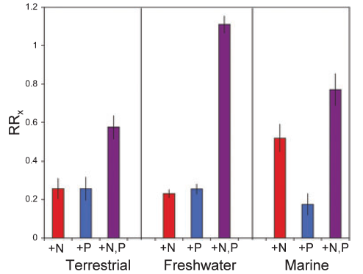
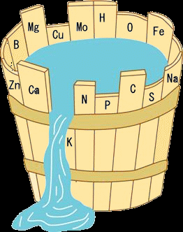
N P Colimitation
Nutrient limitation & ecosystem productivity/function
Single-nutrient limitation
N P colimitation: larger productivity response to N+P together than to either alone
Elser et al., 2007
Notes:
Nutrient limitation is an important factor restraining ecosystem productivity and function. Traditional concept of nutrient limitation refers to single-nutrient limitation derived from Liebig’s Law of the Minimum, suggesting the productivity (or water level in this bucket) is determined by the nutrient of the lowest availability (or shortest stave). More recently limitation by multiple nutrients such as NP colimitation has been suggested to be widespread in terrestrial and aquatic ecosystems in recent literature. Colimitation means … The mechanisms driving colimitation remain less clear.

Slide 3

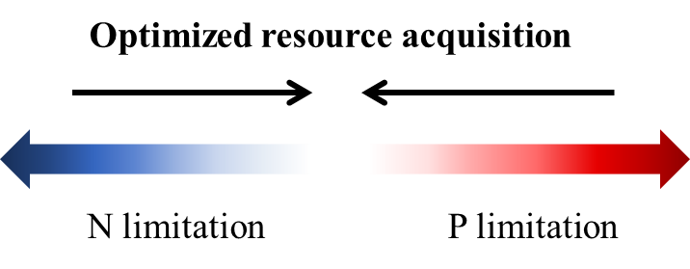
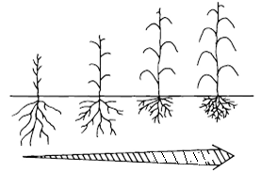
Optimized Resource Acquisition & Nutrient Limitation
Resources
Carbon
Light limitation
Notes:
Plants and soil microbes can respond to resource limitation with optimized resource acquisition. ORA is a tradeoff process where C is allocated primarily to the acquisition of the most limiting resource. For example, plants allocate relatively more aboveground biomass under light limitation. Under single nutrient limitation, ORA processes theoretically minimizes limitation by that single nutrient and potentially contribute to colimitation.

Slide 4
Soil Extracellular Enzymes
Decompose organic matter, release various nutrients into the soil
Indicate nutritional demands of plants and microbes
High production = High demand for the target nutrient
N-acquiring enzyme | P-acquiring enzyme | C-acquiring enzyme
aminopeptidase N-acetyl-glucosaminidase | phosphatase | β-glucosidase cellobiohydrolase
Notes:
One example of resource allocation involved in nutrient acquisition is production of extracellular enzymes. Plants and microbes produce enzymes and released into the soil, called extracellular enzymes. Soil extracellular enzymes catalyze the decomposition of organic matter and release nutrients from organic matters. Consequently these enzymes mediate plant and microbial uptake of these nutrients. The production and activity of enzymes indicate their nutritional demands. High…SEE includes N enzymes such as aminopeptidase, which cleaves single amino acids from peptide in the final decomposition stage of protein, NAG release glucosamine from chitin…

Slide 5
Hypothesis
Ratios of C-, N-, and P-acquiring enzymes respond to changes in nutrient availability in a direction that minimizes limitation by any single nutrient.

Slide 6
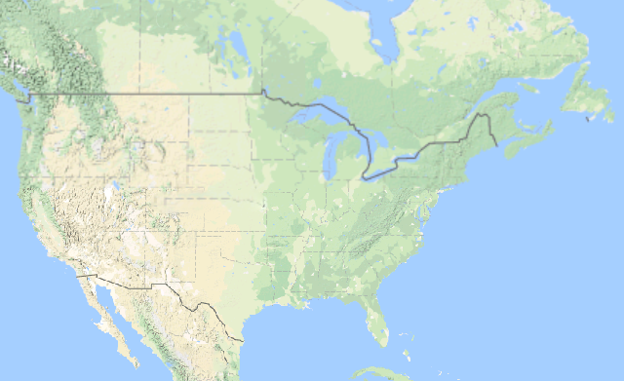
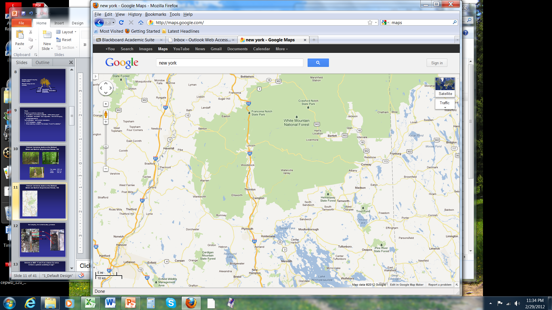

Study Sites
Bartlett stands:
3 young
3 mid-age
3 mature
Jeffers Brook stands:
1 mid-age
1 mature
Hubbard Brook stands:
1 mid-age
1 mature
Stand locations in Central NH

Slide 7
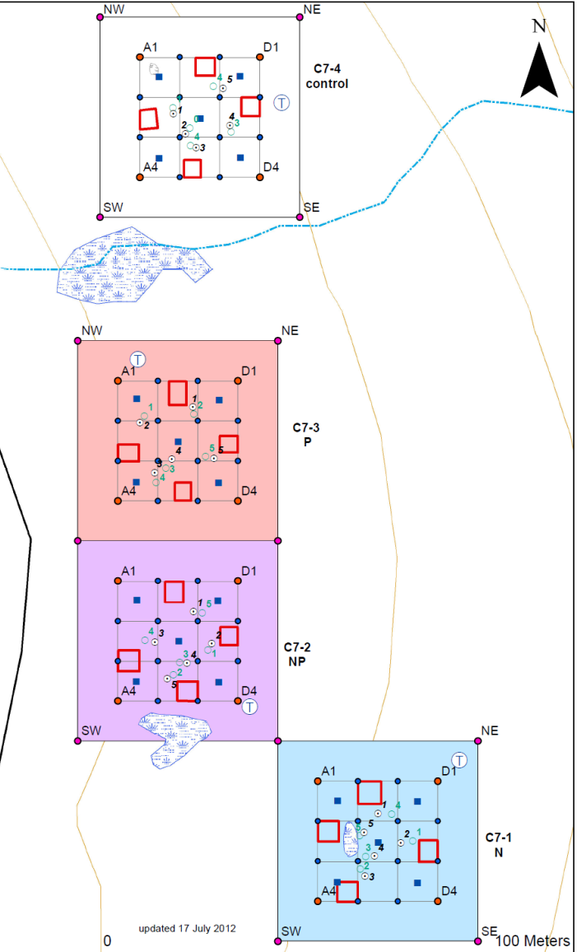

Control
P: 10 kg/ha/yr as KH₂PO₄ )
N+P
Annual fertilization began in 2011
N: 30 kg/ha/yr as NH₄NO₃
Notes:
Within each forest stand, we established 4 treatment plots, fertilized by either N, P, N+P or nothing annually since 2011.
Mention: Modest levels of nutrient addition; responses expected to develop slowly
In order to be able to capture any subtle change in above- and belowground we’ve been adding modest levels of nutrients to monitor the overtime development of responses.

Slide 8
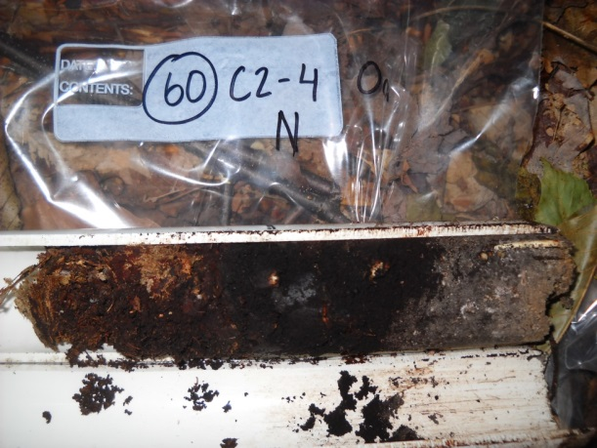
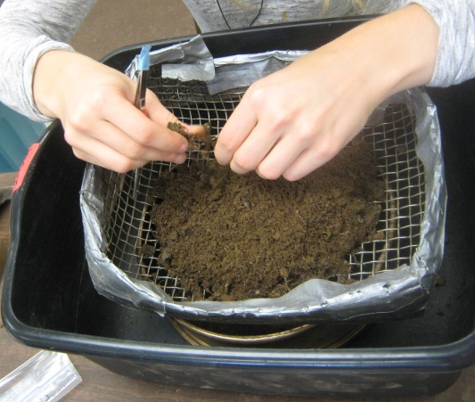
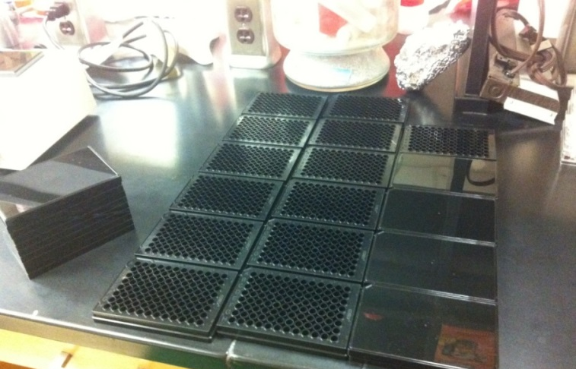
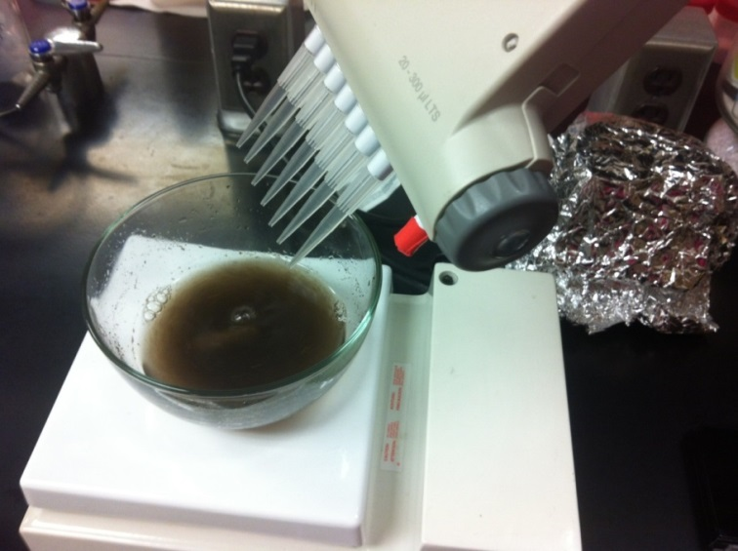
Methods
Soils
Oe
Oa
Mineral
Enzyme activity (fluorescent method)
N: leucine aminopeptidase, alanine amino peptidase
P: acid phosphatase
C: β-glucosidase, cellobiohydrolase
Average 4.9 cm

Slide 9
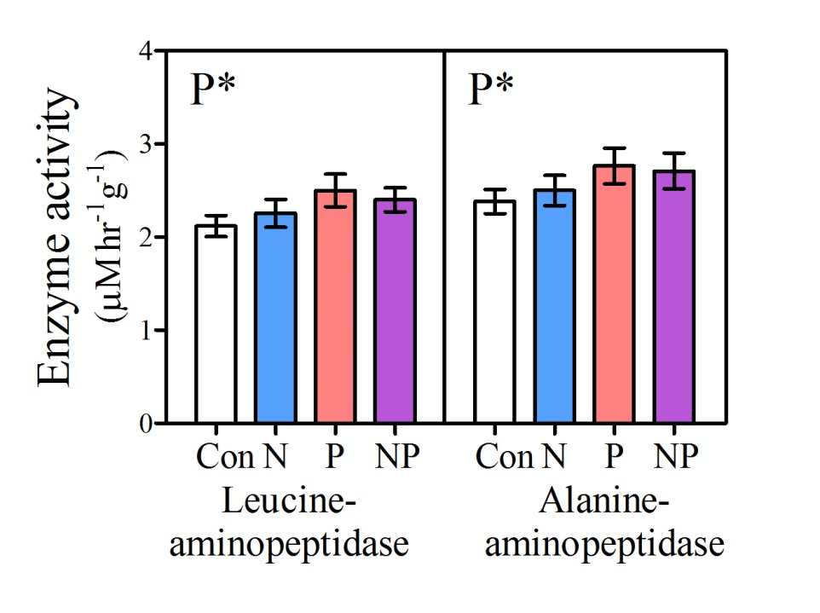
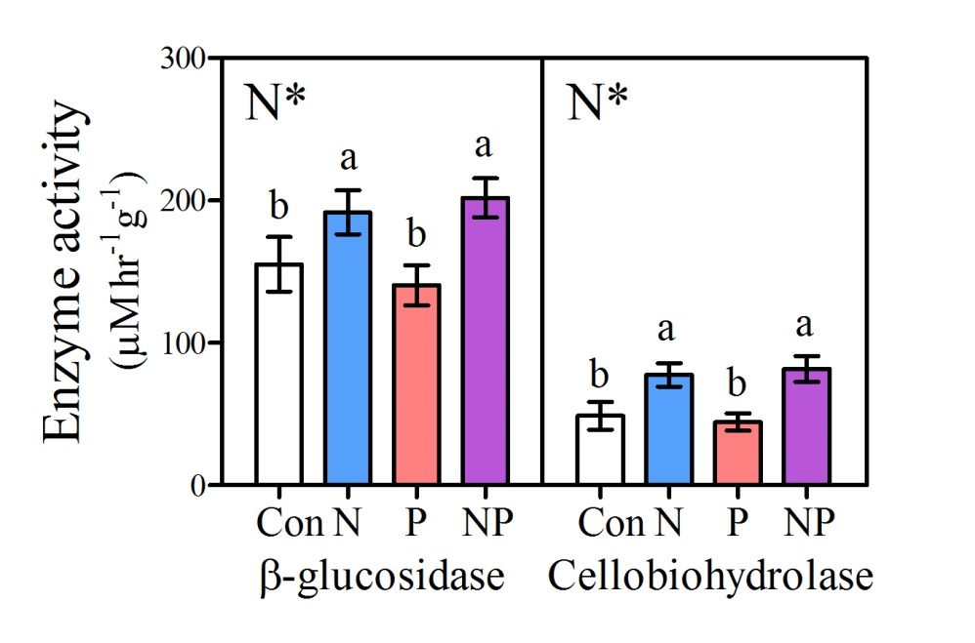
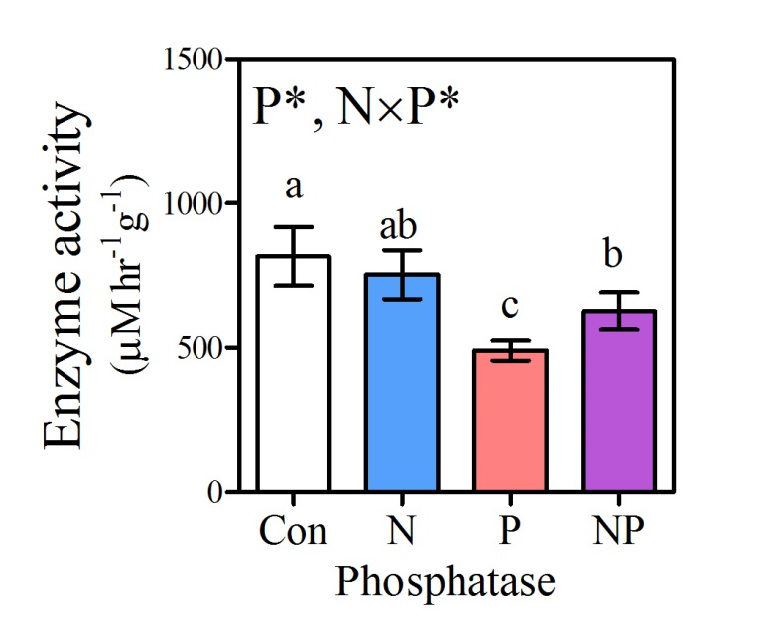
Results
Notes:
This is an example of what we found (actually 2017 data): P increased N-acquiring enzyme activity, decreased P-acquiring enzyme activity; N increased C-acquiring enzyme activity.

Slide 10
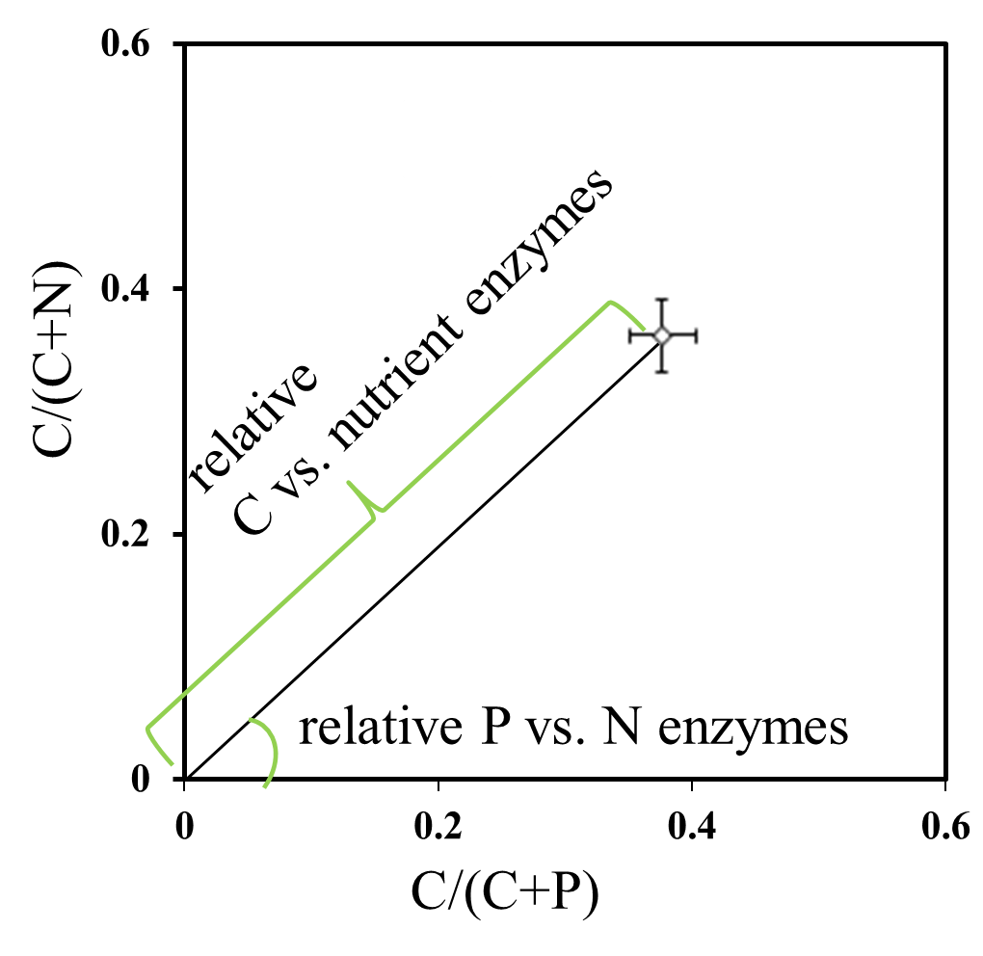
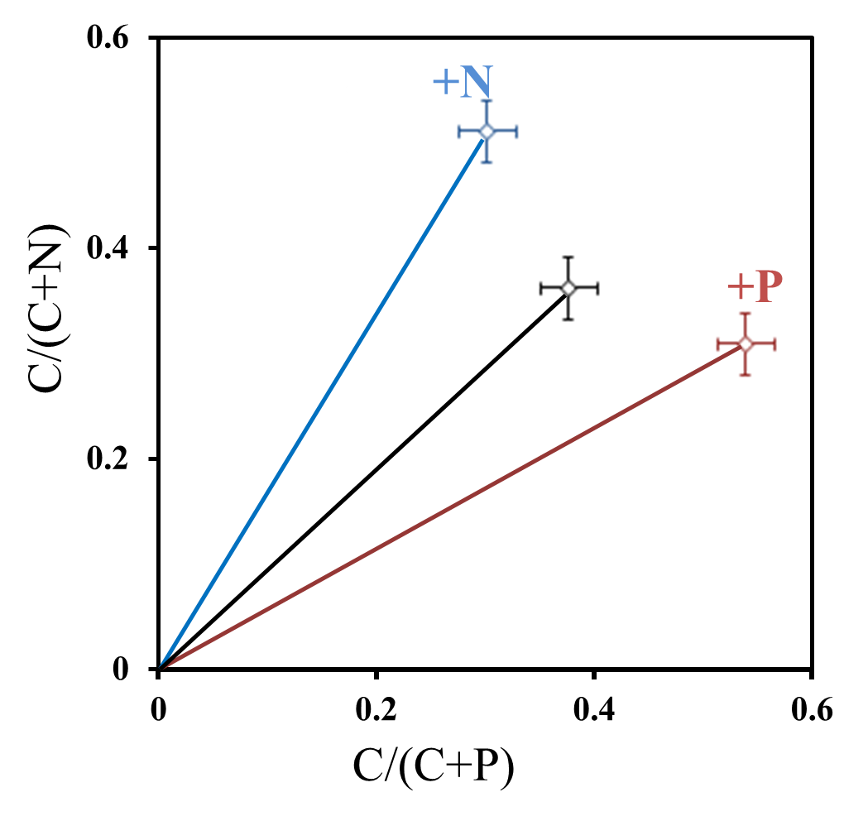
Prediction
Notes:
A better way to show the relative allocation on N, P and C acquiring enzymes is a vector analysis approach. The proportional activity of C vs. N acquiring enzymes (BG/[BG þ NAG þ LAP]) was plotted against C vs. P acquiring enzymes (BG/[BG þ AP]).We then calculated the length and angle of the vector created by connecting a line between the plot origin and point represented by these proportions; the length quantifies relative allocation effort on C vs. nutrient enzymes and the angle quantifies the relative allocation on P vs. N enzymes.
According to the hypothesis, elevated N would cause allocation shift away from N-acquiring enzymes, elevated P..

Slide 11
Con
N
P
NP
P limitation is suggested by vector angles.
N limitation of organic horizon C breakdown is suggested by vector length.
Notes:
(This is 2017 data)
Vector angle (P vs N limitation) decreased with elevated P addition, did not change with elevated N. Vector length (C vs nutrient limitation) increased to elevated N.
However, result shows, in soil organic horizons, elevated P caused allocation shift away from P-acquiring towards N-acquiring enzymes. The angle decreased comparing P to Control and NP to N.
N addition did not cause similar responses. Instead, N addition caused allocation shift from nutrient to C-acquiring enzymes. The vector length increased comparing N to Control and NP to P.

Slide 12
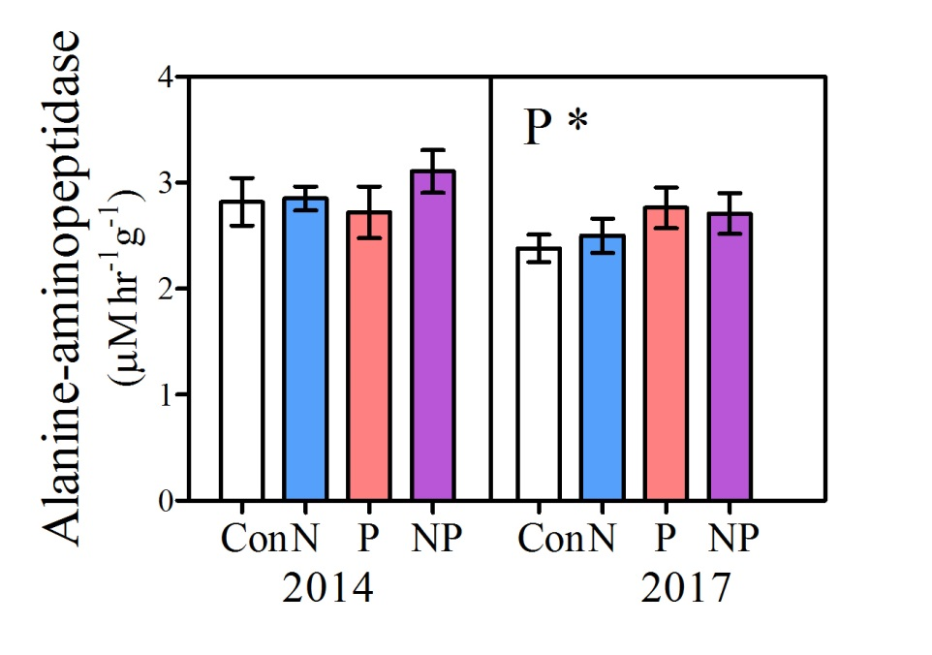
P effect on N-acquiring enzymes developed over time
P-enzyme ↓
N-enzyme −
P-enzyme ↓
N-enzyme ↑

Slide 13
Conclusions
Shan Shan
shans@miamioh.edu
P limitation is suggested by shift from P- to N- acquiring enzymes in response to elevated P.
N limitation of C use is suggested by shift to C-acquiring enzymes in response to elevated N.
Delayed response of N-acquiring enzymes to P addition suggests development of colimitation overtime.

Slide 14






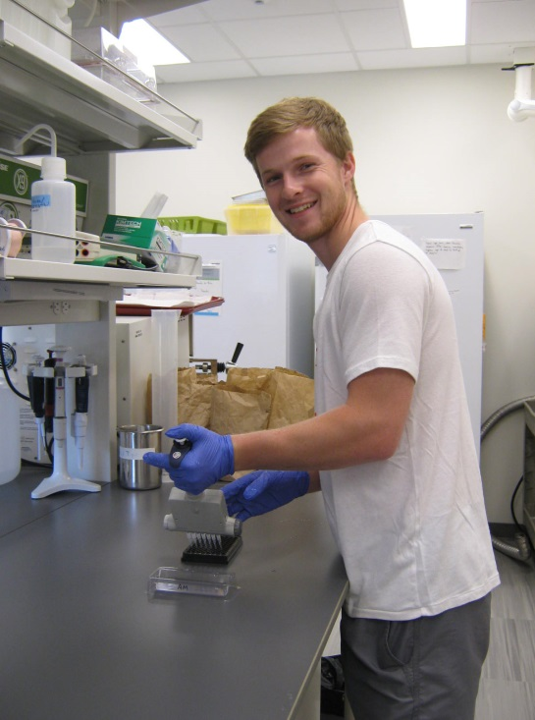
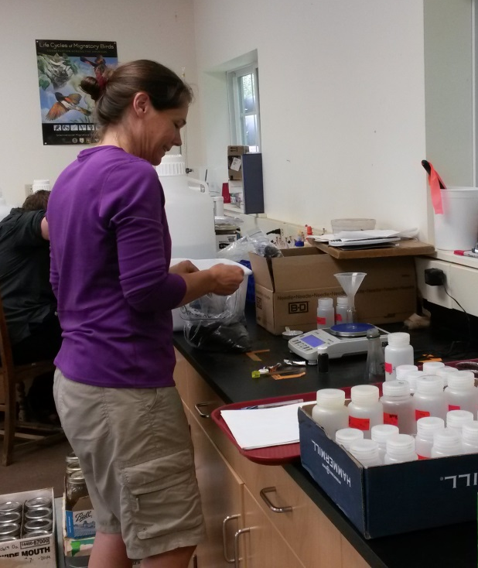

Melany Fisk
Ruth Yanai
Tim Fahey

