Slide 1
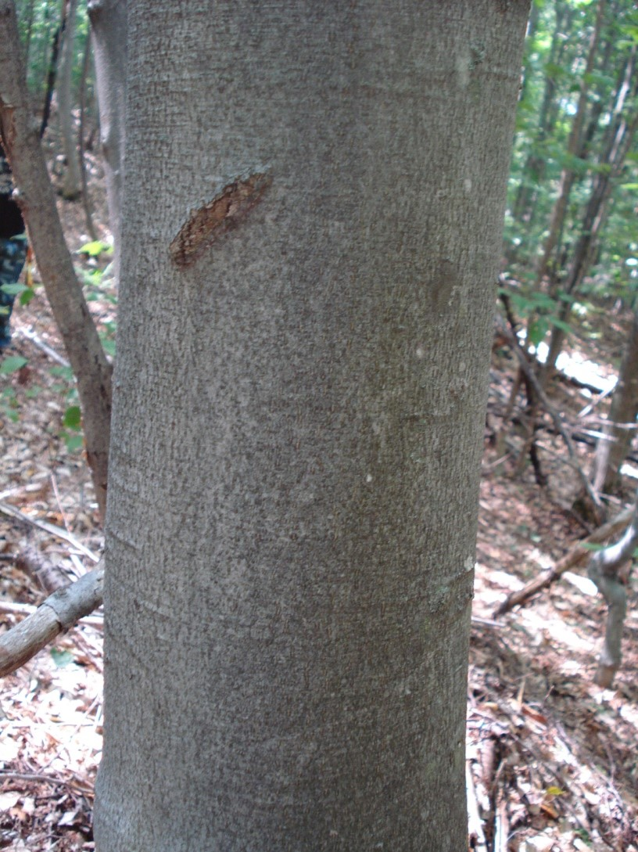
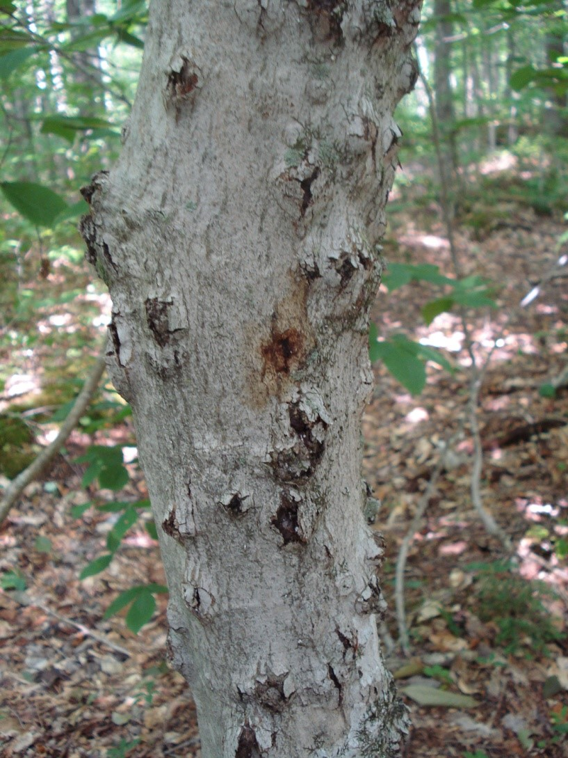
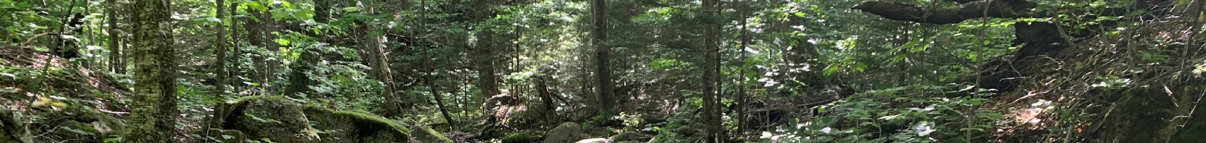
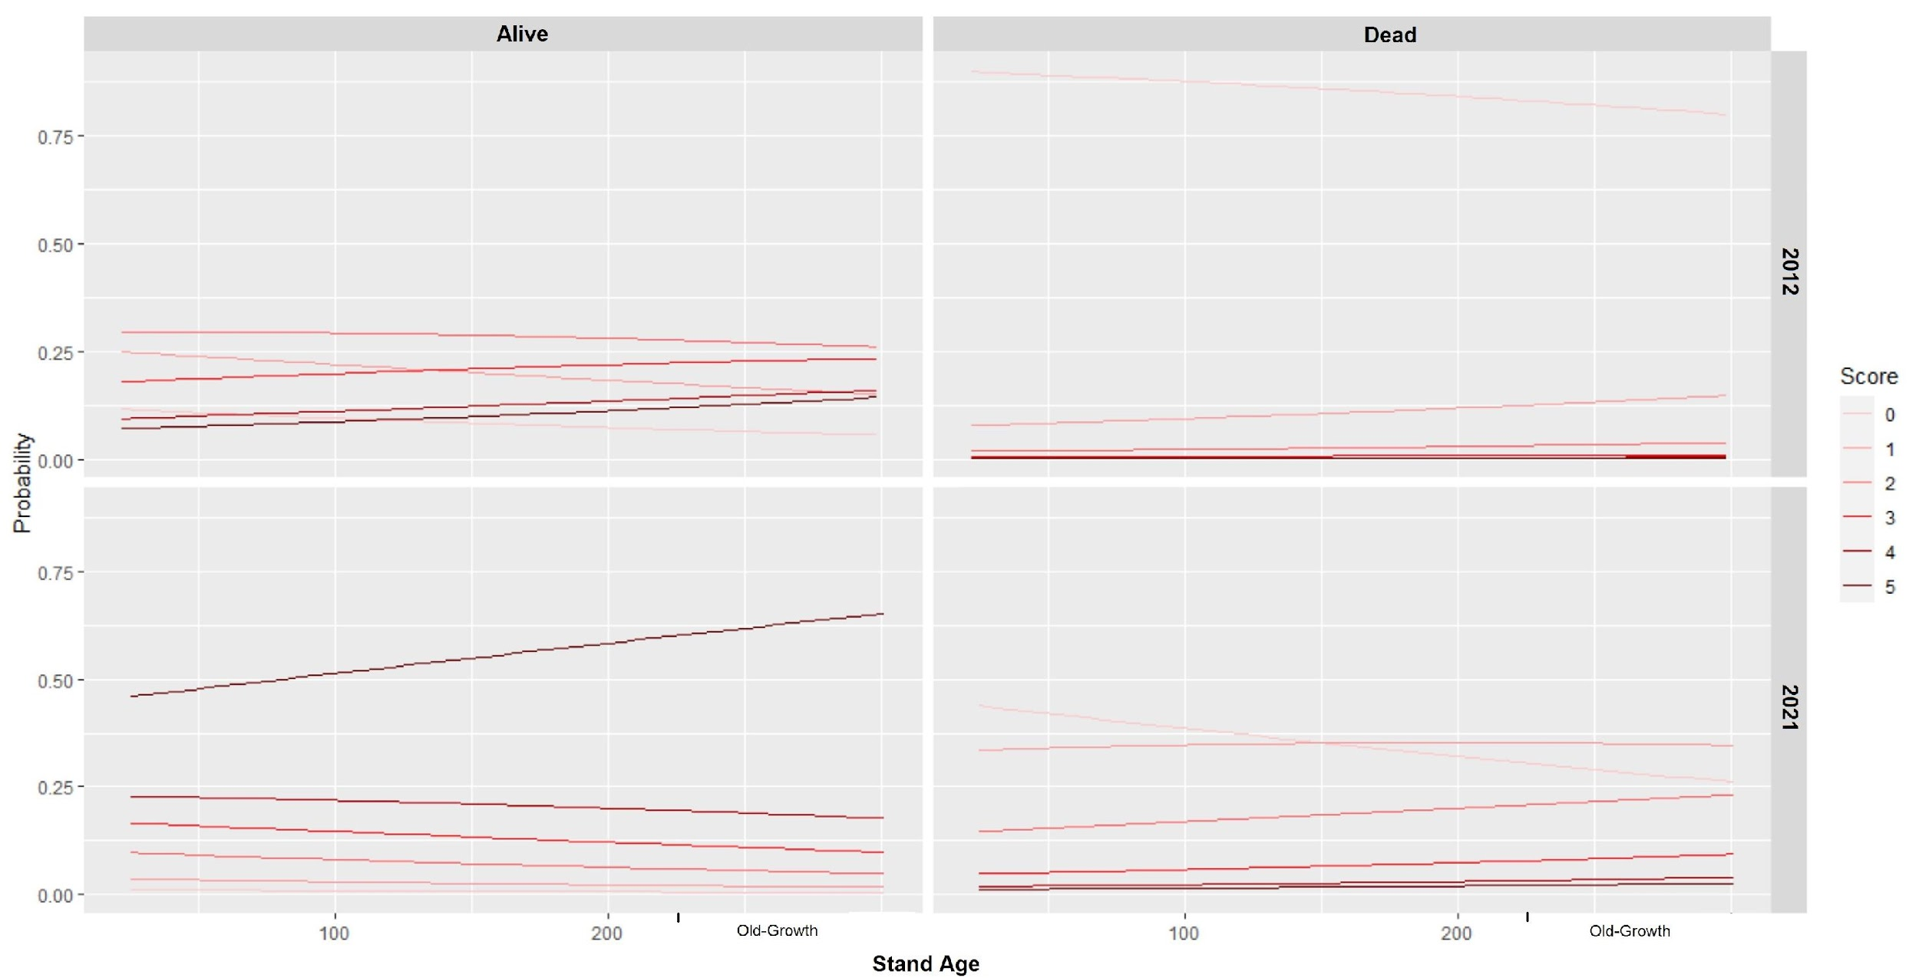
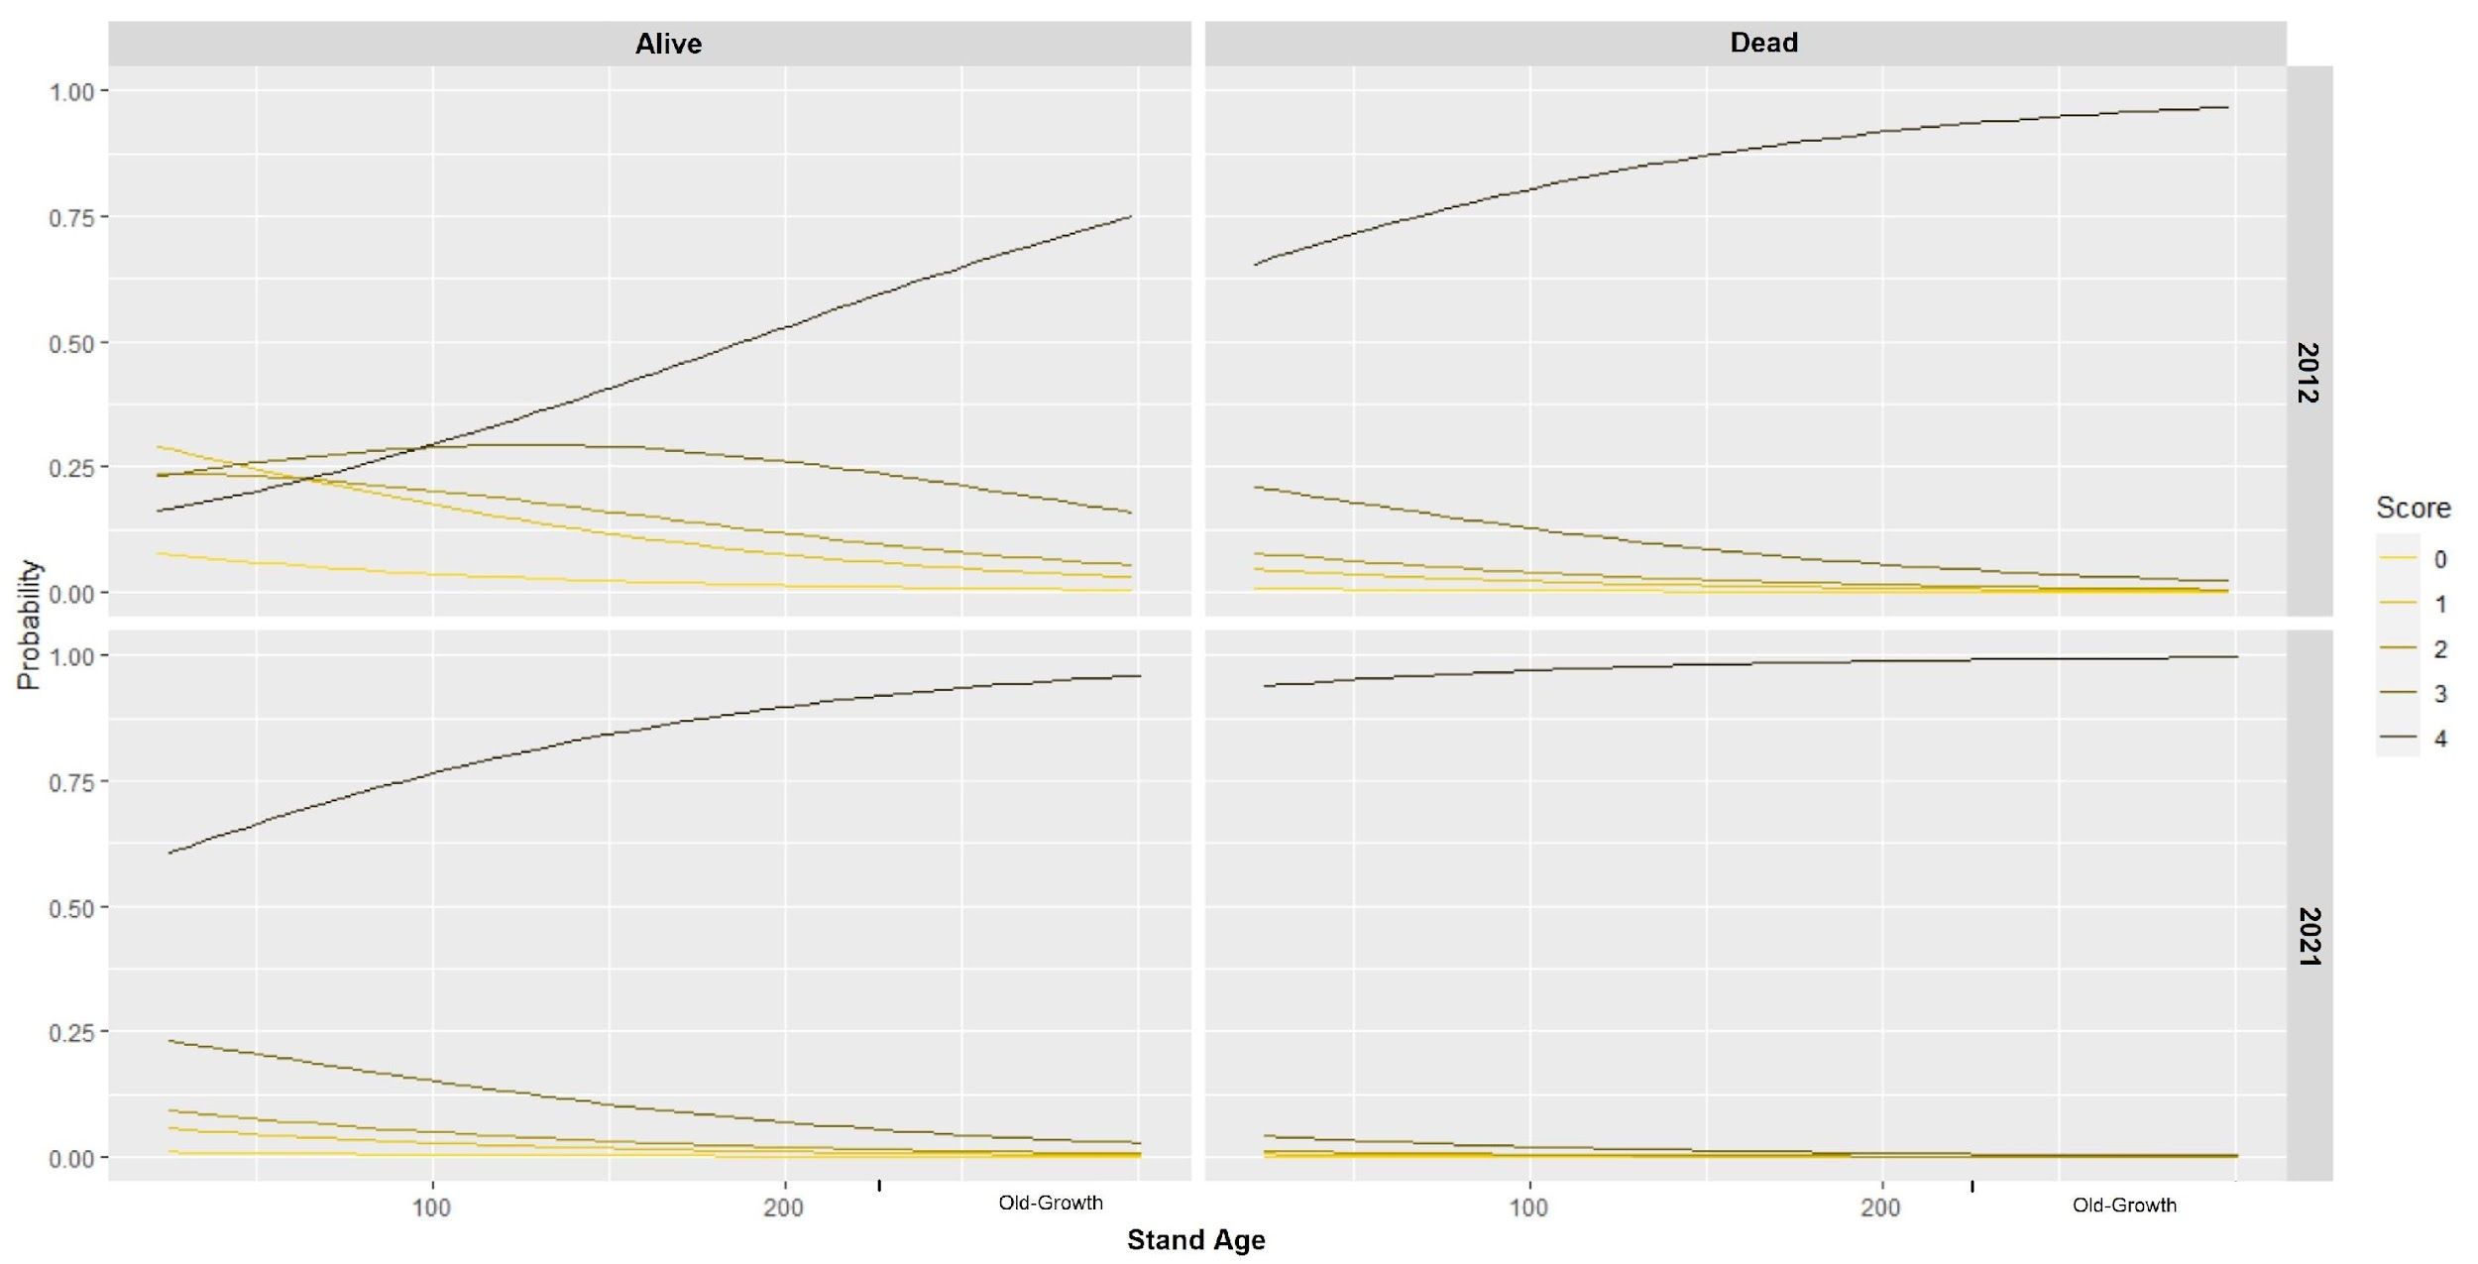
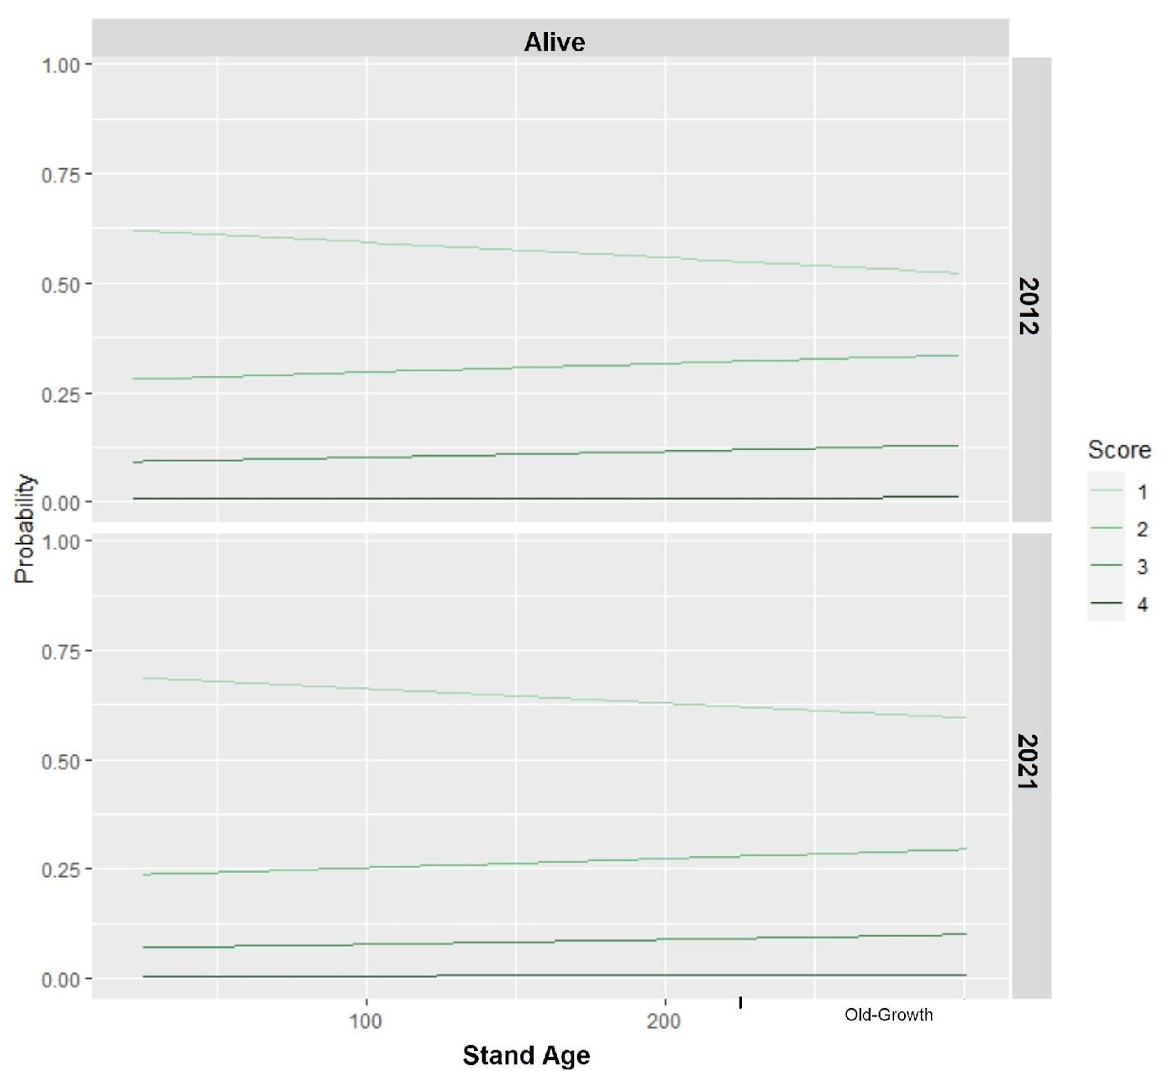
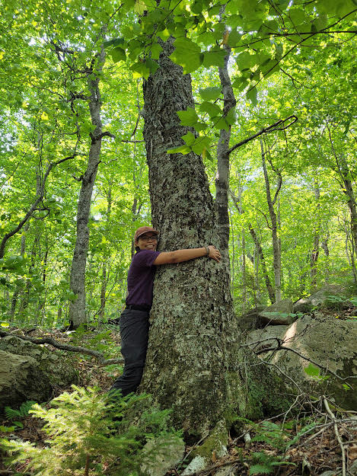
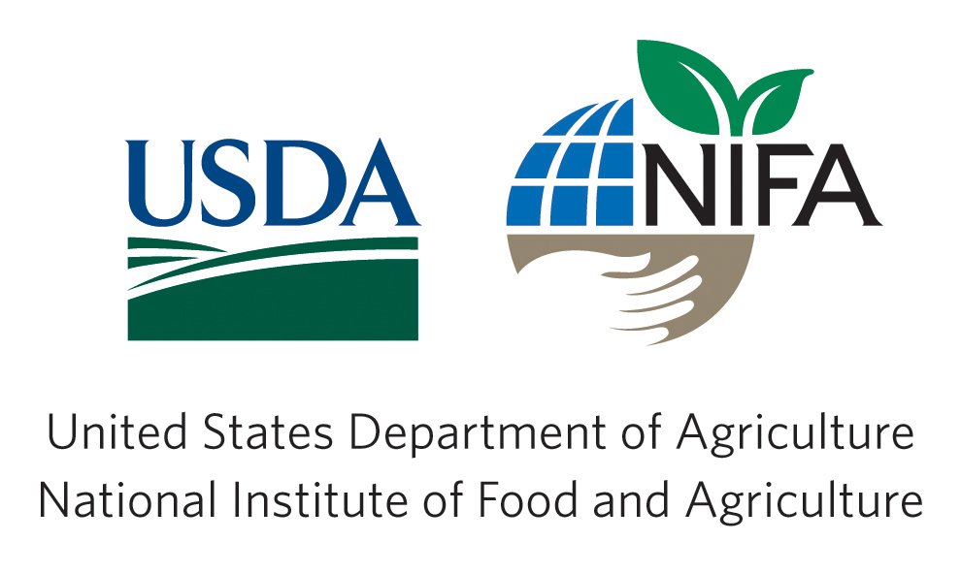
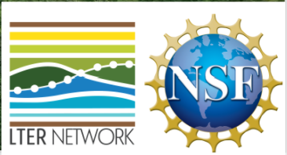

Beech Bark Disease is Still Getting Worse!
Repeated Measures of a Chronosequence in New Hampshire
Erin A. Cornell¹, Adam Wild¹, Ruth D. Yanai¹
¹SUNY College of Environmental Science & Forestry, Syracuse NY
What is beech bark disease?
Beech bark disease is a canker and decline disease that affects Fagus grandifolia (American beech) in northern hardwood forests.
Insect-fungal pathogen: Cryptococcus fagisuga (scale insect) and Neonectria sp.
The spread of other diseases afflicting American beech, like beech leaf disease, increase the importance of research that improves our understanding of how beech bark disease progresses in the forest.
Results
Wax Secretion Cover
Live trees have more wax secretion cover in older stands
p < 0.001
In live trees, high wax secretion cover increases with stand age
p = 0.002
In dead trees, low wax secretion cover increases with stands age
p = 0.002
Wax secretion cover was greater in 2021 across all stands than in 2012
p < 0.001
The Chronosequence
14 northern hardwood stands that vary in age sampled in 2012 and 2021 plus 2 old-growth stands sampled in 2021 in White Mountain National Forest, NH
5 transects within each stand; trees ≥ 10 cm DBH sampled
Disease severity variables evaluated:
  Wax secretions produced by the scale insect
  Cankers from the Neonectria fungus
  Loss of tree canopy
Neonectria Canker Cover
In both live and dead trees, Neonectria canker cover increases as stands age
p = 0.001
Dead trees have more canker cover than live trees as stands age
p < 0.001
Neonectria cover was greater in 2021 across all stands than in 2012
p < 0.001
Canopy Loss
Trees lost more of their canopy between 2012 and 2021
p = 0.024
Canopy loss had no relationship with stand age
p = 0.997
*Grids displaying dead trees were not included because the canopy loss scoring system accounts for dead trees (Score 4)
Main Questions
Does disease severity increase with stand age?
Did disease severity increase from 2012 to 2021?
Do dead trees exhibit more severe symptoms than live trees?
Conclusion
Beech bark disease severity was worse in 2021 than 9 years earlier, for wax cover, canker cover, and canopy loss.
Acknowledgements
USDA NIFA
NSF LTER Network
SUNY ESF Honors Program
MELNHE Lab Crew & Dr. Jonathan Cale

