Slide 1

A Century of ESF Chemistry

Slide 2
The Early Years

Slide 3
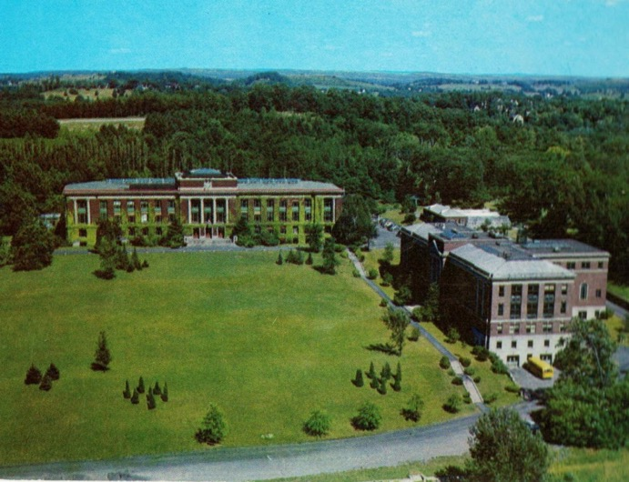
Bray Hall – the first home of FCH
1954

Slide 4
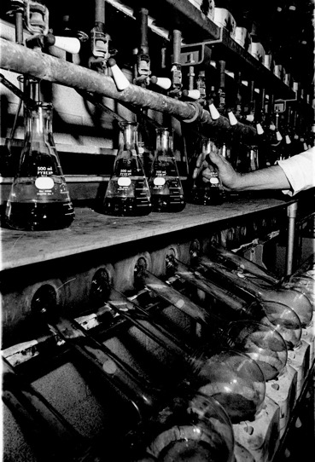
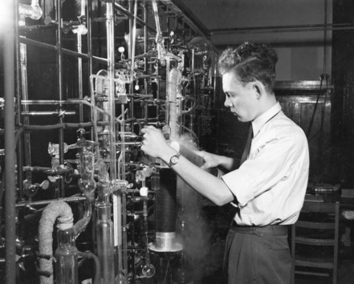
Science in the basement of Bray Hall

Slide 5
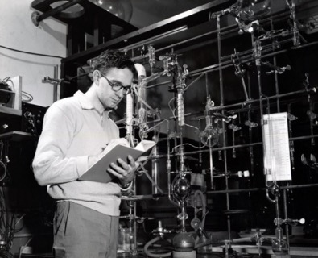
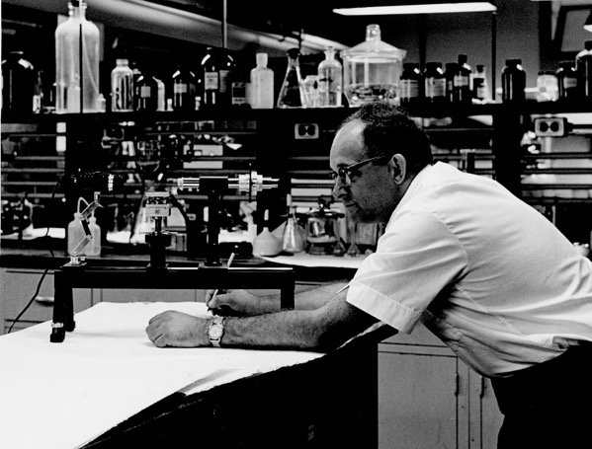
Science in the Basement of Bray Hall

Slide 6
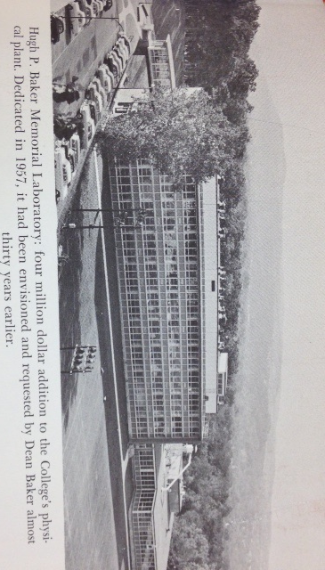
Baker Laboratory – FCH New Home
1957

Slide 7
The Baker Years

Slide 8
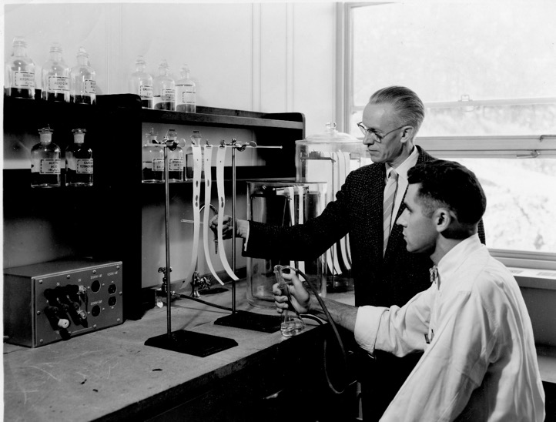
TLC in the 50’s
Edwin C. Jahn & graduate student

Slide 9
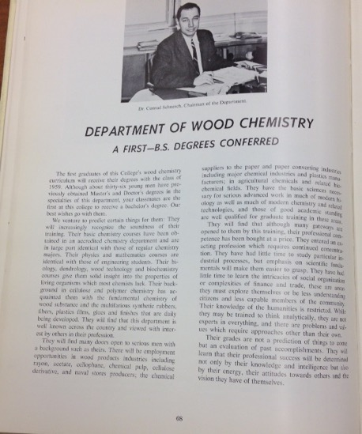
Proudly announcing the first B.S. in wood chemistry
Connie Schuerch in State Forester, 1959

Slide 10
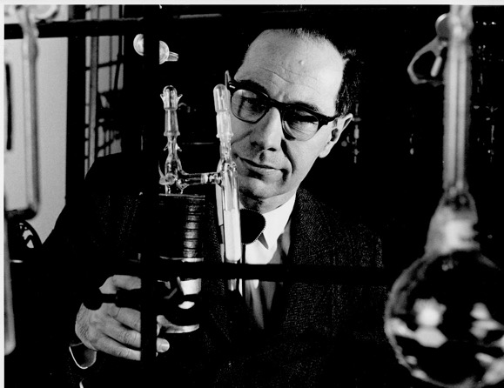
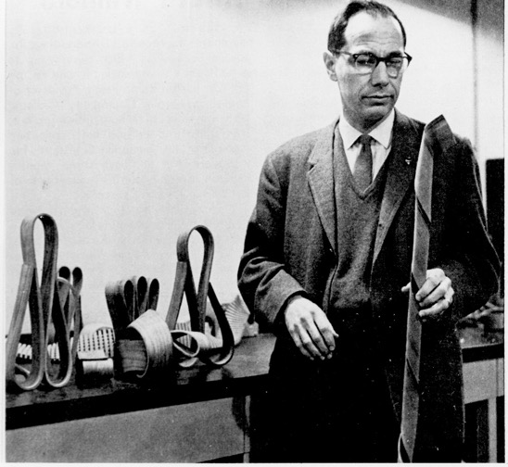
Connie Schuerch, a pioneer in carbohydrate research
… and wood twisting

Slide 11
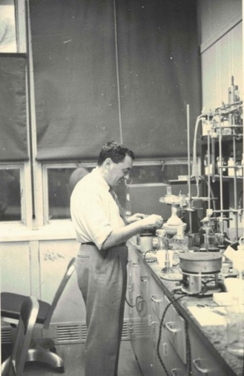
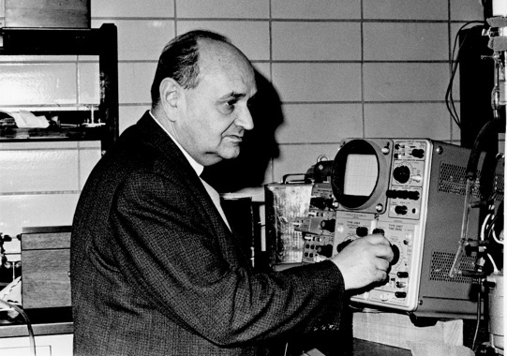
Professors like to play in the lab when nobody is around
Ernest Sondheimer
Michael Szwarc

Slide 12
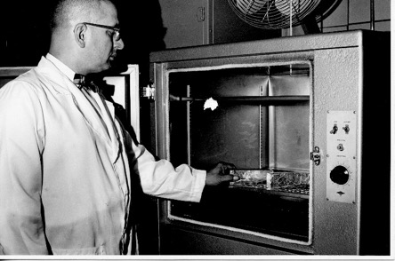
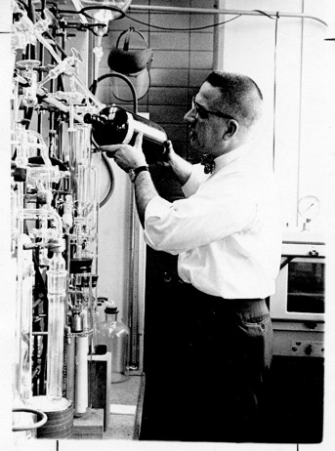
Chemistry in the 60’s: no gloves, no goggles, but bow ties and white shirts
John Meyer

Slide 13
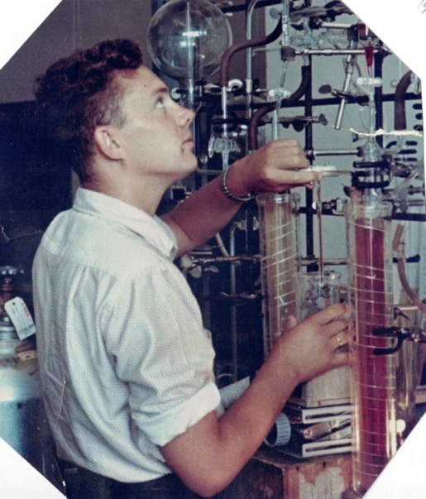
How fast can styrene polymerize?
Han Smid in action, 1960

Slide 14
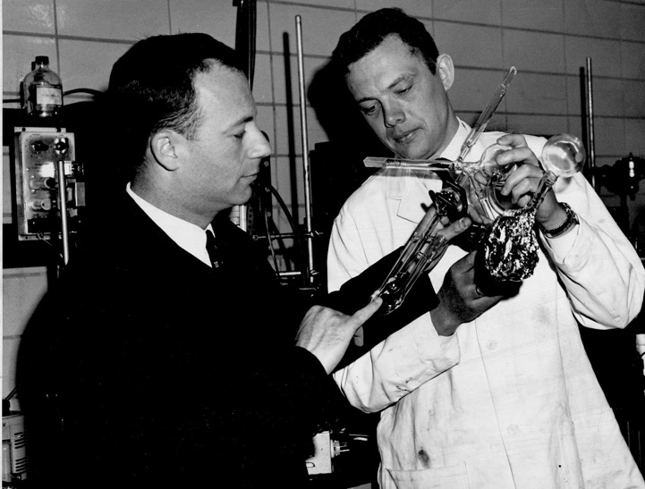
You can touch it only once!
Han Smid shows Prof. Nikolay A. Plate (Vice President of RAS) a “living” polymer

Slide 15
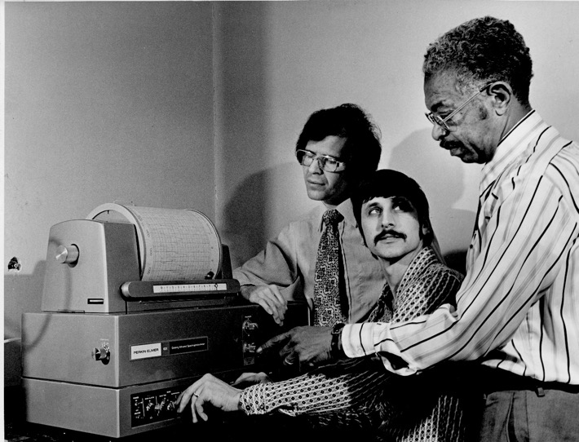
Not this knob, the other knob…
Paul Caluwe, Tom Majewicz & David Wilkins

Slide 16
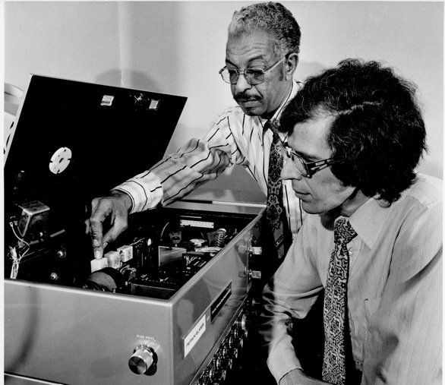
How to teach an organic chemistry professor simple electronics? Use your fingers.
Dave Wilkins & Paul Caluwe

Slide 17
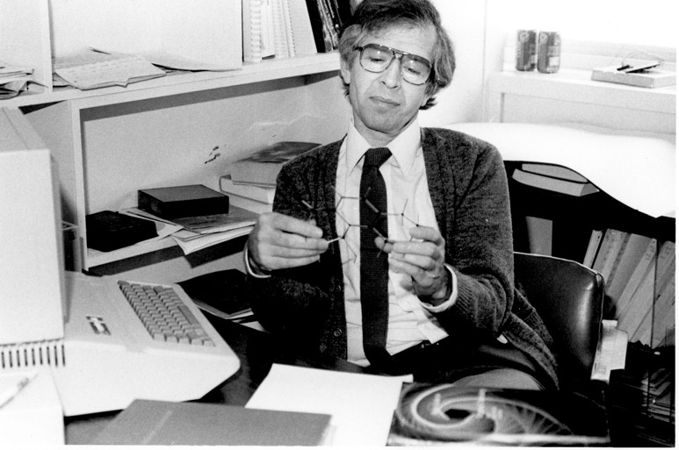
Molecular models bring much more comfort
Typewriter/Computer(?) and Paul Caluwe

Slide 18
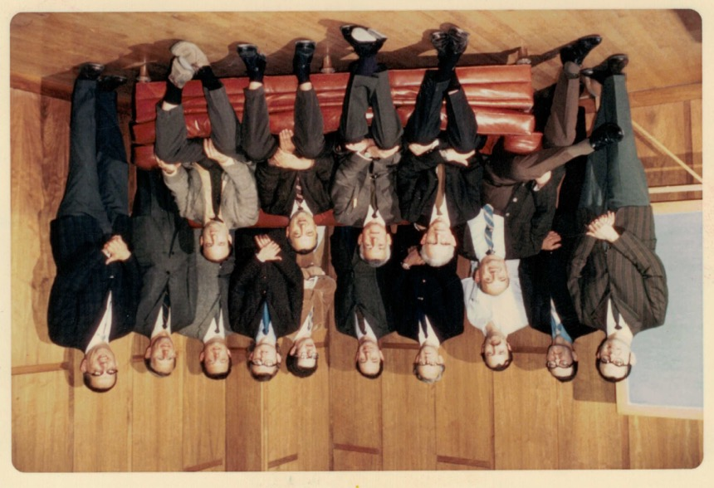
The distinguished FCH faculty
May, 1971

Slide 19
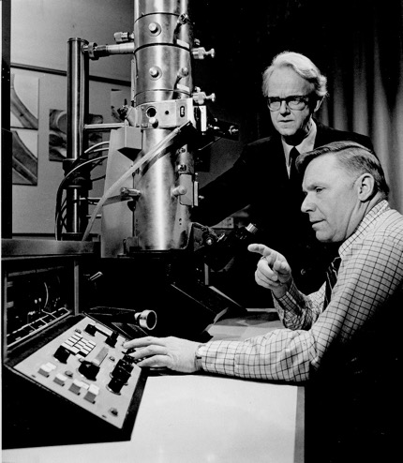
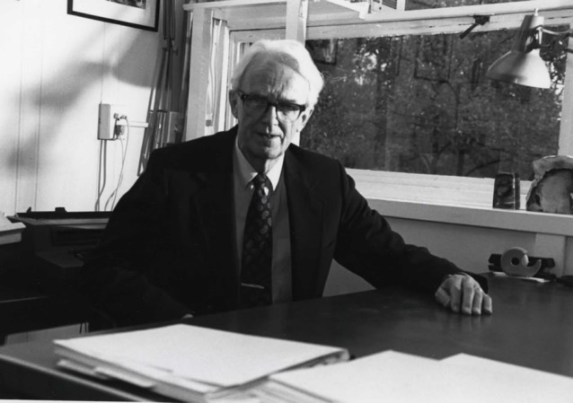
The world authority in wood chemistry
Torre Timel

Slide 20
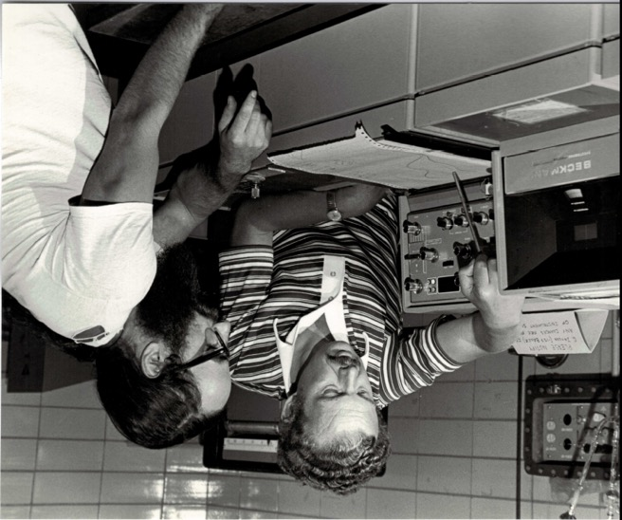
Where is the “naked” ion here
Han Smid and Roger Sinta

Slide 21
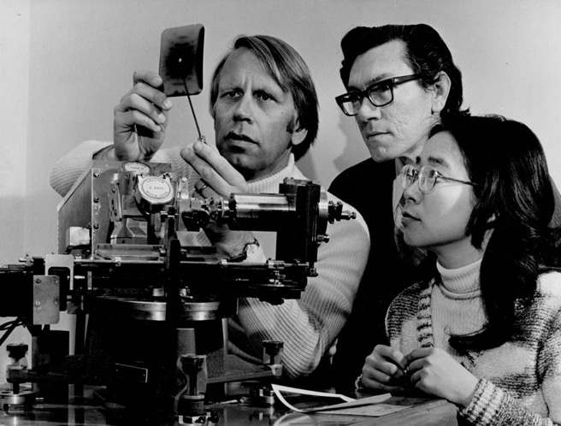
Ken, do you see any crystalline reflexes?
Tony Sarko, Ken Smith & Vivian Suan

Slide 22
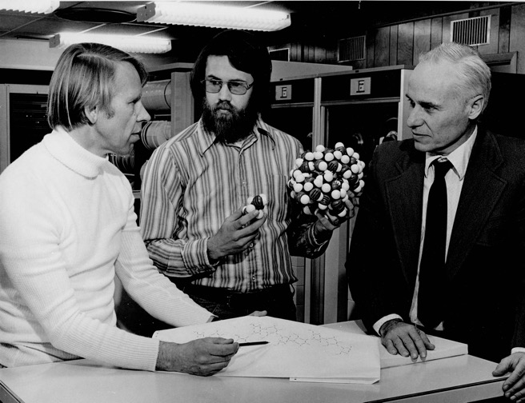
Prof, there is no space to stick this in
Tony Sarko, Terry Blum & Charles Lee

Slide 23
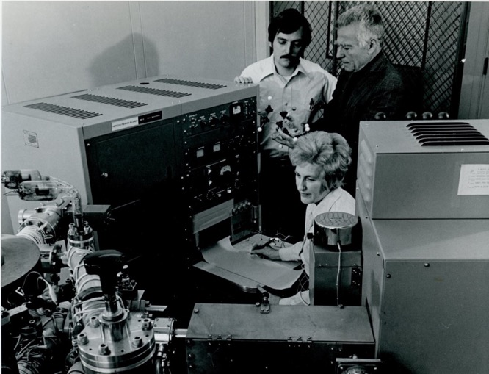
Complex machinery yields simple molecules
Glen Pearce, Milt Silverstein & Hazel Jenison

Slide 24
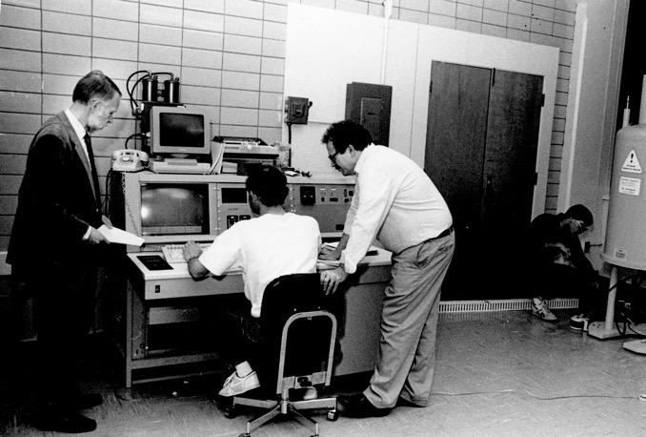
FCH new toy – a Bruker 300 MHz NMR
Tony Sarko, Daryle Fish & Bill Winter, 1990

Slide 25
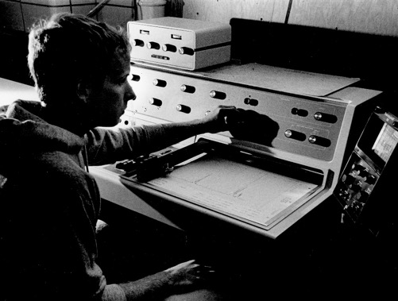
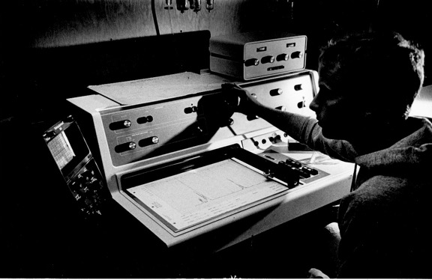
Regardless of the viewing angle the NMR spectrum looks the same

Slide 26
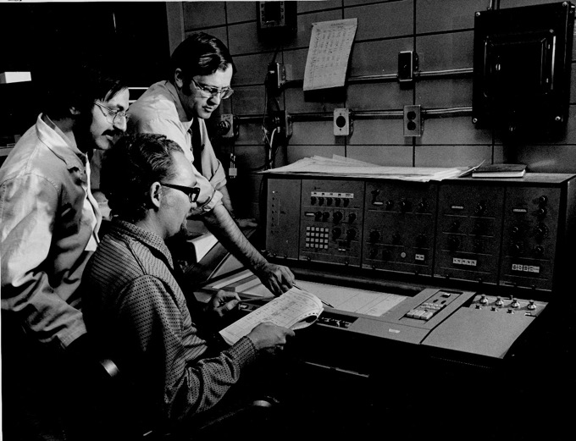
I want to see a triplet right here
Tom Donvito, Larry McCandless & Bob LaLonde

Slide 27
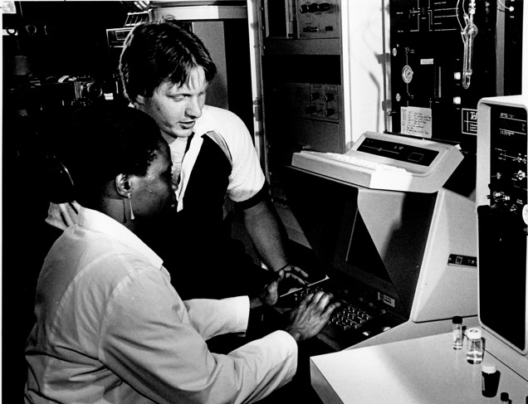
This is simple, press this key …
Dave Kiemle helps a student

Slide 28
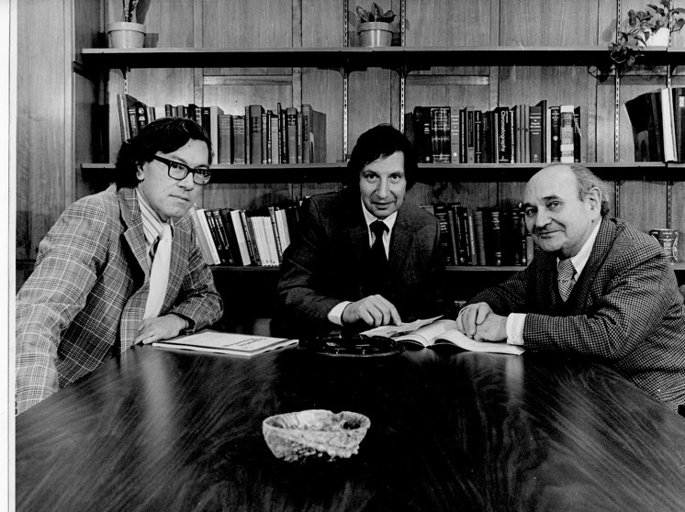
The powerful triumvirate
Ken Smith, Stu Tanenbaum & Michael Szwarc

Slide 29
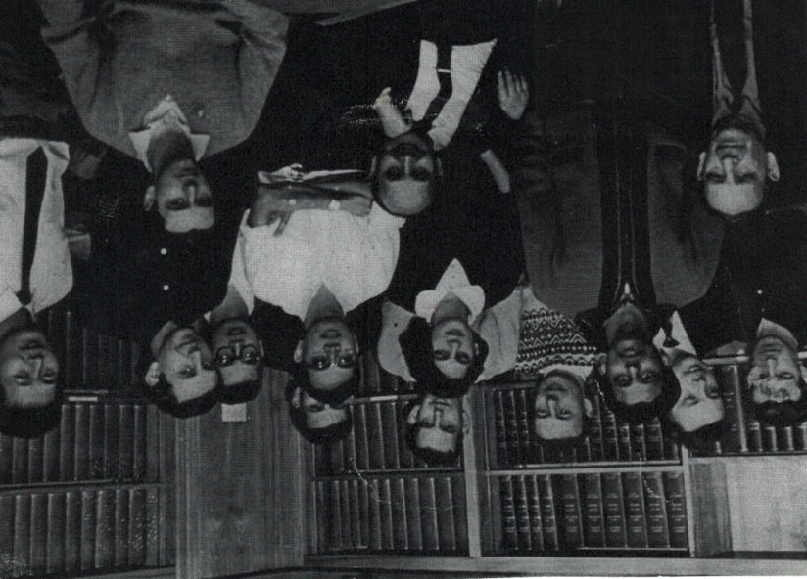
Szwarc group in the 60’s

Slide 30
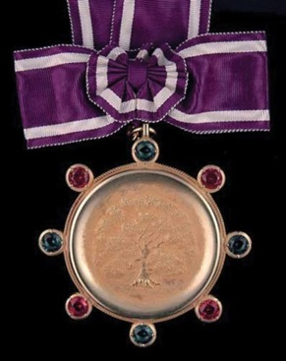
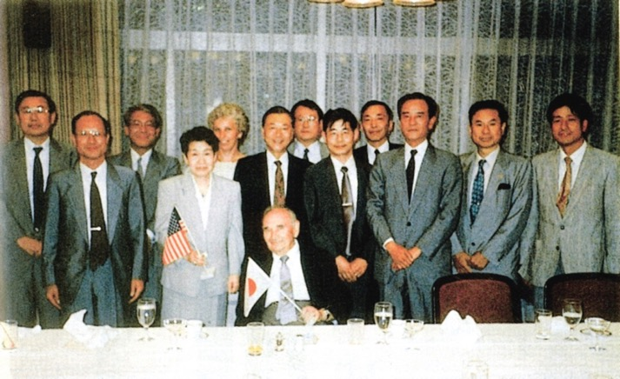
Michael Szwarc receives the Kyoto Prize from Inamori Foundation
The Kyoto Star
On exhibit in Bray Rotunda
The official reception by Kyoto Mayor

Slide 31
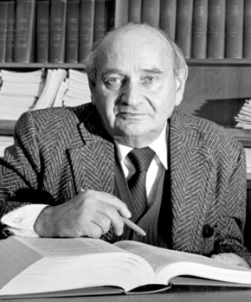
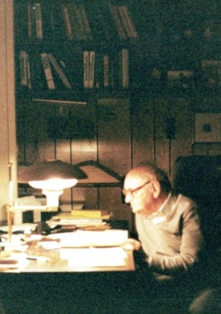
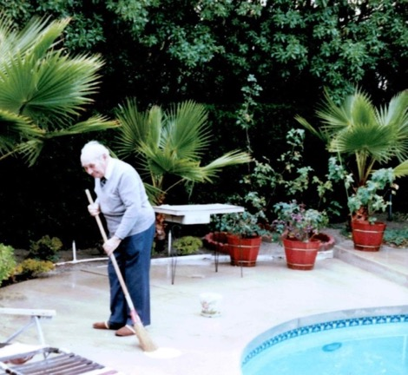
Michael Szwarc: Work gives you a sense of life
Syracuse, 1980
California, 1999

Slide 32
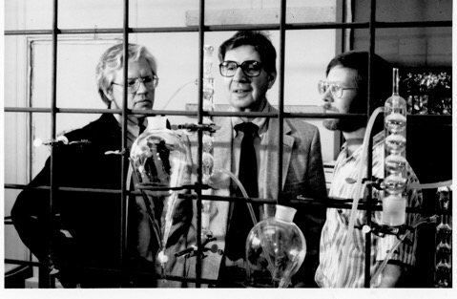
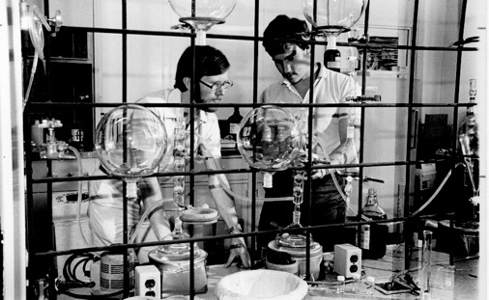
Senior faculty shows junior colleagues a reflux condenser
And the junior colleague shows it further
Jim Nakas, Stu Tanenbaum, John Hassett
John Hassett & student

Slide 33
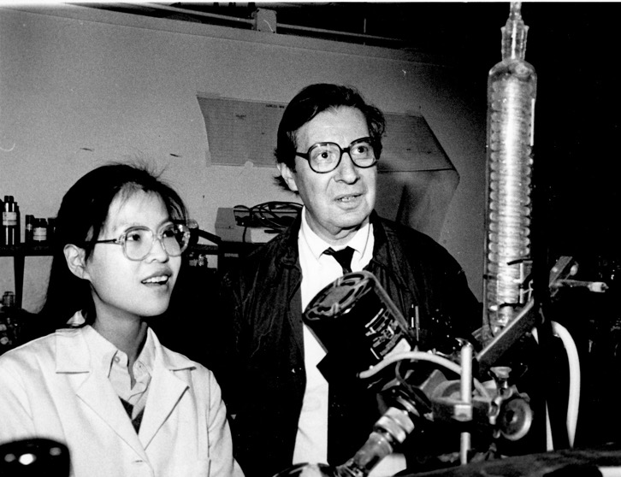
Always excited about science
Stu Tanenbaum & student

Slide 34
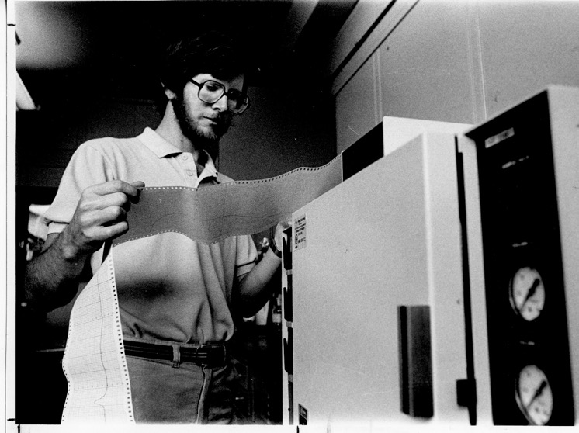
There are no peaks in my chromatogram!
John Hassett and a GC

Slide 35
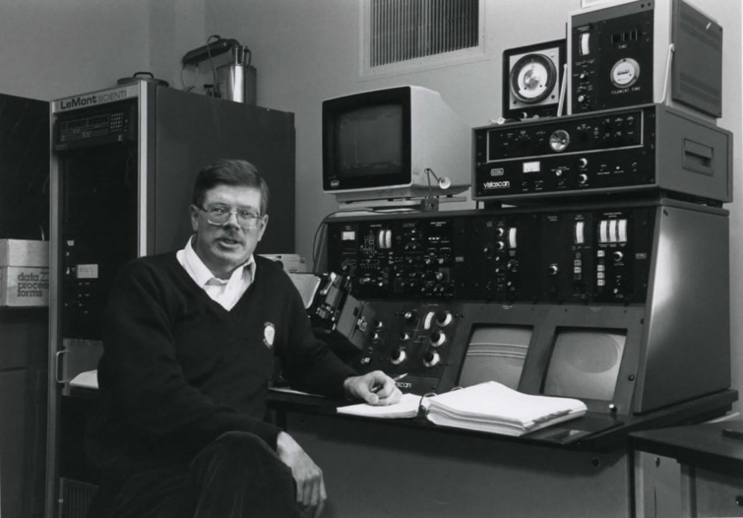
Imagine, there was time without Google, laptops and even smart phones
Dave Johnson, an instrument and a tick manual

Slide 36

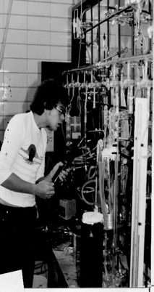
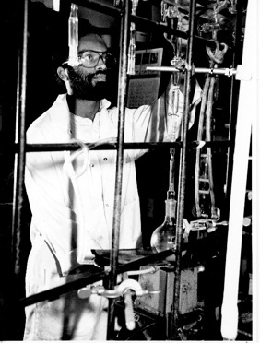
FCH high vacuum techniques developed in Bray, practiced in Baker and…
Han Smid, 1950
???
Gotham Chatterjee, 1992

Slide 37
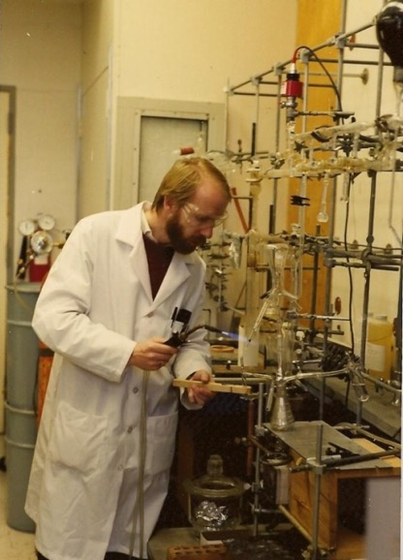
…and shamelessly copied elsewhere
Ivan Gitsov, Cornell, 1994

Slide 38
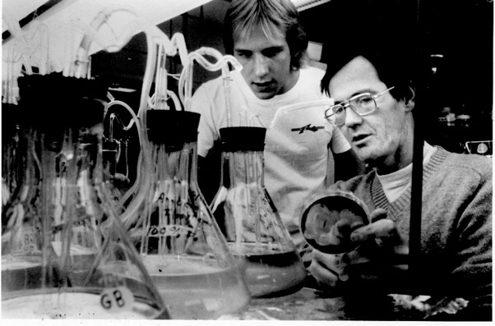
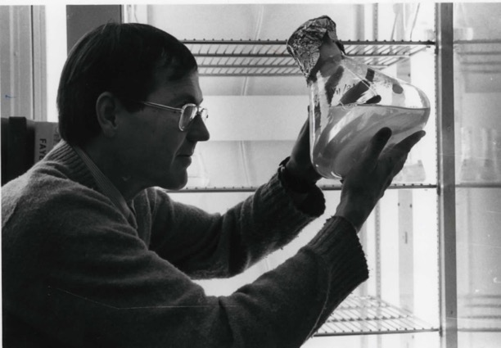
Biochemists like Erlenmeyer flasks
Greg Boyer & student

Slide 39
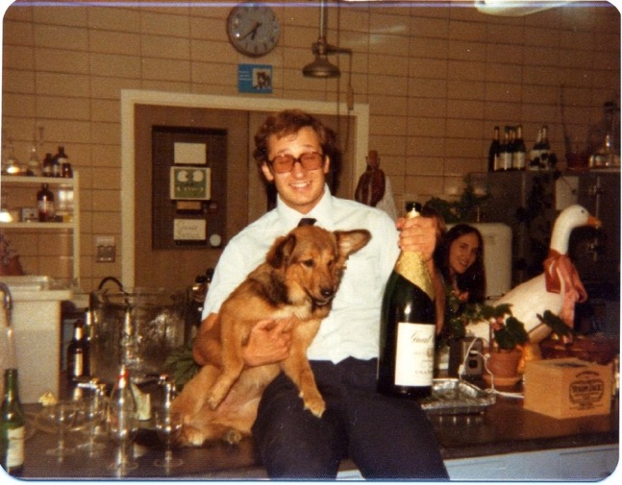
Baker basement – a place of exciting experiments
Art Stipanovic hugging his lab assistant

Slide 40
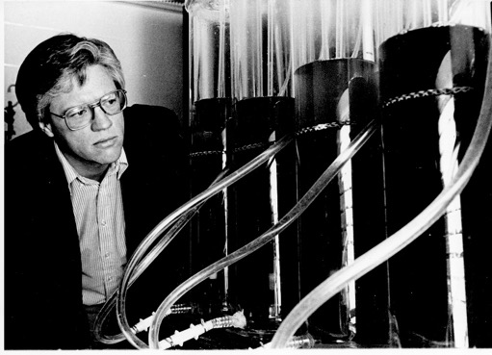

Something is brewing here
Jim Nakas and …
first attempts towards
artificial life

Slide 41

Where is Sigourney Weaver?
Jim Nakas with the Alien brewing tank

Slide 42


No, this is not a paper towel roll!
Israel Cabasso with one of his new membranes, 1981

Slide 43

A new type of FCH researcher – oceanographic chemist
Dave Kieber just joining ESF

Slide 44

Jahn Laboratory – FCH recent home
1997

Slide 45

The official opening of Jahn Laboratory
Ed Jahn surrounded by non-chemistry people

Slide 46
The Jahn Years

Slide 47

This is not my start-up package, but they let me get a picture in front of it
Ivan Gitsov and the multi-detector SEC line, 1997

Slide 48

Always use goggles when working with hazardous instruments
Neal Abrams & student

Slide 49

And always use gloves when working with computers
Students & Neal Abrams

Slide 50

FCH in Antarctica
Dave Kieber and his group, 2005

Slide 51

FCH in Antarctica
Some stay warm – Jordan & John, 2005

Slide 52

FCH in Antarctica
Dave Kieber with some natives, 2005

Slide 53

FCH in warmer environment
Dave Kieber funneling the clouds, 2006

Slide 54



FCH and the romantic of the sea
Yuting is ready to deploy the CTD

Slide 55


More aqueous adventures
Mark Teece in deep and shallow waters

Slide 56


More aqueous adventures
John Hassett with PISCES (this is a device, not a Zodiak sign)

Slide 57


Pheromone Stories
Fran Webster
and
his victims

Slide 58


Students can try as hard as they can, but only a professor can pull a rabbit when needed
Deep Bhattacharya, Maren Grunert &
Corky Mittelstaedt
Jose Jiner

Slide 59



FCH in the news

Slide 60

FCH chemists in a friendly dispute
Israel Cabasso, Paul Caluwe & Ron Eby, 2008

Slide 61

Remember when I did that?
Ron Eby & Bill Winter

Slide 62

Robert Lenz – pioneer of microbial polyesters
Bob Lenz at ESF, 2009

Slide 63

Robert Lenz – pioneer of microbial polyesters

Slide 64

Two great alums
Han Smid, ‘57 Ph.D. and Bob Lenz, ‘56 Ph.D.

Slide 65

Ivan: I can make “living” polymers with enzymes Bob: I don’t think so Terry: I pass
Ivan Gitsov, Terry Blum, Bob Lenz

Slide 66

Perusing the percolation probability
Avik Chatterjee, 2010

Slide 67


Biochemists still like Erlenmeyer flasks
Chris Nomura, 2012

Slide 68

This is what genetic engineering can do to you
Chris Nomura & his group

Slide 69

And a biochemist without Erlenmeyer
Greg Boyer & a lot of water

Slide 70

FCH students hard at work

Slide 71



FCH Teaching Labs and the force behind them
Joy Logan

Slide 72

AFM made simple
Ivan Gitsov, Bao Zhang & linear-dendritic supermolecule

Slide 73

The dendrimer makers
I.G., Eoghan Connors, Dieter Scheibel & Xin Liu

Slide 74


Cellulose nanocrystals on demand
Yae Takahashi
&
Jake Goodrich

Slide 75

Lasers are cool
Ted Dibble & Karen Schmidt

Slide 76

The atmospheric computational team
Ted Dibble & his group

Slide 77

The distinguished FCH faculty
May, 2014

Slide 78

An end of an era in ESF organic chemistry
Paul Caluwe last class lecture

Slide 79

An end of an era in ESF organic chemistry
Paul Caluwe last class lecture

Slide 80


FCH in China
R. Talbot (U. Houston), Yan Wang (Shandong U.)
Huiting Mao (SUNY ESF) and their team, 2015
Mt. Tai in East Central China

Slide 81

The mercury tracers
Huiting Mao and her group, 2017

Slide 82

The newest FCH research
Jaime Mirowsky is somewhere here

Slide 83

FCH at the New York State Fair

Slide 84

FCH at the New York State Fair

Slide 85

FCH at the New York State Fair
FCH alum Roger Sinta shows up

Slide 86

FCH at the New York State Fair

Slide 87

FCH at the New York State Fair

Slide 88

FCH at the New York State Fair

Slide 89

FCH at the New York State Fair

Slide 90

FCH at the New York State Fair

Slide 91

FCH at the New York State Fair

Slide 92

FCH at the New York State Fair

Slide 93

FCH at the New York State Fair

Slide 94

FCH at the New York State Fair

Slide 95

FCH at the New York State Fair

Slide 96

FCH at the New York State Fair

Slide 97

FCH at the New York State Fair

Slide 98

FCH at the New York State Fair
Genetically engineered chicken? No, simple stain chemistry

Slide 99

FCH at the New York State Fair

Slide 100

FCH at the New York State Fair

Slide 101

FCH at the New York State Fair

Slide 102

FCH at the New York State Fair

Slide 103

FCH at the New York State Fair

Slide 104

FCH at the New York State Fair

Slide 105

FCH at the New York State Fair

Slide 106

FCH at the New York State Fair

Slide 107

FCH at the New York State Fair

Slide 108

FCH Outside the lab

Slide 109

FCH Outside the lab

Slide 110

FCH Outside the lab

Slide 111

FCH Outside the lab

Slide 112

FCH Outside the lab

Slide 113

FCH Outside the lab

Slide 114

FCH Outside the lab

Slide 115

FCH Outside the lab

Slide 116

FCH Outside the lab

Slide 117

FCH Outside the lab

Slide 118

FCH Outside the lab

Slide 119

FCH Outside the lab

Slide 120

FCH Outside the lab

Slide 121

FCH Outside the lab

Slide 122

FCH Outside the lab

Slide 123

FCH Outside the lab

Slide 124

FCH Outside the lab

Slide 125

FCH Outside the lab

Slide 126


FCH Outside the lab

Slide 127

FCH Outside the lab

Slide 128

FCH Outside the lab

Slide 129

FCH Outside the lab

Slide 130

FCH Outside the lab

Slide 131

FCH Outside the lab

Slide 132

FCH Outside the lab

Slide 133

FCH Outside the lab

Slide 134

FCH Outside the lab

Slide 135

FCH Outside the lab

Slide 136

FCH can be formal

Slide 137

FCH can be formal

Slide 138

FCH can be formal

Slide 139

…and dancing

Slide 140

FCH can be formal

Slide 141

FCH Farewell Parties

Slide 142

FCH Farewell Parties

Slide 143

FCH Farewell Parties

Slide 144

FCH Farewell Parties

Slide 145


FCH Farewell Parties

Slide 146

FCH Farewell Parties

Slide 147

FCH Farewell Parties

Slide 148

FCH Farewell Parties

Slide 149

FCH Farewell Parties

Slide 150

FCH Farewell Parties

Slide 151

FCH Farewell Parties

Slide 152

FCH Farewell Parties

Slide 153

FCH Farewell Parties

Slide 154

FCH Farewell Parties

Slide 155

FCH Farewell Parties

Slide 156

FCH Farewell Parties

Slide 157

FCH Farewell Parties

Slide 158

FCH Farewell Parties

Slide 159

FCH Farewell Parties

Slide 160


FCH Farewell Parties

Slide 161

FCH Farewell Parties

Slide 162

FCH Farewell Parties

Slide 163

FCH Farewell Parties

Slide 164

FCH Farewell Parties

Slide 165

FCH Farewell Parties

Slide 166

FCH Farewell Parties

Slide 167

FCH Farewell Parties

Slide 168

FCH Farewell Parties

Slide 169


FCH Farewell Parties

Slide 170

FCH Farewell Parties

Slide 171

FCH Farewell Parties

Slide 172

FCH Farewell Parties

Slide 173

FCH Farewell Parties

Slide 174

FCH Farewell Parties

Slide 175

FCH Farewell Parties

Slide 176

FCH Farewell Parties

Slide 177

FCH Farewell Parties

Slide 178

FCH Farewell Parties

Slide 179

FCH Farewell Parties

Slide 180

FCH Farewell Parties

Slide 181

FCH Farewell Parties

Slide 182

FCH Farewell Parties

Slide 183

FCH Farewell Parties

Slide 184

FCH Farewell Parties

Slide 185

FCH graduates – our pride and our legacy

Slide 186

FCH graduates – our pride and our legacy

Slide 187

FCH graduates – our pride and our legacy

Slide 188

FCH graduates – our pride and our legacy

Slide 189

FCH graduates – our pride and our legacy

Slide 190

FCH graduates – our pride and our legacy

Slide 191

FCH graduates – our pride and our legacy

Slide 192

FCH graduates – our pride and our legacy

Slide 193

FCH graduates – our pride and our legacy

Slide 194

FCH graduates – our pride and our legacy

Slide 195

FCH graduates – our pride and our legacy

Slide 196

FCH graduates – our pride and our legacy

Slide 197

FCH graduates – our pride and our legacy

Slide 198

FCH graduates – our pride and our legacy

Slide 199

FCH graduates – our pride and our legacy

Slide 200

FCH graduates – our pride and our legacy

Slide 201

FCH graduates – our pride and our legacy

Slide 202

FCH graduates – our pride and our legacy

Slide 203

FCH graduates – our pride and our legacy

Slide 204

FCH graduates – our pride and our legacy

Slide 205

FCH graduates – our pride and our legacy

Slide 206

FCH graduates – our pride and our legacy

Slide 207

FCH graduates – our pride and our legacy

Slide 208

FCH graduates – our pride and our legacy

Slide 209

FCH graduates – our pride and our legacy

Slide 210

FCH graduates – our pride and our legacy

Slide 211

FCH graduates – our pride and our legacy

Slide 212









The Department Chairs (servants, to be precise)
Luis Wise
1919-1932
Clarence Libby
1932-1952
Conrad Schuerch
1956-1972
Kenneth Smith
1972-1984
Anatole Sarko
1984-1997
John Hassett
1997-2007
Arthur Stipanovic
2007-2011
Gregory Boyer
2011-2014
Ivan Gitsov
2015-20xx
Note the decreasing time of service

