Slide 1




SUNY Financials
Procurement Card
June 2015

Slide 2




Overview
The SUNY Financials Procurement Card application is used to manage the regular operations of SUNY’s Procurement Card program. The system gives cardholders, department managers, A/P officers, and program administrators the ability to:
Reconcile and certify transaction statements
Maintain and view data on cardholders and the department hierarchy
This presentation is provided to guide users through the procedures for using the Procurement Card application.

Slide 3
User Security Roles
The Procurement Card system is a role-based system. Security roles are managed by the campus Security Administrator. Each role limits what the user can do with the system:
Cardholders can:
  View their own card statements
  Change their own transaction and default accounts based on their own accounting security
  Certify on their own behalf
Department Managers can:
  View any card statement within their department hierarchy
  Change transaction accounts based on their own accounting security
  Certify on the cardholder’s behalf
  Certify at the department level
Accounts Payable Officers can:
  View all card statements for the campus
  Change transaction accounts based on their own accounting security
  Certify on the cardholder’s behalf
  Certify at the campus level

Slide 4


Cardholder Functions

Slide 5
Cardholder Functions
Cardholders are responsible for reviewing their statement transactions and optionally dividing the expenditures for their transactions between departmental accounts. This section will review how to review transactions, divide expenditures, and certify a statement once all activity for the billing cycle is completed.

Slide 6
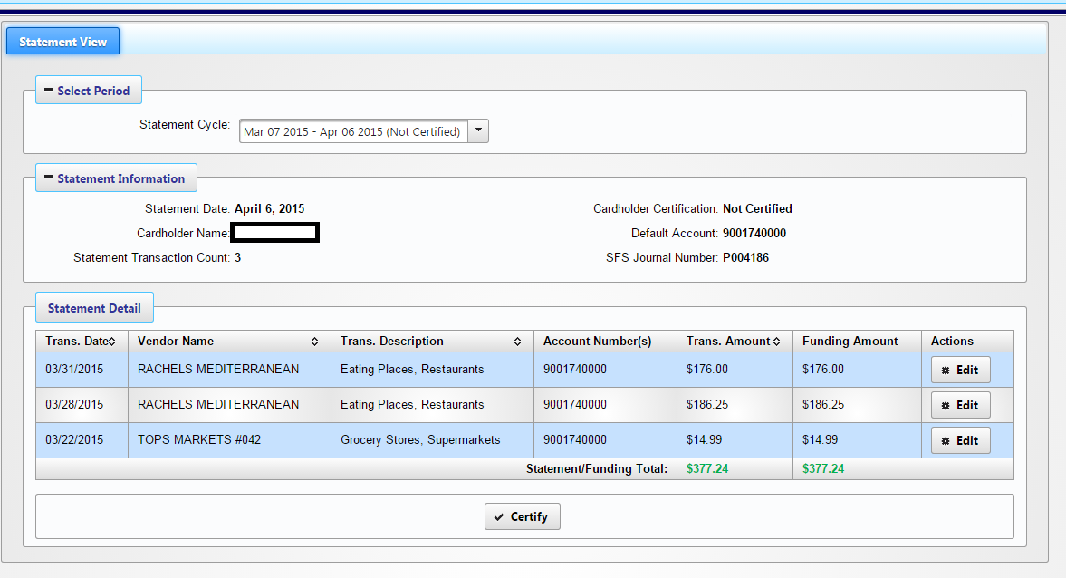
Cardholder Functions
To review your transactions, click on “Cardholder Statement” via the Finance menu. The following page will be displayed.

Slide 7
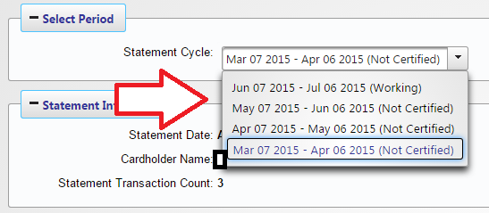
Cardholder Functions
You can select any billing cycle on record via the Statement Cycle drop-down.

Slide 8
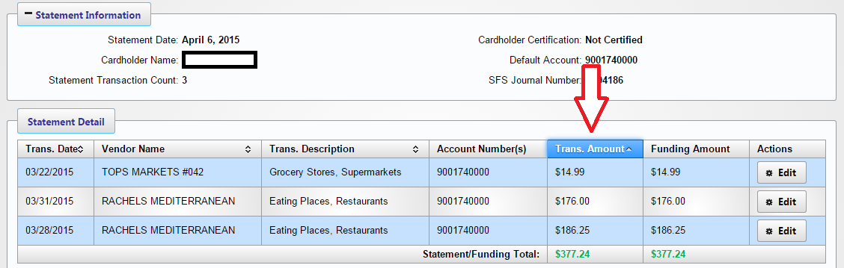
Cardholder Functions
The page will show you information about the currently selected billing cycle, along with a detail view on transactions for the selected billing cycle. The transactions are sorted by transaction date in descending order (i.e. latest transactions first), but you can also custom-sort the transactions by clicking any table header that has a tick mark.

Slide 9
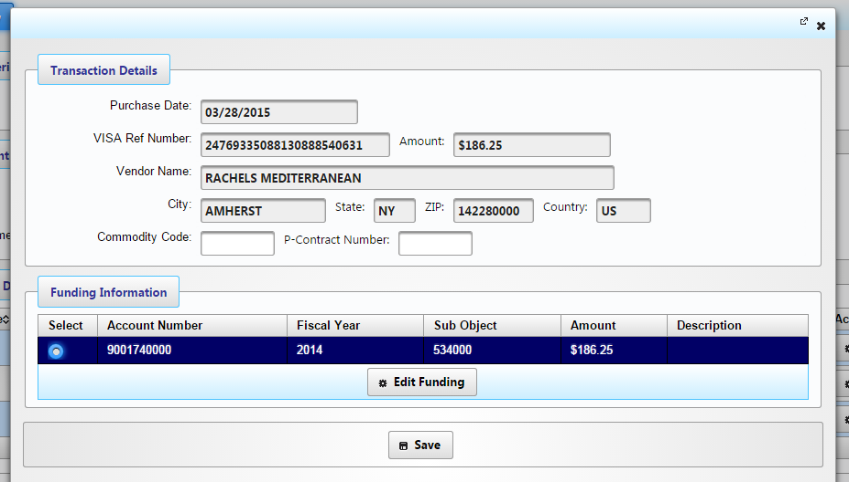
Cardholder Functions
To view detailed information on a transaction, click the Edit button in the rightmost column for the transaction you wish to view. The following page will then be displayed.

Slide 10
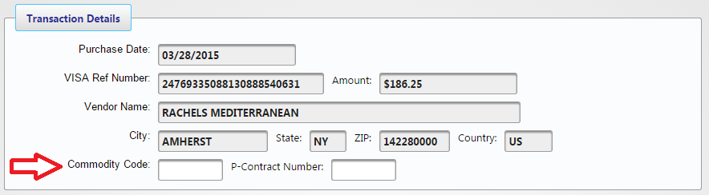
Cardholder Functions
The Transaction Details section will list information about the selected transaction that was received from Citibank, including reference number, transaction amount, and vendor information. This information is read-only. Optionally, you may also enter an OGS Commodity Code or Statewide Contract number for this transaction.

Slide 11
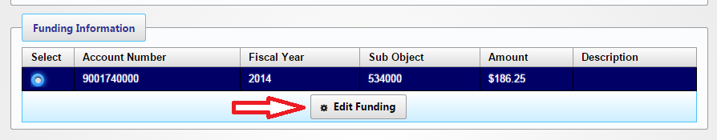
Cardholder Functions
The Funding Information section shows the expenditure(s) associated with this transaction. To change this information before certifying, click Edit Funding.

Slide 12
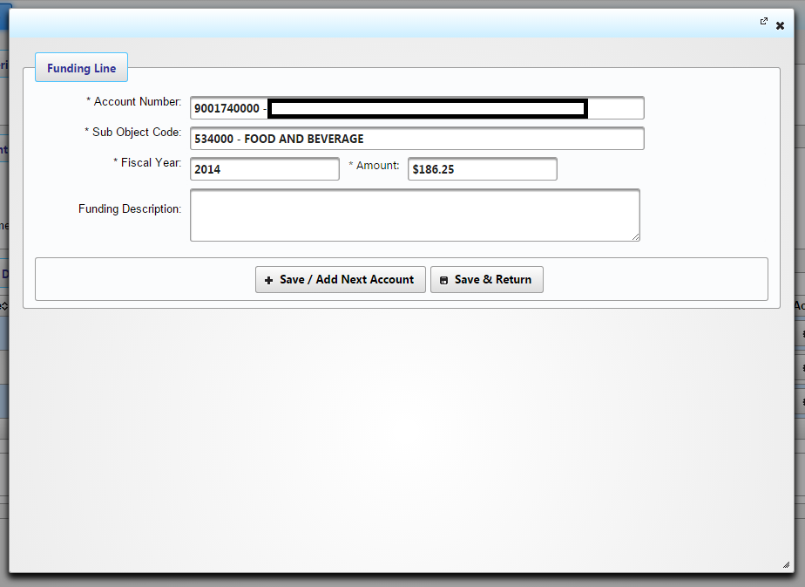
Cardholder Functions
The following page will be displayed for changing funding. The Account Number, SUNY Sub Object Code, and Fiscal Year can be changed to refer to a different campus account. Depending on your accounting security, only some account numbers may be available for use.

Slide 13
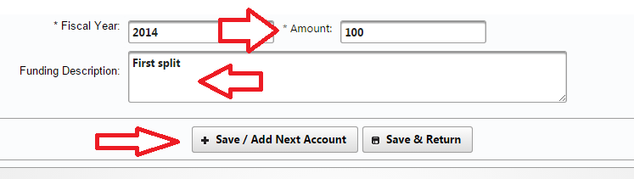
Cardholder Functions
For this example, let’s say you wish to split the expenditure for this transaction between two accounts. To do this, the existing line first needs to be reduced. Below, the amount is changed to $100. You can also enter a description for this funding line. Once the changes are entered, click “Save/Add Next Account”.

Slide 14
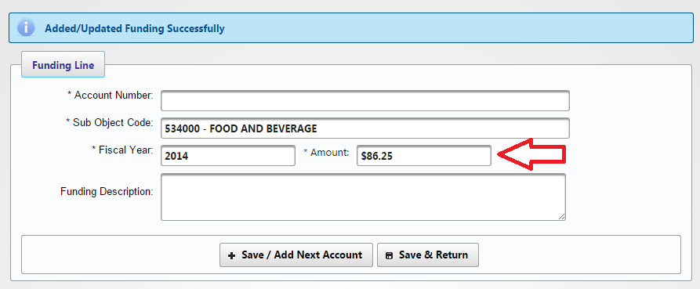
Cardholder Functions
Once the change to the funding has been saved, the page will show as below. Note that the Amount field automatically shows the remaining amount that may be expended for this transaction.

Slide 15
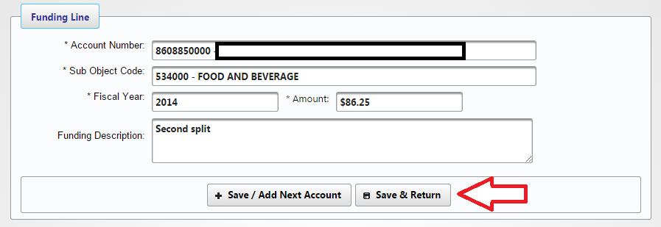
Cardholder Functions
To add the next funding line, enter the required information, then click “Save/Add Next Account” if you wish to enter more funding, or “Save & Return” if this is the last line to be added.

Slide 16
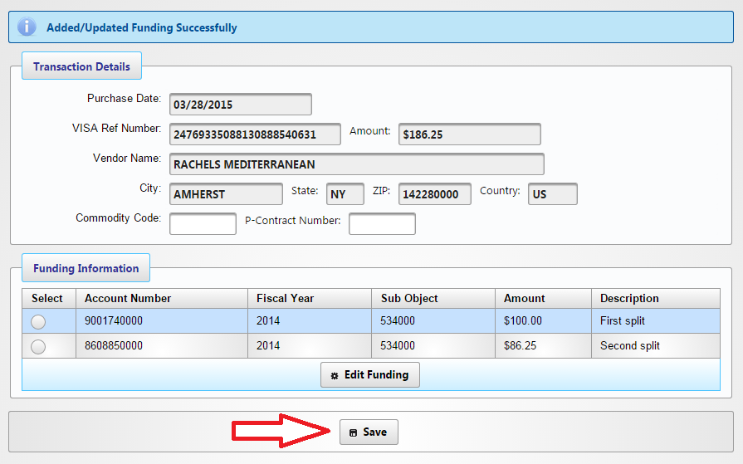
Cardholder Functions
Once all changes for the transaction are completed, click Save on the Transaction Details page.

Slide 17
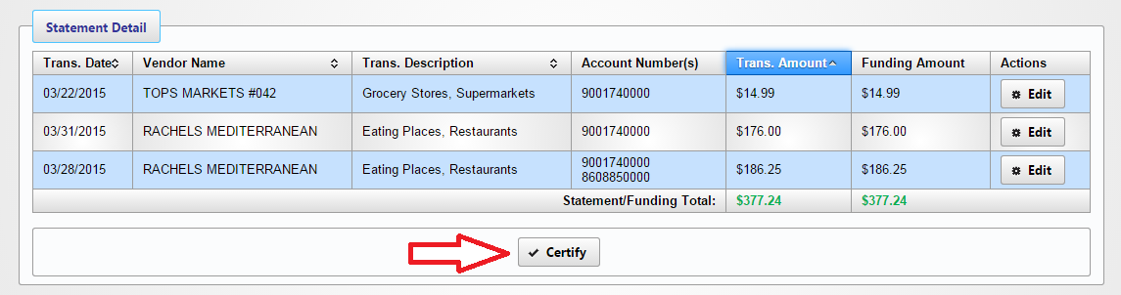
Cardholder Functions
The below shows the transactions on the example billing cycle with one transaction having split funding. Note that if the amount of funding does not match the amount of the transactions, any transactions with missing funding have an Edit button that is highlighted in red and the page will not allow you to certify. In this example, however, the funding and transactions are in balance, so certification is allowed.
Once the transaction changes are complete and the billing cycle is closed, click Certify.

Slide 18
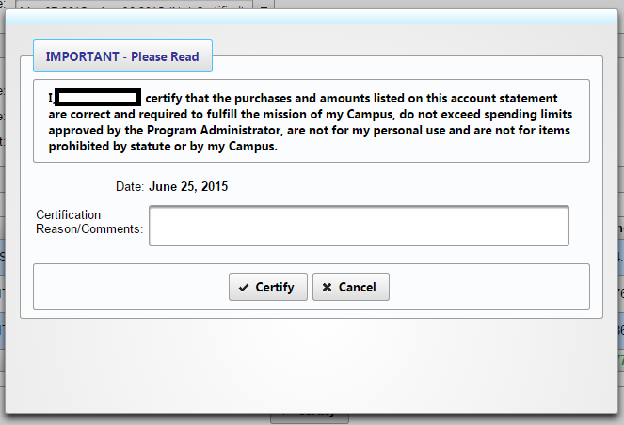
Cardholder Functions
Read and accept the disclaimer. If any comments for this billing cycle certification are needed, enter them in the comments section, then click “Certify”.

Slide 19
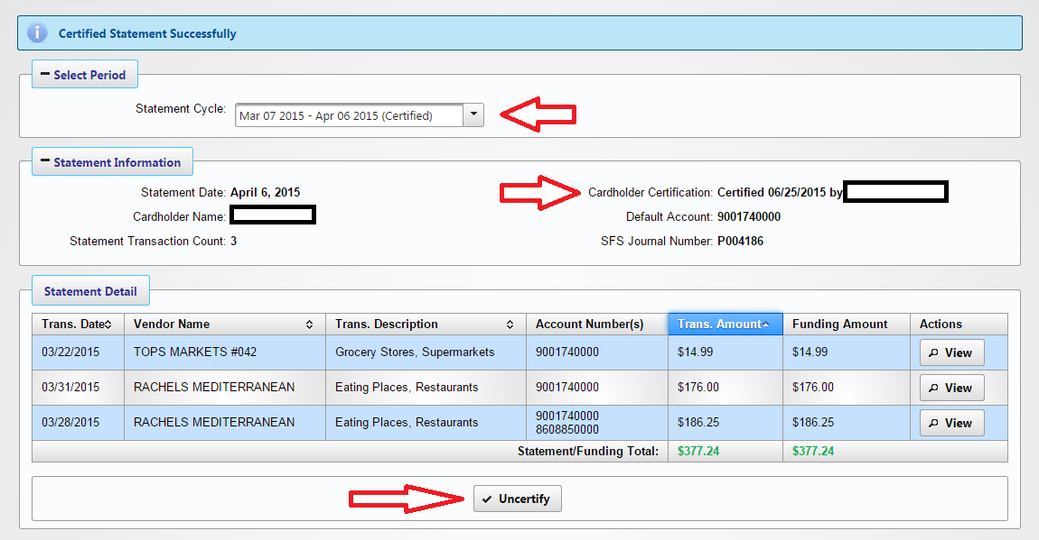
Cardholder Functions
Once certification is completed, the page will update to show that this statement has been certified. If any changes are needed before the statement is certified by the campus, you can click “Uncertify” to undo the certification and make any necessary changes.

Slide 20
Department and Campus Certification

Slide 21
Dept/Campus Certification
The primary function for Department Managers and Accounts Payable officers is to certify the statements for the cardholders they are responsible for overseeing. This duty can be carried out by viewing the Department Certification and Campus Statements pages, respectively. Note that, while the following pictures show the Accounts Payable view, the procedure is the same for Department Managers, with the exception that they will only see data relevant to their department.

Slide 22
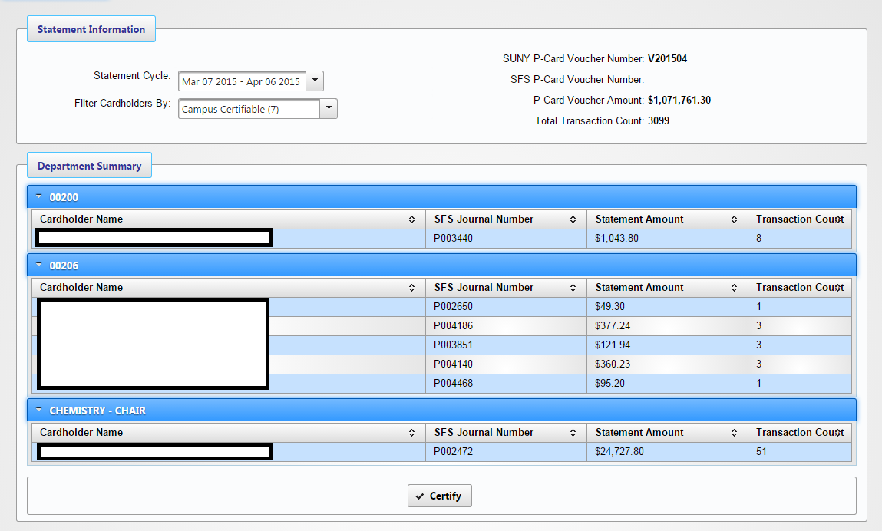
Dept/Campus Certification
Below is an example of what Accounts Payable officers will see when viewing the Campus Statements page. The Statement Information section shows the selected billing cycle and information about the voucher payment that is automatically sent to Citibank at the end of the cycle. The Department Summary section shows cardholders by department and information pertaining to their statements. Click on a Cardholder Name to view that user’s statement for the selected billing cycle.

Slide 23
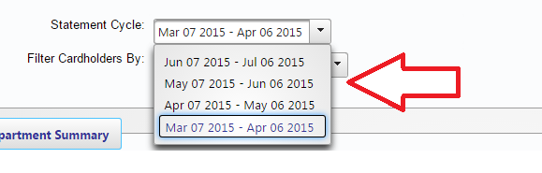
Dept/Campus Certification
Billing cycles can be viewed by using the Statement Cycle drop-down.

Slide 24
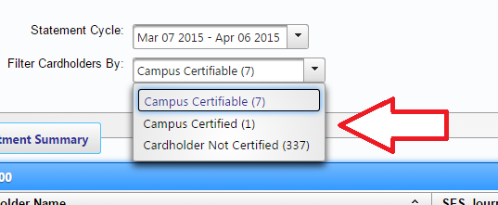
Dept/Campus Certification
Using the Filter Cardholders drop-down, you can select a set of cardholders to view for the currently selected billing cycle:
  Campus Certifiable: Shows cardholders that have certified their statements but have not yet been certified by the campus.
  Campus Certified: Shows cardholders that have been certified by the campus.
  Cardholder Not Certified: Shows cardholders that have not yet certified their statements.

Slide 25
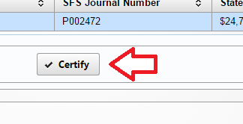
Dept/Campus Certification
Certifying cardholders at the department or campus level is done by clicking Certify when the “certifiable” filter is selected. This will certify ALL cardholders that can be certified at that level.

Slide 26
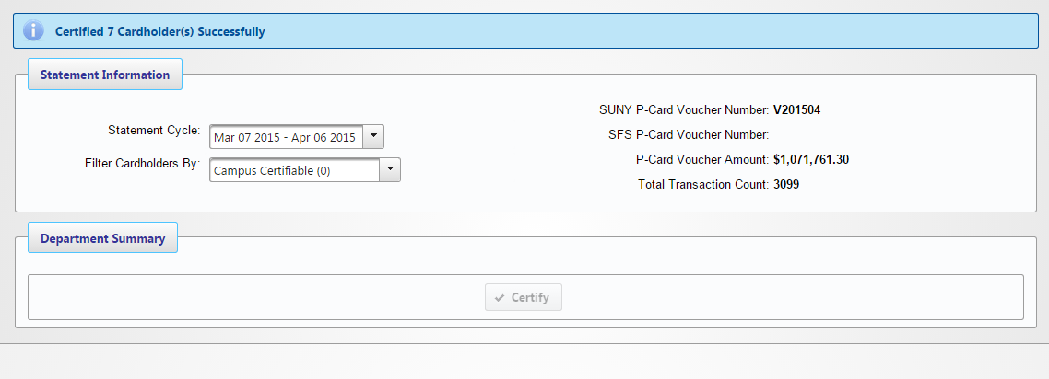
Dept/Campus Certification
The below page will be displayed when certification is completed. Note that all cardholders that were certifiable are now considered certified, and if certifying at the campus level, the Expenditure Journals associated with those cardholders’ transactions are completed and will transmit to SFS that night.

