Slide 1

Project Sunlight &
Its Impact on SUNY

Slide 2
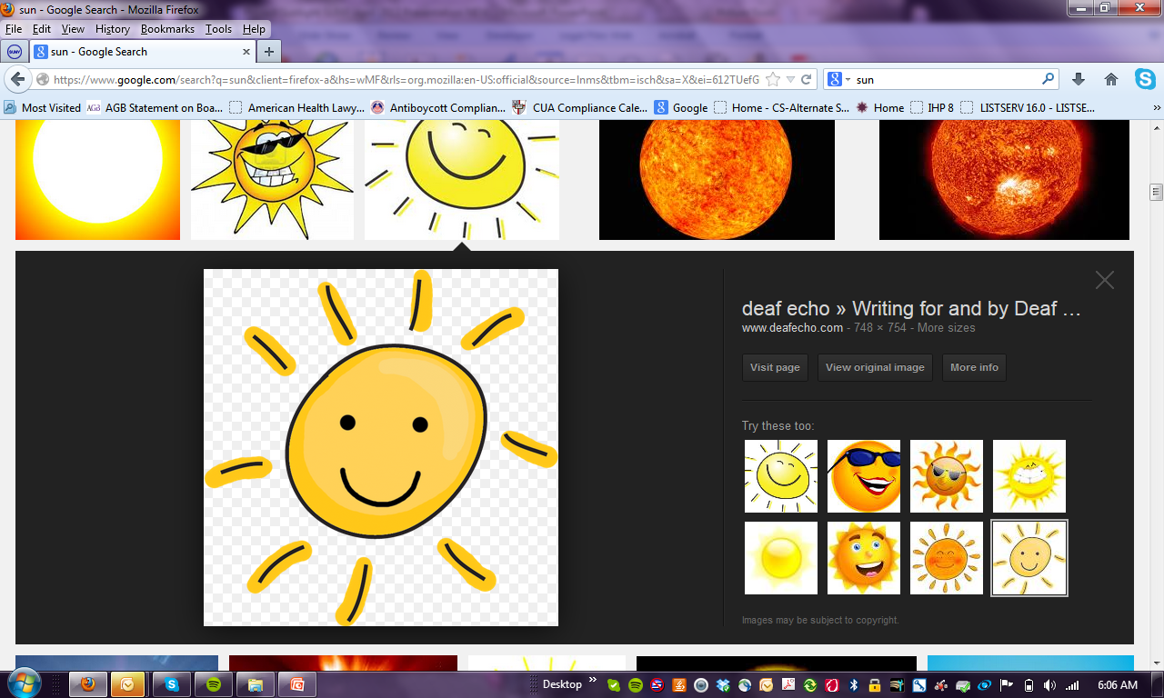
What is Project Sunlight?

Slide 3

What is Project Sunlight contd.
What is Project Sunlight

Slide 4
Covers every state agency, department, division, office and board (including SUNY & CUNY)
Covers every public benefit corporation, public authority, and commissions where at least one member is appointed by the governor
What does Project Sunlight
COVER

Slide 5
What does Project Sunlight
REQUIRE
The law requires that SUNY employees who are decision makers or decision advisors report all substantive “appearances” with non-government entities (both individuals and firms) regarding one of five designated categories to an on-line searchable database within five days of the appearance IF the cost of the procurement / contract could be more than $25,000; All entries will be published on a public-facing website.

Slide 6
What does Project Sunlight
REQUIRE
Only ‘appearances’ related to FIVE categories need to be reported to OGS:
(1) Procurement of State contract for real property, goods, or services over $25,000
(2) rate-making,
(3) regulatory matters,
(4) judicial or quasi-judicial proceedings, and
(5) rule-making per the State Administrative Procedures

Slide 7
Category Most Likely to Affect SUNY: PROCUREMENT
(1) Procurement of State contract for real property, goods, or services over $25,000
SUNY decision makers and advisors must report appearances for the purpose of “procuring a state contract for real property, goods or services;” Includes:
  When SUNY is purchasing/ going to purchase
  Where SUNY is entering into a revenue-generating contract
  Sale-of-land contracts involving SUNY land
  Facilities use contracts where SUNY is paid for use of space
  Any other potential STATE ‘contracts with a value over $25,000

Slide 8
Project Sunlight Appearances:
WHAT must be reported
You only report appearances related to the:
SPENDING OF STATE FUNDS or
PROCURING OF A STATE CONTRACT
If appearance is related to the spending of funds from a non-State fund account (i.e. Foundation, Auxiliary, or RF funds) = NOT REPORTED
If meeting to discuss a potential State contact (i.e. for the sale of SUNY land) or use of State-funded account = REPORT

Slide 9
What Entities MUST report Appearances under Project Sunlight
State operated campuses
SUNY System Administration
Construction Fund
Charter Schools
Board of Trustees
Statutory Colleges

Slide 10
What Entities DO NOT report Appearances under Project Sunlight
RF
Foundations
Auxiliary Corps.
Community Colleges

Slide 11
Project Sunlight:
WHO DOES NOT Report
  Elected officials, executive or legislative employees or judges or employees of the judiciary
Inmates and parolees and their representatives before criminal justice state entities regarding their supervision and/or conditions of confinement
Representatives of the media
Persons under the age of 18

Slide 12
Project Sunlight:
WHO DOES NOT Report
  Medical practitioners at SUNY medical institutions (unless they are acting in the capacity as a SUNY Administrator)
  SUNY Hospitals
  SUNY Optometry
  UB Dental School
  NOTE: This is an exemption specifically for SUNY

Slide 13
Project Sunlight:
WHEN to Report By
Time Requirement:
Appearances must be reported to the database within five (5) business days of the appearance, whenever feasible.

Slide 14
Law only wants you to report Pre-Contract Appearances:
Once contract is in place, reporting not required unless your meeting is ‘outside the scope’ of the existing contract
Why: who SUNY/ State entities contract with is already made public
Project Sunlight:
What to Report

Slide 15
Project Sunlight:
What must be reported – How much $
Amount Threshold:
Must ONLY report appearances that could result in purchase/ contract of $25,000 or more in goods and/or services
If you don’t know how much the value of the Procurement/ contract will be, you must err on the side of reporting
You DO NOT need to aggregate purchases in the absence of a contract

Slide 16
What is a Project Sunlight ‘Appearance’
Appearance: A substantive interaction that is meant to have an impact on the decision making process of a state entity.
  Non-written communication:
    In-person meeting OR
    Video conference
  Between State entity and an outside party:
    Purely intra-State meetings do not need to be reported

Slide 17
Project Sunlight Appearances:
Interpretations of WHAT must be reported
Substantive Interaction v. Ministerial:
If the interaction between the SUNY representative and the vendor/advocate is purely informational, reporting is not required.
Example: Individuals scheduling a meeting is considered ministerial

Slide 18
Project Sunlight Appearances:
Interpretations of WHAT must be reported
Initiation:
It does not matter WHO initiated the appearance. It must be reported whether SUNY or the outside party initiated.
Formality and Location:
The level of formality and the physical location of the meeting are irrelevant.
Example: Vendor/advocate approaches you at the gym and tries to influence you regarding a procurement = Must report regardless of location / lack of formality/ initiation by vendor

Slide 19
Project Sunlight Appearances:
Interpretations of WHAT must be reported
Single Matter Can Have Multiple Appearances:
There can be multiple ‘appearances’ related to one single matter, and each appearance must be reported separately.
Only One Report Per Meeting:
If multiple ‘covered individuals’ (decision makers and advisors) attend a meeting together, only one report is necessary
Each meeting need only be entered into the Project Sunlight database once by one mandated reporter.

Slide 20



Who is a Decision Maker or Decision Advisor under Project Sunlight?

Slide 21
WHO Is a DECISION MAKER under PROJECT SUNLIGHT
Campus decision-makers include,
but are not limited to:
Vice President for Administration | Director of Procurement
Purchasing Agent | Athletics Director
President | Dean
Vice President for Administration | Chief Information Officer
Provost | Facilities Director

Slide 22
WHO Is a DECISION MAKER under PROJECT SUNLIGHT
WHO is a decision-maker or decision advisor:
Campuses have different levels of employees who have the authority to make or influence procurement decisions such that they are Project Sunlight reporters
Determining the decision makers and advisors will depend upon the facts of a particular procurement and the purchasing structure at the campus
Example: A Faculty member meets with microscope vendors to find the best microscope for their academic program needs, and advises the procurement employee which microscope to purchase
→ Faculty member is a mandated Project Sunlight reporter in this fact scenario

Slide 23
WHO Is a DECISION MAKER under PROJECT SUNLIGHT
How should a campus decide/ evaluate WHO the decision-makers and decision advisor are:
Campuses should evaluate their own administrative structure and err on the side of caution in deciding who to train in order to ensure that decision makers, decision advisors, and potential decision makers and advisors are aware of:
their personal reporting obligations under the law
the specific campus administrative protocol for how to report to the OGS database

Slide 24
What appearances
MUST be reported under Project Sunlight?

Slide 25
Project Sunlight Appearances:
WHAT MUST be reported
Discretionary State Funds: REPORT
Appearances for the purpose of advocating for the receipt of discretionary state funds that have already been appropriated
New Vendors for New Products, Service, Contracts: REPORT
Meetings with new vendors for products, goods and services, prior to a contract being in place

Slide 26
Project Sunlight Appearances:
WHAT MUST be reported
Existing Vendors for New Products; New Services; New Contract: REPORT
• Meetings with existing vendors for new products or services, or products and services outside the scope of the current contract agreement with vendor
Contract Re-Negotiation: REPORT
Meetings involving substantial renegotiations of
Contracts

Slide 27
Project Sunlight Appearances:
WHAT MUST be reported
Appearances by Advocacy Organizations: REPORT
Meetings with organizations, unions, and other businesses that are advocating for another business are also considered appearances
Example: Another higher education institution advocates for SUNY to use a vendor that they also use; this scenario constitutes a reported appearance

Slide 28
What is NOT reported under Project Sunlight?

Slide 29
Not Project Sunlight Appearances:
NOT reported
Written communication: NOT REPORTED
Faxes, letters, or emails are not appearances
Phone Calls: NOT REPORTED
Phone calls are not appearances
ONLY in-person and video conference appearances are reported
Under Threshold Amount: NOT REPORTED
Contacts related to procurements under $25,000

Slide 30
Not Project Sunlight Appearances:
NOT reported
Intra-State Communications:
NOT REPORTED
Contact between SUNY and other state agencies; Includes appearances before:
  other state and local agencies and authorities (including CUNY)
  tribal governments
  federal government representatives

Slide 31
Not Project Sunlight Appearances:
NOT reported
Elected Officials: NOT REPORTED
Contact by elected officials, executive or legislative employees
Legislation/ Budget Appearances: NOT REPORTED
Contact related to legislation or SUNY’s budget
Philanthropy: NOT REPORTED
Gifts, donations, or grants to the State that are not in exchange for real property, goods, or services

Slide 32
Not Project Sunlight Appearances:
NOT reported
Existing Contracts: NOT REPORTED
Appearances following the award of a contract related to contract administration; This includes:
  Discussion of open contract terms
  Purchases off an already existing contract
  Meetings regarding contract performance
Meetings with the Research Foundation: NOT REPORTED
Appearances in front of the Research Foundation because we have an existing contract with the RF to do business, generally, on SUNY’s behalf

Slide 33
Not Project Sunlight Appearances:
NOT reported
Confidential Proceedings: NOT REPORTED
Any interaction that an agency or authority treats as confidential pursuant to any law, rule or regulation does not need to be reported.
Note: Confidentiality requirements from federal & state statutes, rules or regulations always take precedence over reporting requirements of Project Sunlight.

Slide 34
Not Project Sunlight Appearances:
NOT reported
Employee/Student Disciplinary Matters:
NOT REPORTED
Employee and student disciplinary matters conducted in-house are not judicial or quasi-judicial proceedings (such that they would fall under one of the five categories outlined in the statute) and are also confidential personnel matters

Slide 35
Not Project Sunlight Appearances:
NOT reported
Emergency Procurements: NOT REPORTED
Procurements related to emergencies, where emergency is defined the same as it is in the State finance laws.
Agents of the State Entity: NOT REPORTED
Appearances between a covered individual at a state entity and an agent of the agency, such as a consultant

Slide 36
Not Project Sunlight Appearances:
NOT reported
Non-Substantive Interaction: NOT REPORTED
Purely informational or ministerial contact
Social Interaction: NOT REPORTED
Short and informal meet and greets, introductions, or purely social interactions
Note: A social interaction can become a reportable appearance once the person tries to influence your decision related to a procurement or state contract

Slide 37
Not Project Sunlight Appearances:
NOT reported
Determining Availability/ Market Research: NOT REPORTED
Outreach initiated by SUNY (state entity), where response is informational, where SUNY is:
  determining interest or availability for an upcoming procurement, including inquiring about whether or not a company is an M/WBE, and whether they have the products or services needed, or
  conducting market research, or
  informing a policy decision
NOTE: When initiated by the vendor/advocate, market research/ interest/ availability IS A REPORTABLE appearance

Slide 38
Not Project Sunlight Appearances:
NOT reported
Industry Meetings, Conferences & Expos: NOT REPORTED
Participation in widely-attended industry meeting is not considered a an appearance
Practically, this means no reporting is required for:
  professional conferences
  expos/ visiting booths on a show floor/ exhibit hall
  panels
  training or educational programs
  public auctions
  where a vendor attends a SUNY Conference
NOTE: reportable appearances can still happen before and after these widely attended events

Slide 39
Not Project Sunlight Appearances:
NOT reported
Public Meetings: NOT REPORTED
Participation in meetings which are:
  open to the public, or
  subject to the Open Meetings Law, or
  where a record of the meeting is otherwise available
NOTE: communications outside of such public meetings but with respect to the same matter covered in the public meeting MUST be reported

Slide 40
Not Project Sunlight Appearances:
NOT reported
RFP/ IFB Formal Procurement Processes: NOT REPORTED
Appearances as part of a formal procurement that are otherwise covered by the Procurement Lobbying Law, including :
  meetings that occur during the restricted RFP or IFB processes
  bid meetings and presentations
  meetings with designated contacts
  bid clarifications
NOTE: The reason these formal procurement processes are excluded from reporting is because there are existing protocols that restrict communication to a designated contact during this time period

Slide 41
Not Project Sunlight Appearances:
NOT reported
Meetings that Raise Safety Concerns to the parties involved: NOT REPORTED
Any appearance that, if disclosed and published on the public-facing website, could endanger the life or safety of any person, or could subject an individual to a risk of retaliation or adverse employment action

Slide 42
What does Project Sunlight mean to you as a SUNY Decision-maker or advisor?

Slide 43
Must REPORT Information
to OGS Database
Find out the process for reporting appearances on your campus
  CENTRALIZED APPROACH: Some campuses have DESIGNATED employees who access the OGS database and input all Project Sunlight Appearances for the campus
  DECENTRALIZED APPROACH: Some campuses are having the decision makers and advisors access the database and input their own appearances directly

Slide 44
What Information Must be
Reported to OGS
Date of Appearance (month, day, year)
Type of Meeting:
 In-Person  Video Conference
Location of Appearance:
Building, Street, City, State, Zip
Purpose of Meeting: (one of the 5 categories listed in the law)
Procuring, Rate making, Regulatory Matters,
Judicial, Adoption of a Rule
Name of SUNY Contact and Affiliation:
SUNY Sys Admin, SUCF, CAMPUS

Slide 45
What Information Must be
Reported to OGS
Name of Company at Appearance
Company Location:
City, Zip Only
(If large company, location that rep. works out of)
Outside Representative at Appearance:
(e.g., Company’s Attorney, Lobbyist)
Outside Representative’s Location: City, Zip Only
(If large company, location that rep. works out of)
Name of Non-SUNY Contacts

Slide 46
Project Sunlight
Hypotheticals

Slide 47
Project Sunlight Hypotheticals:
WHEN TO REPORT – WHEN NOT TO REPORT
Note: With the following hypotheticals, assume the following:
The appearance is in-person and
The value of the purchase/ contract is over the $25,000 threshold

Slide 48
Project Sunlight Hypotheticals:
WHEN TO REPORT – WHEN NOT TO REPORT
1. Appearances before Current vendors with existing contracts? No
  No because the vendor already has a contract with SUNY, and so ‘appearances’ related to that contract are not reported
  EXCEPT if the appearance discussion is outside the scope of the existing contract, then it would constitute a reported appearance

Slide 49
Project Sunlight Hypotheticals:
WHEN TO REPORT – WHEN NOT TO REPORT
2. A bidders conference occurs during the RFP process. Is this reportable? No
  No because appearances are not reportable if they during the Restricted Period of the RFP Process.
  However, an appearance prior to the commencement of the Restricted Period that is a substantive attempt to influence a SUNY decision-maker to purchase a vendor’s product, even if unsolicited, IS a reportable appearance.

Slide 50
Project Sunlight Hypotheticals:
WHEN TO REPORT – WHEN NOT TO REPORT
3. Another University/ Union/ Association is advocating for you to procure or contract with a particular vendor? Yes
  The law states that we must report appearances where people are acting in a representative capacity, such that this advocacy is reportable

Slide 51
Project Sunlight Hypotheticals:
WHEN TO REPORT – WHEN NOT TO REPORT
4. Meeting related to the sale of SUNY land? YES
  The appearance is related to a potential state contract, so it is reported, even if SUNY is selling its on property
  Remember: Project Sunlight covers procurements, where SUNY is purchasing, but also revenue-generating contracts, where SUNY is being paid for land/ use of facilities/ services

Slide 52
Project Sunlight Hypotheticals:
WHEN TO REPORT – WHEN NOT TO REPORT
5. Meeting to purchase a software program for the System, where RF funds would be used? NO
  Appearances related to the spending of non-state funds are not reported

Slide 53
Project Sunlight Hypotheticals:
WHEN TO REPORT – WHEN NOT TO REPORT
6. Meeting to purchase a software program for the System, where CF funds would be used? YES
  Remember that the Construction Fund, as a public benefit corporation, is included for purposes of reporting under Project Sunlight, so an appearance related to the spending of Construction Fund’s own funds MUST be reported

Slide 54
Project Sunlight Recap

Slide 55
How will Project Sunlight
Impact SUNY
Compliance Mandate:
SUNY employees who are decision makers or decision advisors report substantive “appearances” with non-government entities (both individuals and firms) regarding one of five designated categories to an OGS on-line searchable database within five days of the appearance if cost of the potential procurement / contract could be more than $25,000.

Slide 56
How will Project Sunlight
Impact SUNY
Remember:
Only pre-contract ‘appearances’ need to be reported
Only in-person and video conference ‘appearances’ need to be reported
Only ‘appearances’ that could result in contracts/ procurements with a value over $25,000 need to be reported

Slide 57
Required SUNY Action
Each Campus and Operational Center MUST:
1. Designate one/several individuals responsible for entering data in the OGS Project Sunlight database
  See the SUNY Project Sunlight Compliance website for instructions on how to access the database
2. Decide who is a decision maker or decision advisor, and ensure those employees undergo Project Sunlight training
  Retain records of WHO has been trained at your campus, and ensure re-training every other year

Slide 58
Required SUNY Action
Continued
Each Campus and Operational Center MUST:
3. Develop procedures to assure SUNY individuals before whom outside individuals and firms make reportable appearances complete the OGS form or convey notice of the appearance to the SUNY individual responsible for entering data in the OGS database

Slide 59
Project Sunlight Resources
All Project Sunlight Information can be found on the SUNY Compliance Website [www.suny.edu/compliance]
TOPICS: Project Sunlight
  Forms
  Training Materials
  Other Resources
Questions: submit to projectsunlight@SUNY.edu
Specific legal questions: SUNY Legal Counsel Office (518) 320-1400 or your campus counsel directly
New York State Website: http://projectsunlight.ny.gov/

Slide 60
Thank you!

