Slide 1
MS Word Accessibility

Slide 2
Understanding Word Accessibility
Creating content that is accessible to all users
Accessibility of all elements
Document structure
Images
Hyperlinks
Lists
Tables

Slide 3
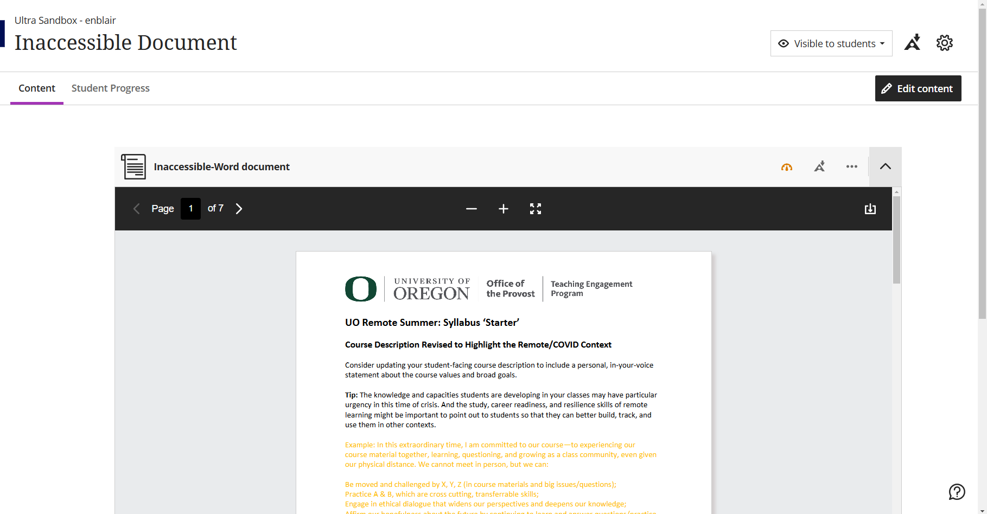
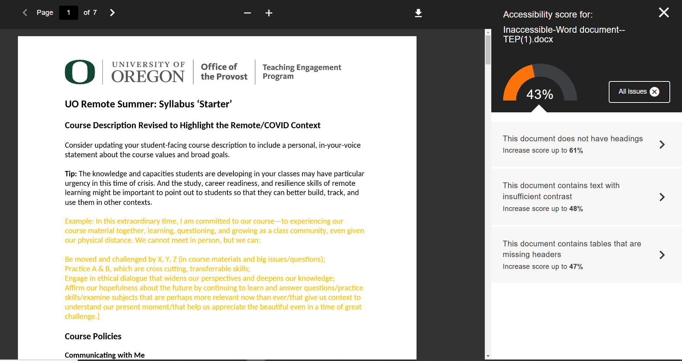
Inaccessible Doc in Blackboard
Notes:
Built in accessibility checker in Blackboard
When you upload a word doc, powerpoint, or PDF there will be a little gauge that will be red, orange, or green depending on how accessible that item is
This one is orange. When I click on it, I see that it gets an accessibility score of 43%. I can click a little “information” icon to see “all issues” and it will show me what exactly is wrong with this document. This one is missing headers, has low contrast, and the table is missing a header row.
We will cover those things and more in this presentation!

Slide 4
File Metadata
Add clear title and filename
Identify the document language

Slide 5
Headings
Heading 1 – Title of the document
Heading 2 – Major section titles
Headings 3-6 – Subsections
Do not use "Title" as a heading
Notes:
Title is not recognized as a heading by MS word. It is recognized as a paragraph text.

Slide 6
Images or Other visual Elements
Figures, graphs, graphics,
Add alternative texts for all visual elements
Label decorative images as “decorative” in the alternative text
Ensure sufficient color contrast in all visual elements
Add descriptions for complex images
Avoid text boxes

Slide 7
Hyperlinks
Use descriptive text for the link
Make links stand out (typically blue and underlined)
If you expect users to print the document, include both the full hyperlink text and descriptive link text
Example:
https://www.esf.edu/open-academy/professional-development/green-building/
Green Building Conference

Slide 8
Text Styling
Use a minimum of 12-point font
Use simple fonts, preferably sans serif fonts (e.g., Arial, Veranda, or Helvetica)
Avoid using all caps
Notes:
All caps are read by screen readers as single letters rather than whole word

Slide 9
Tables
Use "Insert Table" tool. Do not use "Draw Table" tool
Set heading rows or columns to label data in the table
Provide Alt Text for the table
Avoid complex tables with multiple heading rows
Do not use tables for layout purposes

Slide 10
Lists
Use list number style for ordered lists
Use bullet style list for unordered lists
Avoid manually typing bullets or numbers

Slide 11
Headers and Footers
Do not place important information in Header or Footer
Contents not accessible to users of assistive technology

Slide 12
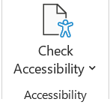
Accessibility Checker
Use built in Accessibility Checker to review results
Errors – Difficult or impossible for people with disabilities to access
Warnings – Difficult for people with disabilities to access
Tips – People with disabilities can access, but that might be better organized or presented

Slide 13
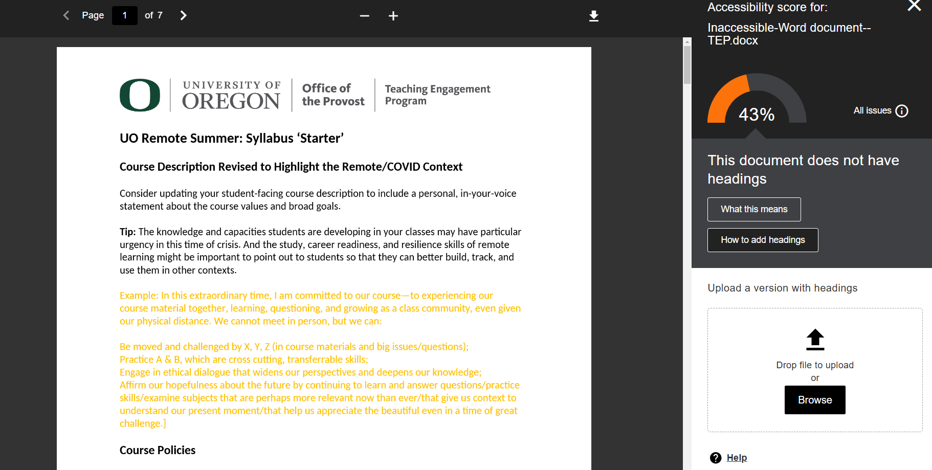
Make a Doc Accessible in Blackboard
Notes:
Now I have uploaded an accessible document and I have a green gauge. When I hover over it, I can see that this document gets a PERFECT accessibility score!

Slide 14
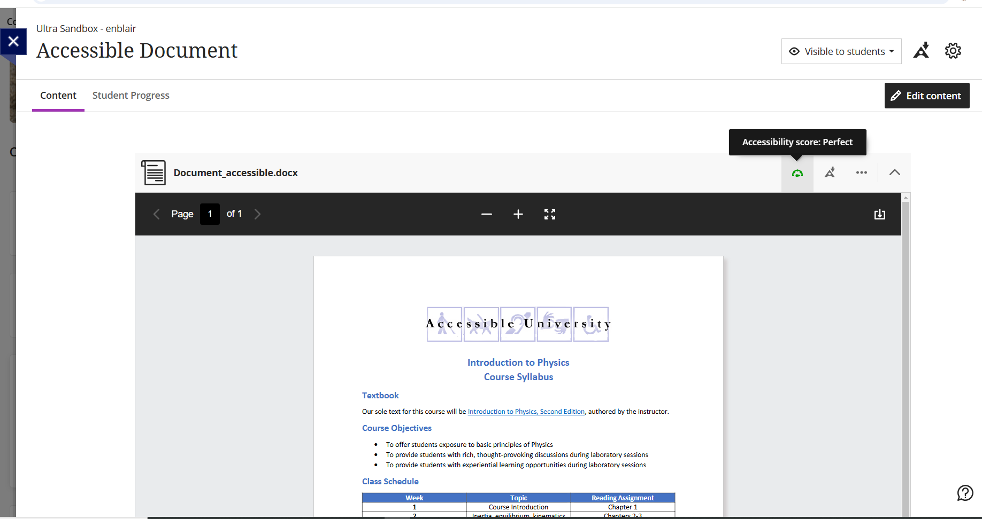
Accessible Doc in Blackboard
Notes:
Now I have uploaded an accessible document and I have a green gauge. When I hover over it, I can see that this document gets a PERFECT accessibility score!

Slide 15
Quick Guide
Set title and language of the document
Use proper heading structure
Check color contrast and font
Add alt text to all images and non-text elements
Clear and accurate description for hyperlinks
Tables should be used to convey data and not for layout
Run Accessibility checker

Slide 16
Questions?

Slide 17
Next up in the series:
March 18th
Accessible PowerPoints
April 15th
Accessible PDFs

