Slide 1
MS PowerPoint Accessibility

Slide 2
Understanding PowerPoint Accessibility
Creating content that is accessible to all users
Use built in layouts and themes
Accessibility of all elements
Images
Hyperlinks
Lists
Tables

Slide 3
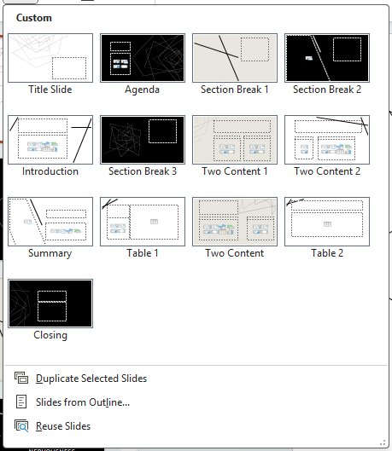
Layouts
Slide layouts contain formatting, positioning, and placeholder boxes for all of the content to appear on the slide
Layouts can be modified to meet specific needs
Slide Master view can be used to change standard slide layouts

Slide 4
Themes
Predefined set of colors, fonts, and visual effects
A uniformed look is achieved with minimal effort
All graphics added to the slide have same theme colors
Color contrast for ease of reading*
*Not all themes have sufficient color contrast

Slide 5



Template
A theme plus some content for a specific purpose
Notes:
Title is not recognized as a heading by MS word. It is recognized as a paragraph text.

Slide 6

Reading order
Objects listed in the order that the screen reader will read
Number next to each object indicates the position in the sequence
Object without number is skipped
Reading order starts from the bottom and moves upward

Slide 7
Heading/Slide Title
Slide title = heading
Slide titles should be unique

Slide 8
Images and Text Boxes
Accessible Slides
Add alt text for all images
"Mark as decorative" not read correctly by all screen readers
Use the word "decorative" in alt text for decorative images
Text boxes are accessible
Shapes are accessible
Text added to shapes are also accessible

Slide 9
Hyperlinks
Use descriptive text for the link
Make links stand out (typically blue and underlined)
Example:
Green Building Conference

Slide 10
Text Styling
24 point for Titles
18 points for Body text
Most important is to know your audience
Use simple fonts, preferably sans serif fonts (e.g., Arial, Veranda, or Helvetica)
Avoid using all caps
Notes:
All caps are read by screen readers as single letters rather than whole word

Slide 11
Tables
Use "Insert Table" tool. Do not use "Draw Table" tool
Set heading rows or columns to label data in the table
Provide Alt Text for the table
Avoid complex tables with multiple heading rows

Slide 12
Animations
If animation conveys meaning, that information needs to also appear in written form
Some animations may be distracting or induce disorientation in individuals with disability

Slide 13
Videos
Provide caption files for videos
Video should have sufficient description of any visual content
ESF faculty, staff, and students can use Kaltura for closed captioning

Slide 14

Cranberry Lake Biological Station

Slide 15
Slide Notes
Accessible
Alert users if important information is added to slide notes
Screen readers need to deliberately enter slide notes
May be hidden for sighted users
More details in slide notes.

Slide 16
Footers
Accessible
Use clear language
Maintain Contrast
Footer Content
Slide number
Presentation Title
Company name
Date

Slide 17
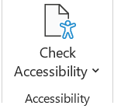
Accessibility Checker
Use built in Accessibility Checker to review results
Errors – Difficult or impossible for people with disabilities to access
Warnings – Difficult for people with disabilities to access
Tips – People with disabilities can access, but that might be better organized or presented

Slide 18
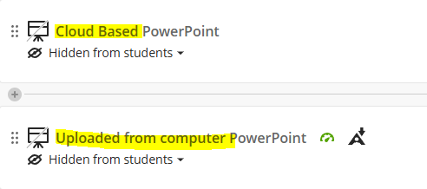
Accessibility Checker in Blackboard
Pro Tip:
Upload directly from your computer (as opposed to uploading a cloud-based file) for faster results
Notes:
Just like with word, Bb has a built in accessibility checker for power points
Pro Tip: upload directly from your computer for quicker accessibility report. Uploading from cloud took a day for the checker to check
(walk through the difference)

Slide 19

Make a PowerPoint Accessible in Blackboard
Click on the accessibility gauge
Whatever the "biggest" problem is will be shown first.
Click "All issues" to see everything that has been flagged
3. Click on "How to fix..." to see step by step instructions on how to fix the problem.
4. Upload corrected version
Notes:
Go through these steps in Bb

Slide 20
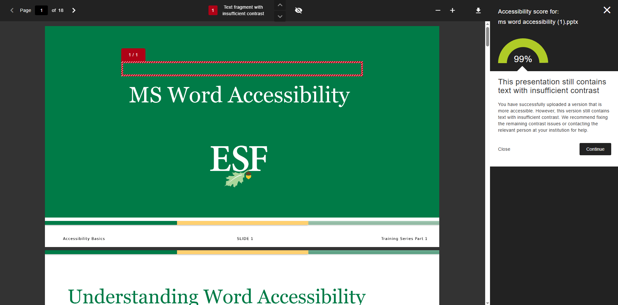
Accessible PowerPoint in Blackboard
Notes:
Note! Some times it might flag something that does not actually exist (I cannot find this text box), or it might not flag something that is a problem (like the text in the inaccessible powerpoint).

Slide 21
Quick Guide
All slides should have a unique, meaningful slide title
Ensure the reading order of content on each slide is correct
Ensure all text is in readable font, easy to read, and surrounded by sufficient white space
Adequate color contrast
Do not use style alone to convey meaning
Use list buttons to create lists
Add alt text to all images and non text elements
Insert long description for complex graphics where appropriate

Slide 22
Next up in the series:
April 15th
Accessible PDFs

Slide 23
Questions?

