Slide 1
Accessibility Basics

Slide 2
Why Accessibility?
The Office of Civil Rights (OCR) at the U.S. Department of Education defines accessibility as meaning “when a person with a disability is afforded the opportunity to acquire the same information, engage in the same interactions, and enjoy the same services as a person without a disability in an equally integrated and equally effective manner, with substantially equivalent ease of use”

Slide 3
Legal
ADA (Americans with Disabilities Act)
  Prohibits discrimination with disabilities in various areas of public life
Section 508
  Requires federal agencies to make their electronic and information technology accessible to people with disabilities
NYS Office of Information Technology Services
  Accessibility of Information Communication Technology

Slide 4
Types of Disabilities
Blind
Color Blind
Low Vision
Cognitive Disabilities
Speech Disabilities
Deaf
Deafblind
Seizures
Reading Disabilities
Motor Disabilities
Multiple Disabilities

Slide 5
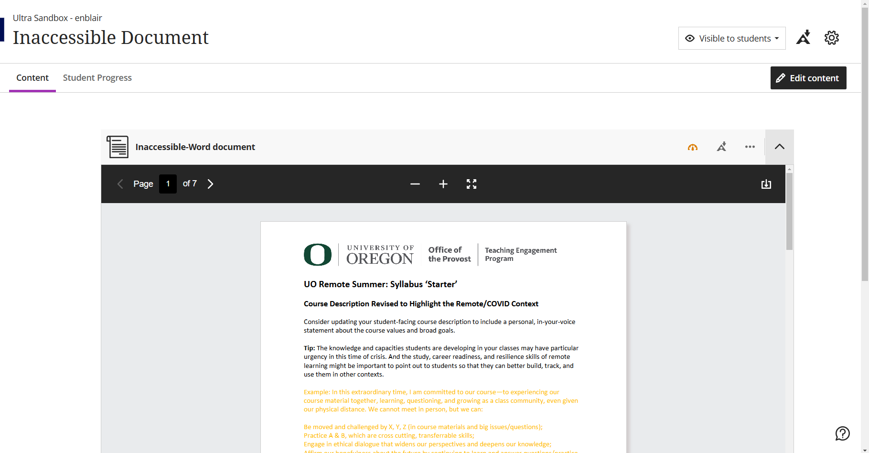
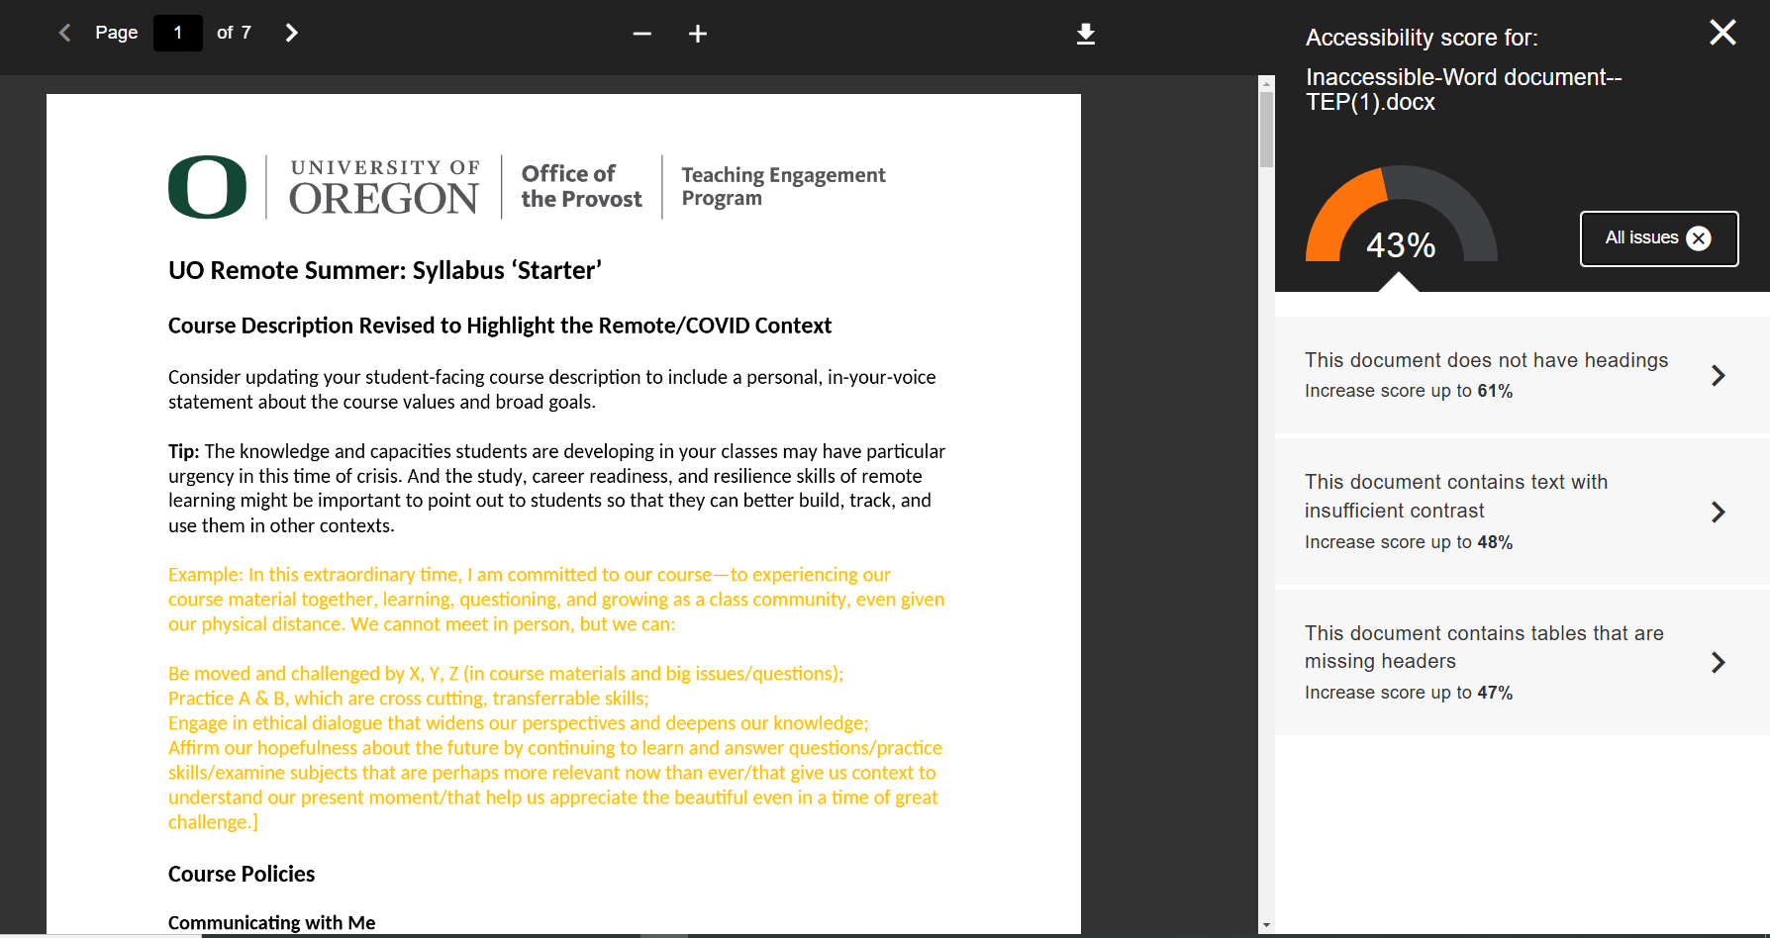
Inaccessible Doc in Blackboard
Notes:
Built in accessibility checker in Blackboard
When you upload a word doc, powerpoint, or PDF there will be a little gauge that will be red, orange, or green depending on how accessible that item is
This one is orange. When I click on it, I see that it gets an accessibility score of 43%. I can click a little “information” icon to see “all issues” and it will show me what exactly is wrong with this document. This one is missing headers, has low contrast, and the table is missing a header row.
We will cover those things and more in this presentation!

Slide 6
Title and Headings
Add a unique title to your document that matches the content
Use one H1 heading level for title of the document
Always use headings in order from H1 through H6
Modify heading styles to present the desired visual presentation
Heading can be nested
Do not skip a heading level
Notes:
Proper heading styles also ensures in creating a table of content

Slide 7
Color Contrast
Choose high contrast between text and the background
Color Combinations to avoid:
  Green and red
  Blue and yellow
Don’t rely on color as the sole means to convey the information
Bad Contrast
Good Contrast
Bad Contrast
Good Contrast

Slide 8
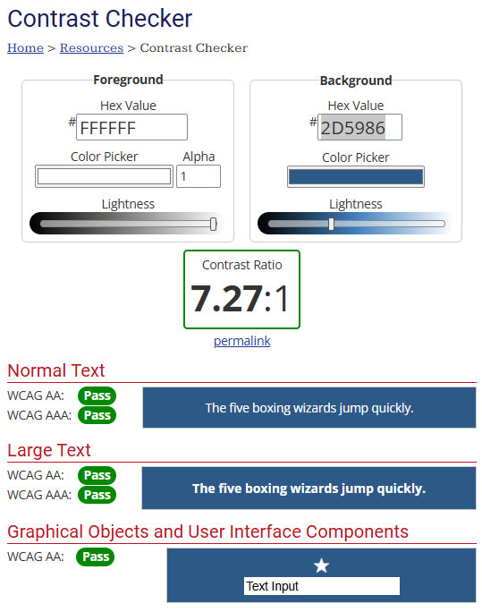
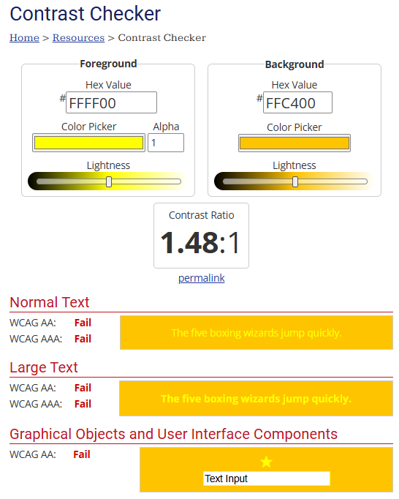
Contrast Checker

Slide 9
Color Contrast Resources
WebAIM color contrast checker
TPGir contrast checker
Wave Tool by WebAIM

Slide 10
Hyperlinks
Use descriptive text for the link
Make links stand out (typically blue and underlined)
If you expect users to print the document, include both the full hyperlink text and descriptive link text
Example:
  https://www.esf.edu/open-academy/professional-development/green-building/
  Green Building Conference

Slide 11
Images or Other visual Elements
Figures, graphs, graphics,
Add alternative texts for all visual elements
Label decorative images as “decorative” in the alternative text
Ensure sufficient color contrast in all visual elements
Add descriptions for complex images

Slide 12
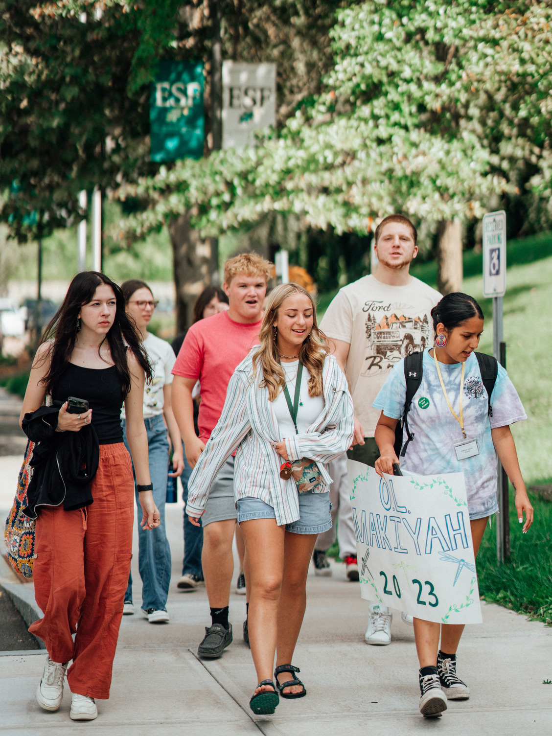
Example of Good Alt Text
Good alt text should be descriptive, concise, and provide context for the image
A group of young college students laughing and walking on a sidewalk

Slide 13

Example to Bad Alt Text
Using "image of" or "picture of"
Being too vague or too detailed
Repeating caption
Not specifying decorative images
Picture of a person wearing goggles and holding a bottle
A student wearing safety goggles pouring liquid in a graduated cylinder

Slide 14
Text Styling
Use a minimum of 12-point font
Use simple fonts, preferably sans serif fonts (e.g., Arial, Veranda, or Helvetica)
Avoid using all caps
Notes:
All caps are read by screen readers as single letters rather than whole word

Slide 15
Tables
Set heading rows or columns to label data in the table
Avoid complex tables with multiple heading rows
Tables should be used to display tabular data
Do not use tables for layout purposes

Slide 16
Lists
Use list number style for ordered lists
Use bullet style list for unordered lists
Avoid manually typing bullets or numbers

Slide 17
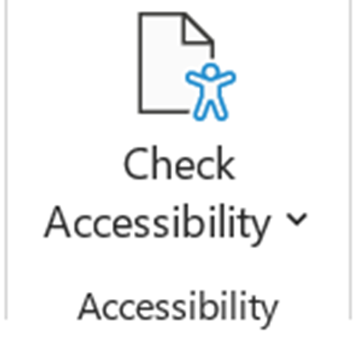
Accessibility Checker
Microsoft 365 has accessibility checkers available in Word, Excel, and Powerpoint

Slide 18
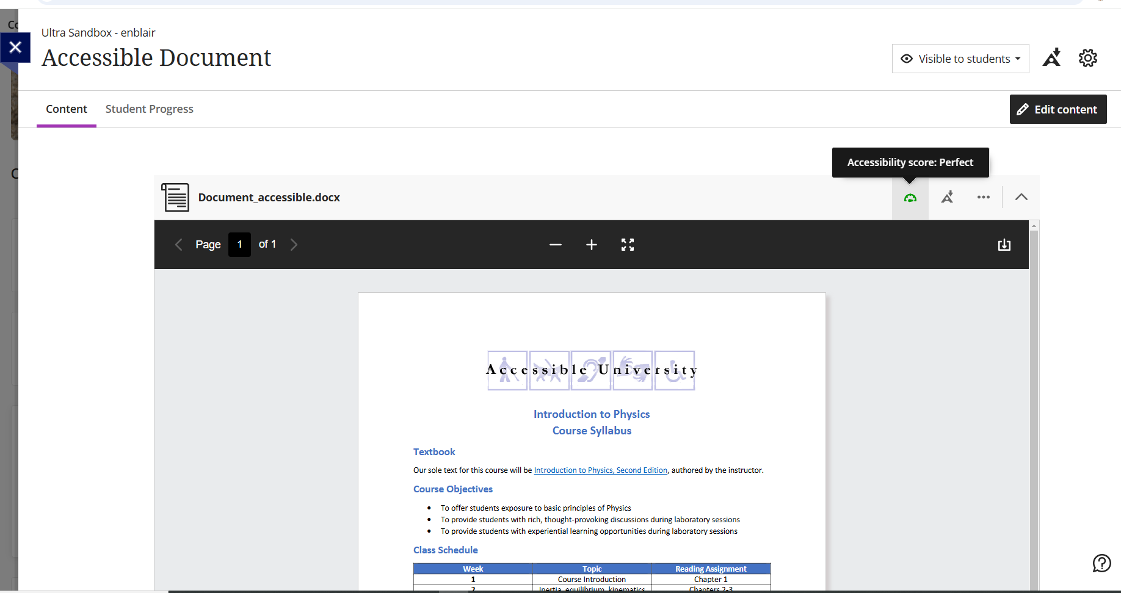
Accessible Doc in Blackboard
Notes:
Now I have uploaded an accessible document and I have a green gauge. When I hover over it, I can see that this document gets a PERFECT accessibility score!

Slide 19
Questions?

Slide 20
Next up in the series:
February 18th
  Microsoft Word: More Powerful Than You Think
March 18th
  Accessible PowerPoints
April 15th
  Accessible PDFs

