Slide 1

MS Word Accessibility
Notes:
Document to use: Inaccessible-Word document--TEP.docx

Slide 2





Understanding Accessibility
Creating content that is accessible to all users (POUR)
Accessibility of all elements
    Document structure
    Images
    Hyperlinks
    Tables
    Color Contrast
Notes:
Accessible does not mean available. We mean that folks who use screen readers, or are colorblind, or deaf, or have dyslexia can perceive, operate, and understand digital content in the same way other folks can.
Title II – going from folks having to request accessible versions to having everything accessible from the start; access without asking
For all content you create, these are the top 5 accessibility concerns to focus on.
Today we will run through all of these and see how to use them in a word document
Going to build a garden of accessibility to hopefully help you remember these elements 🌱

Slide 3
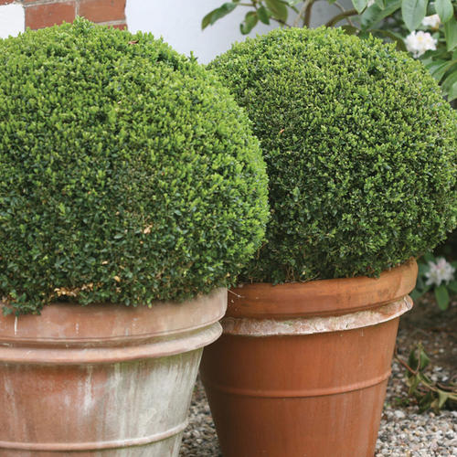
Document Structure and Style
Heading 1 – Title of the document
Heading 2 – Major section titles
Headings 3-6 – Subsections
Do not use "Title" as a heading
Use a minimum of 12-point font
Use simple fonts, preferably sans serif fonts (e.g., Arial, Veranda, or Helvetica)
Avoid using all caps
Notes:
First item in our garden is the structural plant
Sometimes called “architectural plants” or “statement plants,” these are characterized by their strong shape that provides the foundational structure or “bones” of a garden. Using headings can structure our document in a way that not only looks good, but also allows for easy navigation by a screenreader (which is why we use the little speaker icon to represent structure)
Title is not recognized as a heading by MS word. It is recognized as a paragraph text.
All caps are read by screen readers as single letters rather than whole word

Slide 4
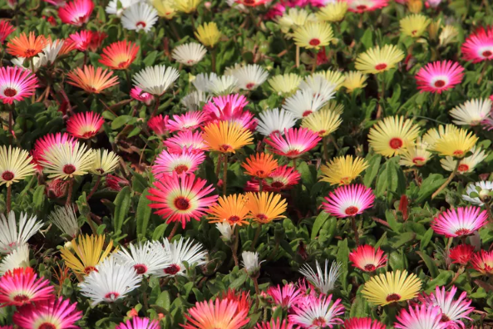
2. Images or Other Visual Elements
Figures, graphs, graphics,
Add alternative texts for all visual elements
Label decorative images as “decorative” in the alternative text
Ensure sufficient color contrast in all visual elements
Add descriptions for complex images
Notes:
Add some color to our garden with my favorite flower, daisies! Your visual elements might highlight something you have typed out, or may be purely decorative. Either way, they should have alt text
Be mindful of your audience. What might the alt text be for this image if you are writing for a gardening blog? A horticulture class? A photography blog?

Slide 5
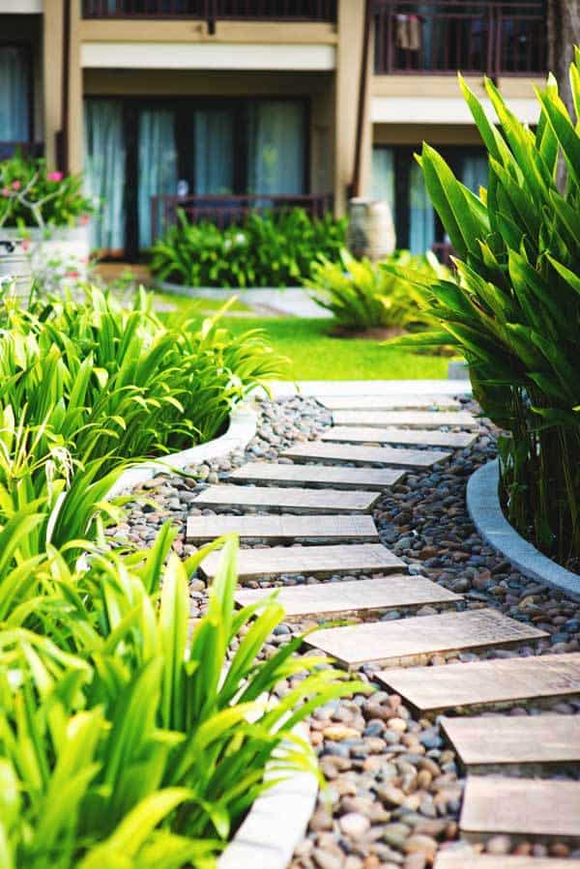
3. Hyperlinks
Use descriptive text for the link
Make links stand out (typically blue and underlined)
If you expect users to print the document, include both the full hyperlink text and descriptive link text
Example:
  https://www.esf.edu/open-academy/professional-development/green-building/
  Green Building Conference
Notes:
Just like this garden path clearly shows us where we are going, meaningful links that help users connect what is being said in the document to where the link will take them

Slide 6
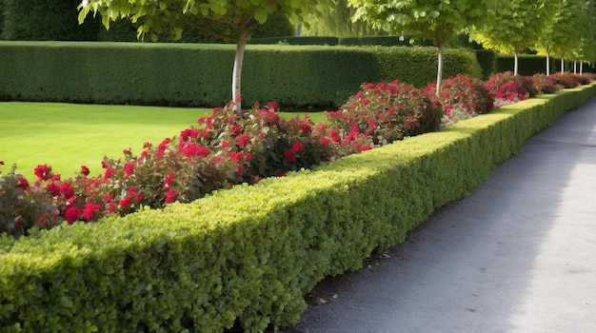
4. Tables
Use "Insert Table" tool. Do not use "Draw Table" tool
Set heading rows or columns to label data in the table
Pin row in some versions of Word
Provide Alt Text for the table
Avoid complex tables with multiple heading rows
Do not use tables for layout purposes
Notes:
Having nice, neat hedge rows can also add structure to a garden. We want to make sure our tables are structured a certain way as well.
In example doc: add row, make it header row, pin row

Slide 7
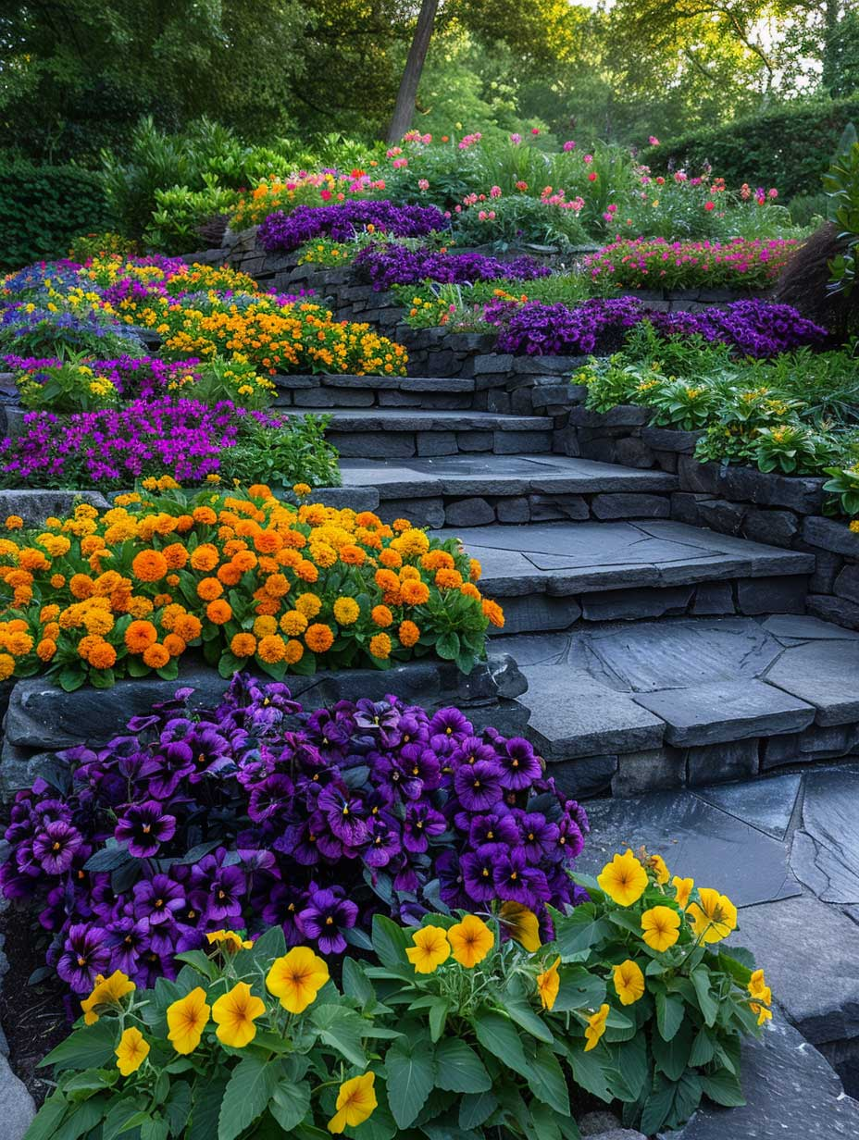
5. Color Contrast
Choose high contrast between text and the background
Color Combinations to avoid:
    Green and red
    Blue and yellow
Don’t rely on color as the sole means to convey the information
Bad Contrast
Good Contrast
Bad Contrast
Good Contrast
Notes:
Just like these dark flowers and light flowers contrast, we want to make sure users are able to clearly distinguish between two parts of your document – the background and the foreground/text.

Slide 8

Notes:
Pop quiz!
Here is our Garden of Accessibility—do you remember the elements?

Slide 9
Lists
Use list number style for ordered lists
Use bullet style list for unordered lists
Avoid manually typing bullets or numbers

Slide 10
Headers and Footers
Do not place important information in Header or Footer
Contents not accessible to users of assistive technology

Slide 11
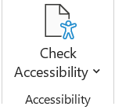
Accessibility Checker
Use built in Accessibility Checker to review results
Errors – Difficult or impossible for people with disabilities to access
Warnings – Difficult for people with disabilities to access
Tips – People with disabilities can access, but that might be better organized or presented
Notes:
Let's hop into an inaccessible document to see how to address these issues. If you have a document handy that you want to work on, go ahead and pull it up to follow along. Pay attention to what the accessibility checker flags, and does NOT flag

Slide 12
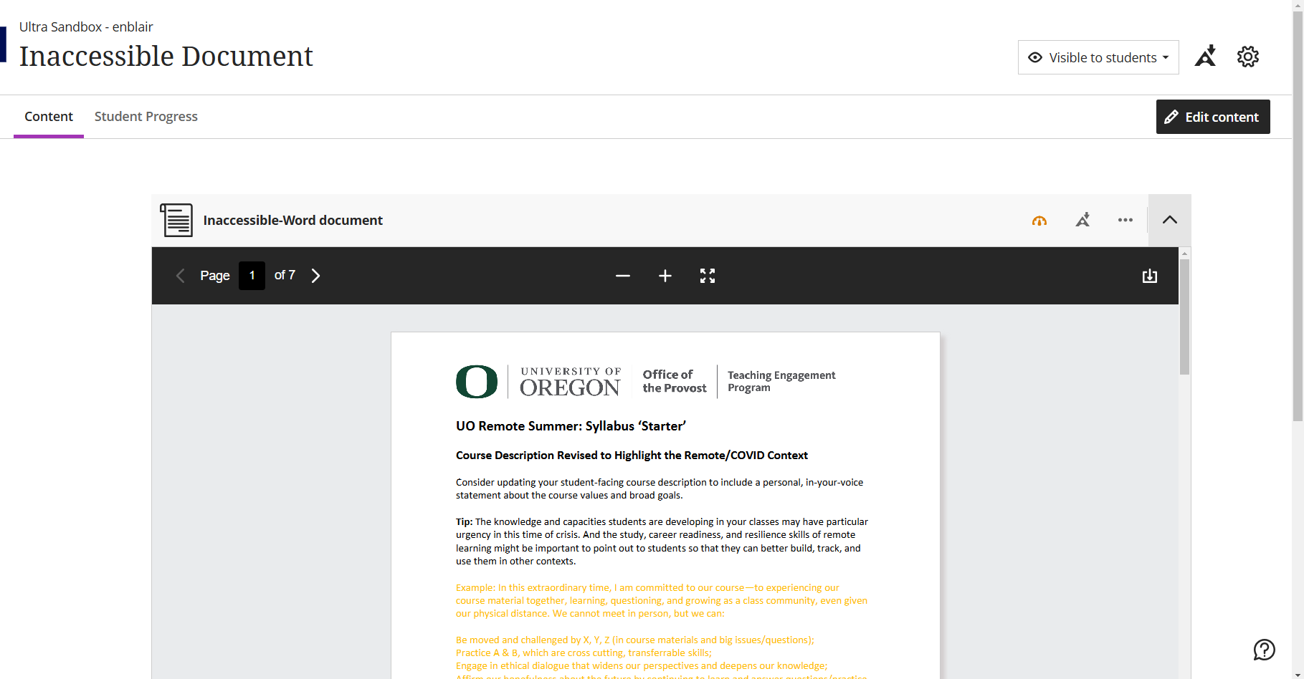
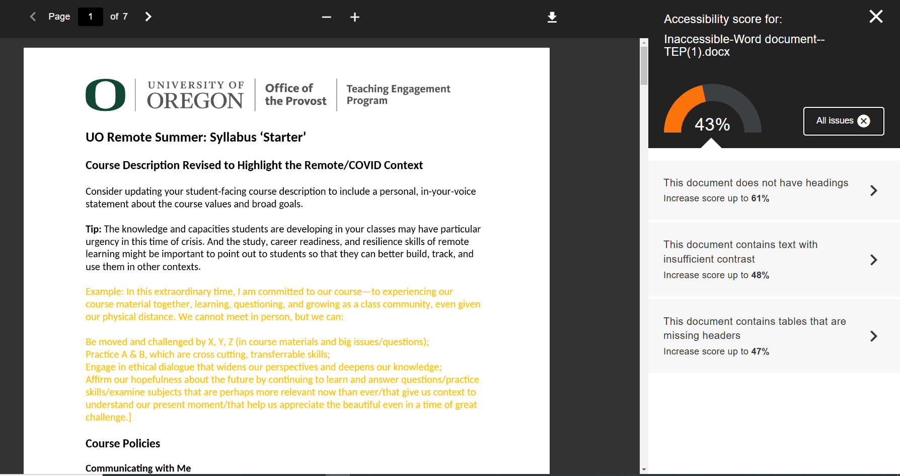
Inaccessible Doc in Blackboard
Notes:
Built in accessibility checker in Blackboard
When you upload a word doc, powerpoint, or PDF there will be a little gauge that will be red, orange, or green depending on how accessible that item is
This one is orange. When I click on it, I see that it gets an accessibility score of 43%. I can click a little “information” icon to see “all issues” and it will show me what exactly is wrong with this document. This one is missing headers, has low contrast, and the table is missing a header row.
We will cover those things and more in this presentation!

Slide 13
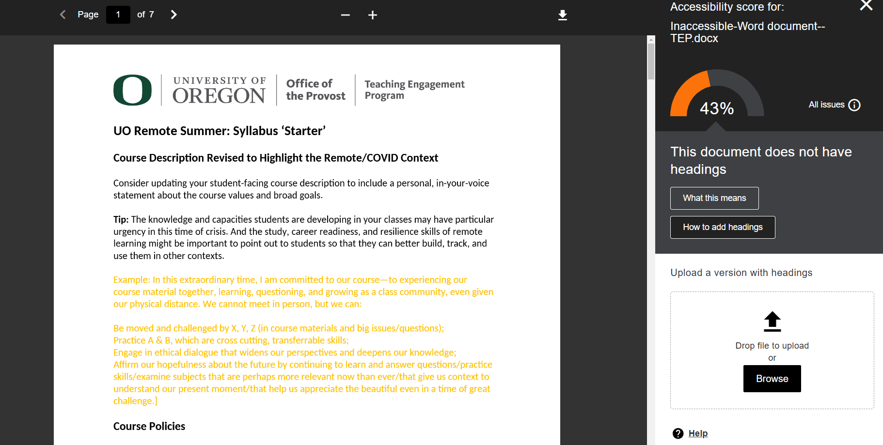
Make a Doc Accessible in Blackboard
Notes:
Now I have uploaded an accessible document and I have a green gauge. When I hover over it, I can see that this document gets a PERFECT accessibility score!

Slide 14
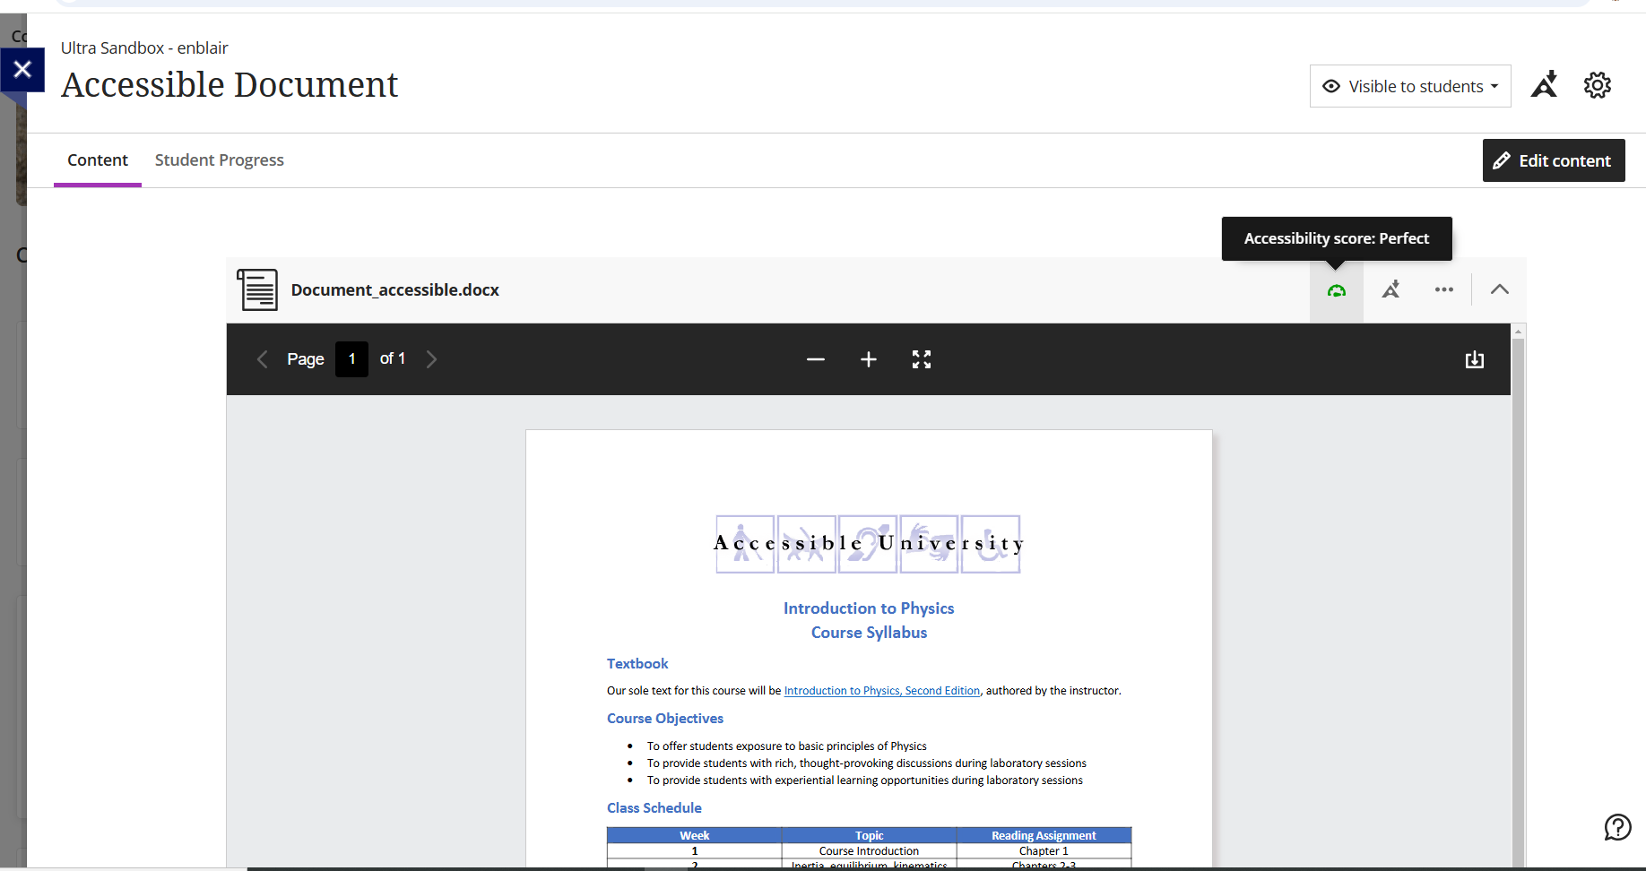
Accessible Doc in Blackboard
Notes:
Now I have uploaded an accessible document and I have a green gauge. When I hover over it, I can see that this document gets a PERFECT accessibility score!

Slide 15
Quick Guide
Use proper heading structure and font
Check color contrast
Add alt text to all images and non-text elements
Clear and accurate description for hyperlinks
Tables should be used to convey data and not for layout
Run Accessibility checker

Slide 16
Questions?

Slide 17
Next up in the series:
November 13th (Gateway 240)
  Accessible PowerPoints
December 11th (Gateway 240)
  Accessible PDFs

Slide 19
